Slide 1
Preparing a data set for analysis
A user’s guide

Slide 2
What do you need to analyze a data set
A properly coded data set
A program to analyze your data
Rcommander
R (if you know how to R it up)
Excel (not my first choice)

Slide 3
Rule #1 when working with data
Don’t delete anything.
Always save a backup when you start to make changes to your dataset.
If you make a mistake, sorry…WHEN YOU MAKE A MISTAKE, you can go always back to version n-1.
So, start any major change by hitting ’Save as…’ and then saving the file with an updated name or in a new location.
For each project, I have a folder called old data sets, for when the number of data files becomes a nuisance.

Slide 4
Creating summary statistics
We are going to use Excel
It’s the easiest
GoogleForms and Qualtrics start us there.
Your first step is going to be to create summary statistics for your subjects.
That means…means (or sums, perhaps) that show how your subjects performed your creativity tasks.

Slide 5
Creating summary statistics
To calculate a mean (or a sum) you use a formula.
The basic syntax of an Excel formula is:
=formulaname(rangeofdata)
Formulaname refers to the statistic you want Excel to calculate.
Range of data is the range of data over which to calculate the statistic

Slide 6
Creating summary statistics
To calculate a mean you might type:
=average(b1:k1)
To calculate a sum you might type:
=sum(b1:k1)
Let’s try it for ourselves…

Slide 7
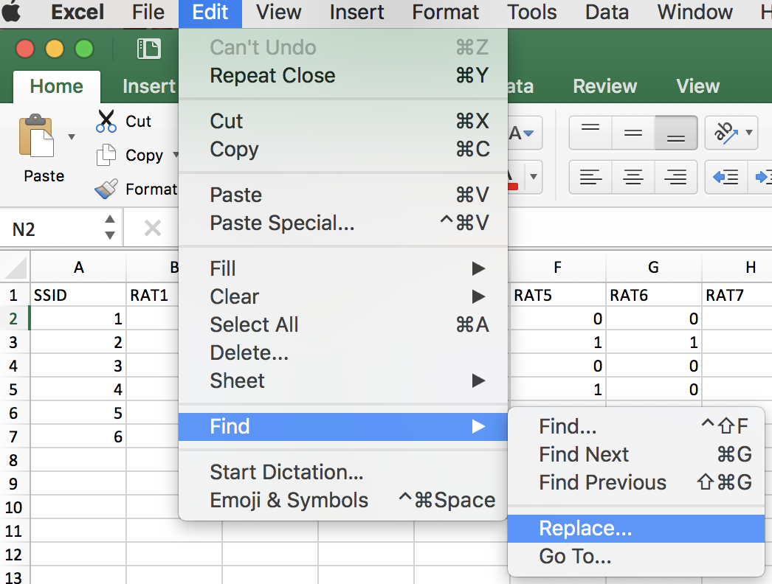
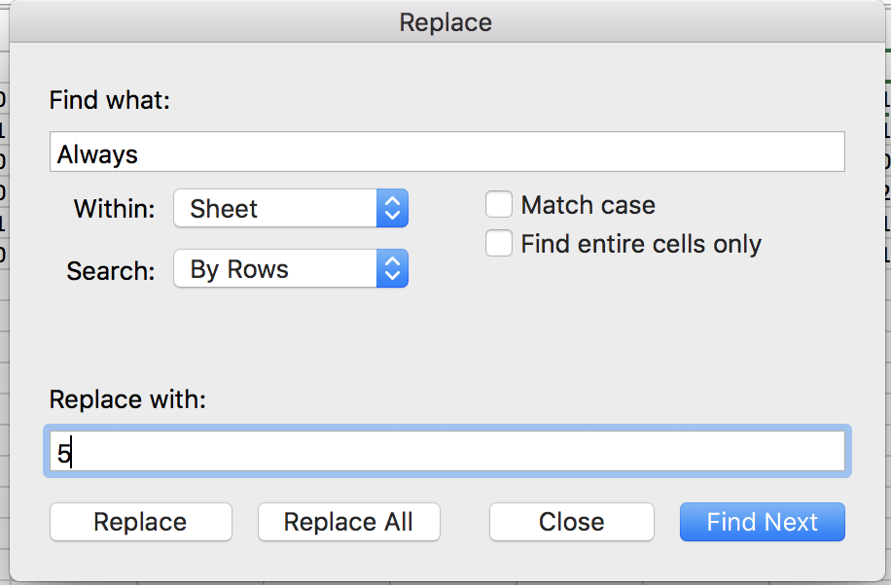
Creating summary statistics
Pretty straightforward for dependent measures of creativity.
For personality measures and other predictors:
Use EDIT➔FIND➔Replace to convert text responses into numerical values (e.g., ‘Always’ into 4; ‘Sometimes’ into 2).
Be careful about reverse—scored items!!!

Slide 8
Creating summary statistics: Useful Excel tips
You can highlight a set of cells using the mouse or cursor to specify the data range.
You can drag a formula into many cells (i.e., calculate a mean for all your subject at once by putting the cursor in the lower right corner of a cell, waiting for the black cross, and then dragging it to all of your cells.
When you want to move a mean to a new file or a new spread sheet, use ‘paste-special’ instead of paste and select ‘Values’.

Slide 9
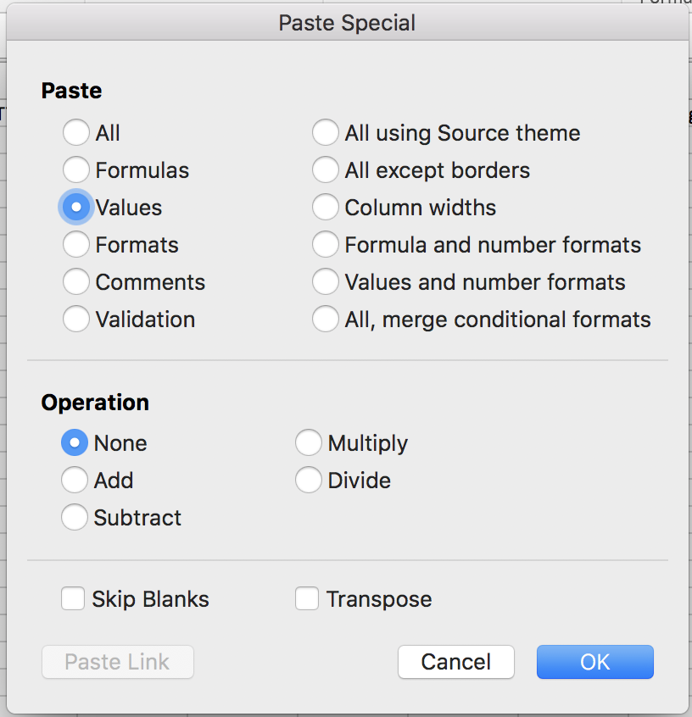
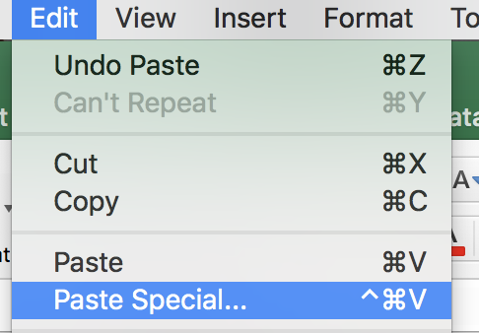
Creating summary statistics: Useful Excel tips
When you want to move a mean to a new file or a new spread sheet, use ‘paste-special’ instead of paste and select ‘Values’.

Slide 10
Creating summary statistics: Z-scores
Standardized scores (z-scores)
If you want to compare across tasks that are measured on different scales (e.g., Unusual uses vs. RAT).
At the bottom of the column for the variable in question
Calculate the mean (=average)
Calculate the standard deviation (=stdev)
Enter the formula:
=standardize(value,mean,stdev)
EX: =standardize(E2,$B$9,$B$10)
The $$$$ are important for ‘dragging’ the formula!!

Slide 11
Formatting a data set for analysis
Identify your independent and dependent variables
What is an IV?
It is the thing you manipulated either to create ‘groups’ or that you think will predict creativity
What is a DV?
Your measure(s) of creativity

Slide 12
Formatting a data set for analysis
For each IV determine whether it is within subjects or between subjects?
What is a within subjects variable?
Every subject experiences every level of the variable.
What is a between subjects variable?
Subjects experience only one level of the IV.
Aside – Pieter and David are going to be super confused, but I got them. I’m a professional.

Slide 13
Formatting a data set for analysis
We’re going to start with an Excel file because that is the easiest way to manipulate data.
Ideally, you want to create an Excel spread sheet for which each subject’s data appears in a single row.
So as a first, step, you probably want to calculate average (or summed responses) for each subject for each dependent measure (e.g., the number or percent of correct responses on the RAT; number of unusual uses).

Slide 14
Formatting a data set for analysis
Once you have that done, you need a place to ‘enter’ those data.
Here is an example of what your Excel spreadsheet might look like:
SSID | BS IV | DM1 | RM IV Level1 | RMIV Level 2
1 | Group1 | 6.4 | 6.4 | 4.5
2 | Group2 | 3.8 | 3.8 | 3.7
3 | Group1 | 2.7 | 2.7 | 3.4
4 | Group2 | 4.9 | 4.9 | 2.8
5 | Group1 | 2.6 | 2.6 | 6.7
6 | Group2 | 5.4 | 5.4 | 5.8

Slide 15
Let’s blow this puppy up a bit
SSID | BS IV | DM1 | RM IV Level1 | RMIV Level 2
1 | Group1 | 6.4 | 6.4 | 4.5
2 | Group2 | 3.8 | 3.8 | 3.7
3 | Group1 | 2.7 | 2.7 | 3.4
4 | Group2 | 4.9 | 4.9 | 2.8
5 | Group1 | 2.6 | 2.6 | 6.7
6 | Group2 | 5.4 | 5.4 | 5.8
Between subjects Independent Variable; e.g. Stress or Relaxed

Slide 16
Let’s blow this puppy up a bit
SSID | Condition | DM1 | RM IV Level1 | RMIV Level 2
1 | Stressed | 6.4 | 6.4 | 4.5
2 | Relaxed | 3.8 | 3.8 | 3.7
3 | Stressed | 2.7 | 2.7 | 3.4
4 | Relaxed | 4.9 | 4.9 | 2.8
5 | Stressed | 2.6 | 2.6 | 6.7
6 | Relaxed | 5.4 | 5.4 | 5.8
Between subjects Independent Variable; e.g. Stress or Relaxed

Slide 17
Let’s blow this puppy up a bit
SSID | Condition | DM1 | RM IV Level1 | RMIV Level 2
1 | Stressed | 6.4 | 6.4 | 4.5
2 | Relaxed | 3.8 | 3.8 | 3.7
3 | Stressed | 2.7 | 2.7 | 3.4
4 | Relaxed | 4.9 | 4.9 | 2.8
5 | Stressed | 2.6 | 2.6 | 6.7
6 | Relaxed | 5.4 | 5.4 | 5.8
Dependent measures in a BS design

Slide 18
Let’s blow this puppy up a bit
SSID | Condition | RAT | RM IV Level1 | RMIV Level 2
1 | Stressed | 6.4 | 6.4 | 4.5
2 | Relaxed | 3.8 | 3.8 | 3.7
3 | Stressed | 2.7 | 2.7 | 3.4
4 | Relaxed | 4.9 | 4.9 | 2.8
5 | Stressed | 2.6 | 2.6 | 6.7
6 | Relaxed | 5.4 | 5.4 | 5.8
Dependent measures in a BS design

Slide 19
Let’s blow this puppy up a bit
SSID | Condition | RAT | RM IV Level1 | RMIV Level 2
1 | Stressed | 6.4 | 6.4 | 4.5
2 | Relaxed | 3.8 | 3.8 | 3.7
3 | Stressed | 2.7 | 2.7 | 3.4
4 | Relaxed | 4.9 | 4.9 | 2.8
5 | Stressed | 2.6 | 2.6 | 6.7
6 | Relaxed | 5.4 | 5.4 | 5.8
Dependent measures in a RM design. Column 1 might be data for a Convergent task; Column 2 Might be data for a Divergent task.

Slide 20
Let’s blow this puppy up a bit
SSID | Condition | RAT | UnusualUses | RAT
1 | Stressed | 6.4 | 6.4 | 4.5
2 | Relaxed | 3.8 | 3.8 | 3.7
3 | Stressed | 2.7 | 2.7 | 3.4
4 | Relaxed | 4.9 | 4.9 | 2.8
5 | Stressed | 2.6 | 2.6 | 6.7
6 | Relaxed | 5.4 | 5.4 | 5.8
Dependent measures in a RM design. Column 1 might be data for a Convergent task; Column 2 Might be data for a Divergent task.

Slide 21
Let’s blow this puppy up a bit
SSID | Condition | RAT | UUNumber | UUNovelty
1 | Stressed | 6.4 | 6.4 | 4.5
2 | Relaxed | 3.8 | 3.8 | 3.7
3 | Stressed | 2.7 | 2.7 | 3.4
4 | Relaxed | 4.9 | 4.9 | 2.8
5 | Stressed | 2.6 | 2.6 | 6.7
6 | Relaxed | 5.4 | 5.4 | 5.8
Dependent measures in a RM design. Column 1 might be data for a Convergent task; Column 2 Might be data for a Divergent task.

