Slide 1
Analyzing Data
A user’s guide

Slide 2
Data analysis programs
R
if you know what you are doing…not recommended
SPSS
I can help you with this one…but not available on your own computer
RCommander!!!
We LOVE IT!!!!

Slide 3
Data analysis programs
R
if you know what you are doing…not recommended
RCommander!!!
We HATES IT!!!!
SPSS
The College has licenses that you can download now!!! WHOOO-HOOO!!!!!

Slide 4
Status of your data
Cleaned
Coded
Formatted properly
In Excel

Slide 5
Downloading SPSS (skip if it’s still on your computer from Stats)
Go to the course schedule page
Click the link that says ‘Analysis Materials’
Click the link that says ‘Install SPSS’.
Choose the right operating system: Windows or Mac
Select the newest version.
Open the ‘.rtf’ file and follow the instructions therein.

Slide 6
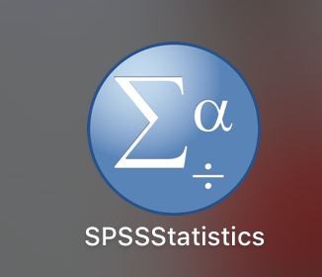
Starting up SPSS
Go to wherever your programs are located
You’re looking for this icon
Start up SPSS
Pray (or similar) that it works!

Slide 7
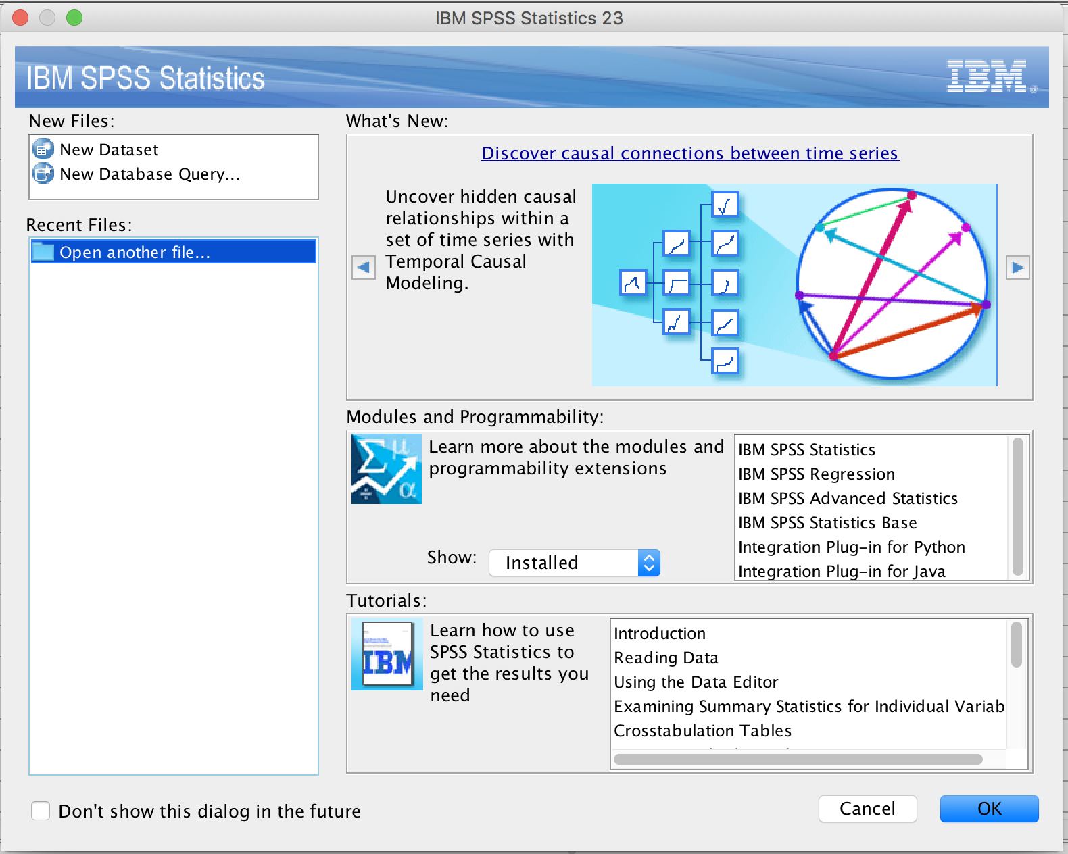
Starting up SPSS
You will see a screen that looks like this.
Click Cancel

Slide 8
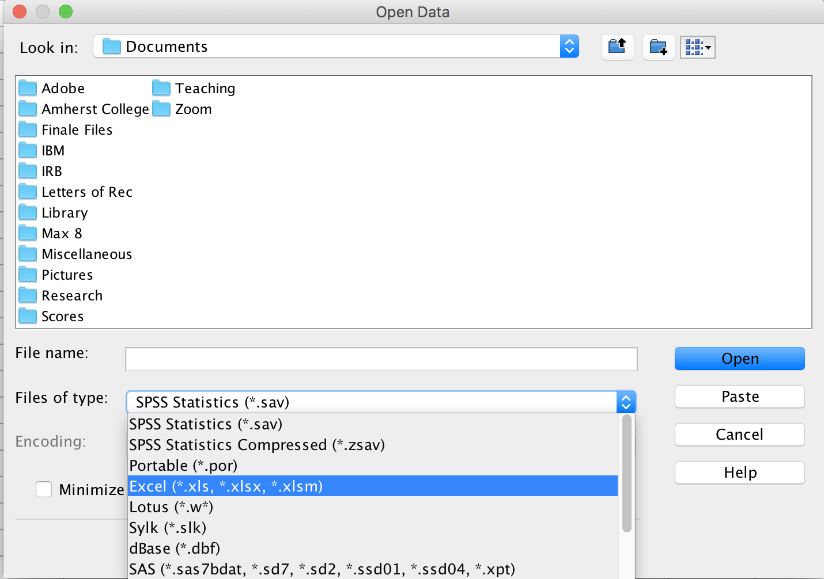
Importing your data file from Excel
Click File → Open
Click the box that says Files of type:
Then click on Excel
This will show you only Excel files
Then navigate to the folder that holds your data

Slide 9
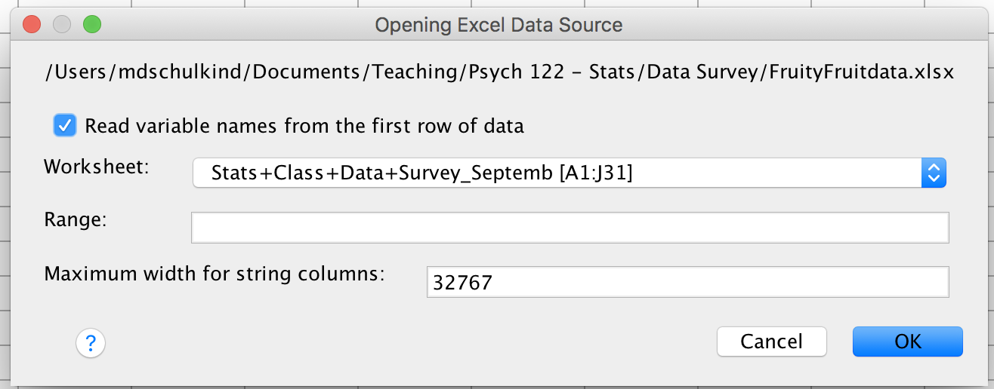
Importing your Excel file into SPSS
You will see a screen that looks like this.
Click ‘OK’

Slide 10
Save your Excel file as an SPSS file
Click File → Save as
Name the data set WhateverYouWant
Click OK

Slide 11
Saving your SPSSDataset
This is the MOST IMPORTANT thing you will ever do in your life.

Slide 12
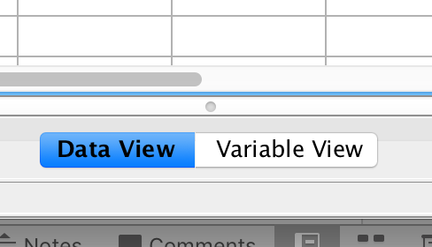
Checking your SPSS file
The bottom middle of the SPSS data window will have two little boxes side-by-side.
Data View shows you the data
Click Variable View to see a list of variables and their attributes

Slide 13
Checking your SPSS file
Check the column labeled Type to make sure your variables are labeled correctly.
Numerical is numerical
String for alphanumeric categories
Click Save to save any changes you have made.

Slide 14
Double-check your SPSS Dataset
Are all of your variables included?
Are all of your variables labeled properly?
Are all of your subjects included?

Slide 15
Your data are now saved in SPSS

Slide 16
Now you are ready to analyze your data

