Slide 1
Analyzing Data
A user’s guide

Slide 2
Data analysis programs
R
  if you know what you are doing…not recommended
SPSS
  I can help you with this one…but not available on your own computer
RCommander!!!
  We LOVE IT!!!!

Slide 3
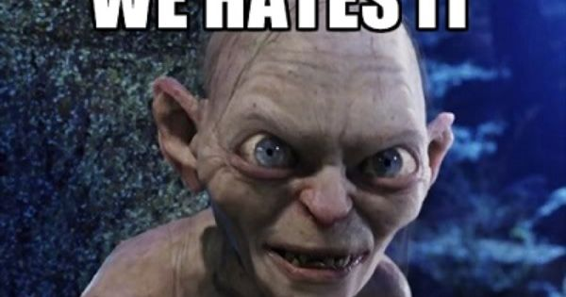
Data analysis programs
R
  if you know what you are doing…not recommended
RCommander!!!
  We HATES IT!!!!
SPSS
  The College has licenses that you can download now!!! WHOOO-HOOO!!!!!

Slide 4
Status of your data
Cleaned
Coded
Formatted properly
In Excel

Slide 5

Downloading SPSS
(skip if it’s still on your computer from Stats)
Go to the course schedule page
Click the link that says ‘Analysis Materials’
Click the link that says ‘Install SPSS’.
  Choose the right operating system: Windows or Mac
Select the newest version.
Open the ‘.rtf’ file and follow the instructions therein.

Slide 6
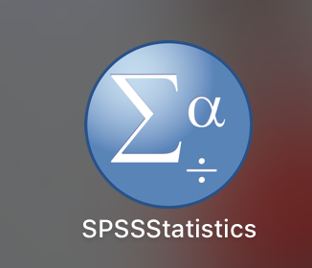
Starting up SPSS
Go to wherever your programs are located
  You’re looking for this icon
Start up SPSS
Pray (or similar) that it works!

Slide 7
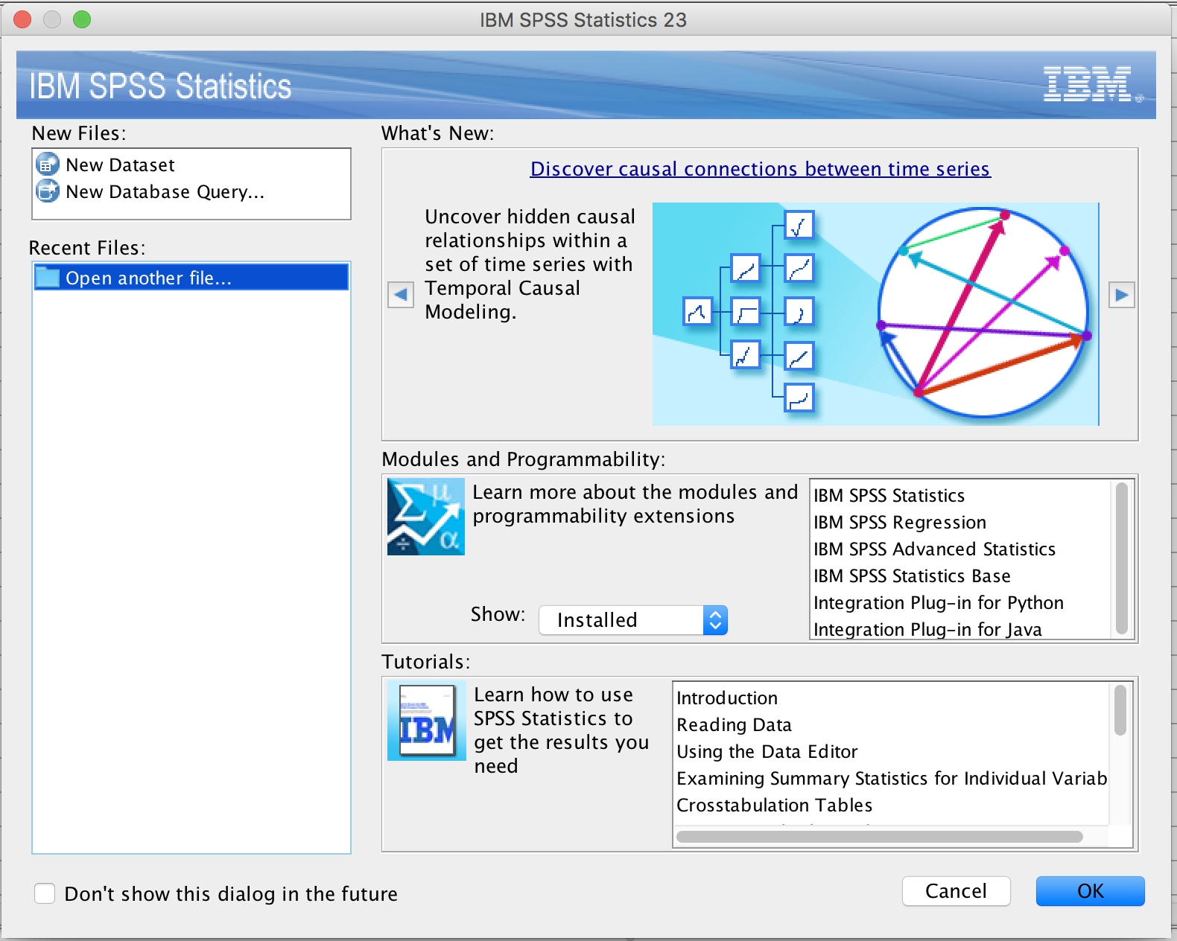
Starting up SPSS
You will see a screen that looks like this.
Click Cancel

Slide 8
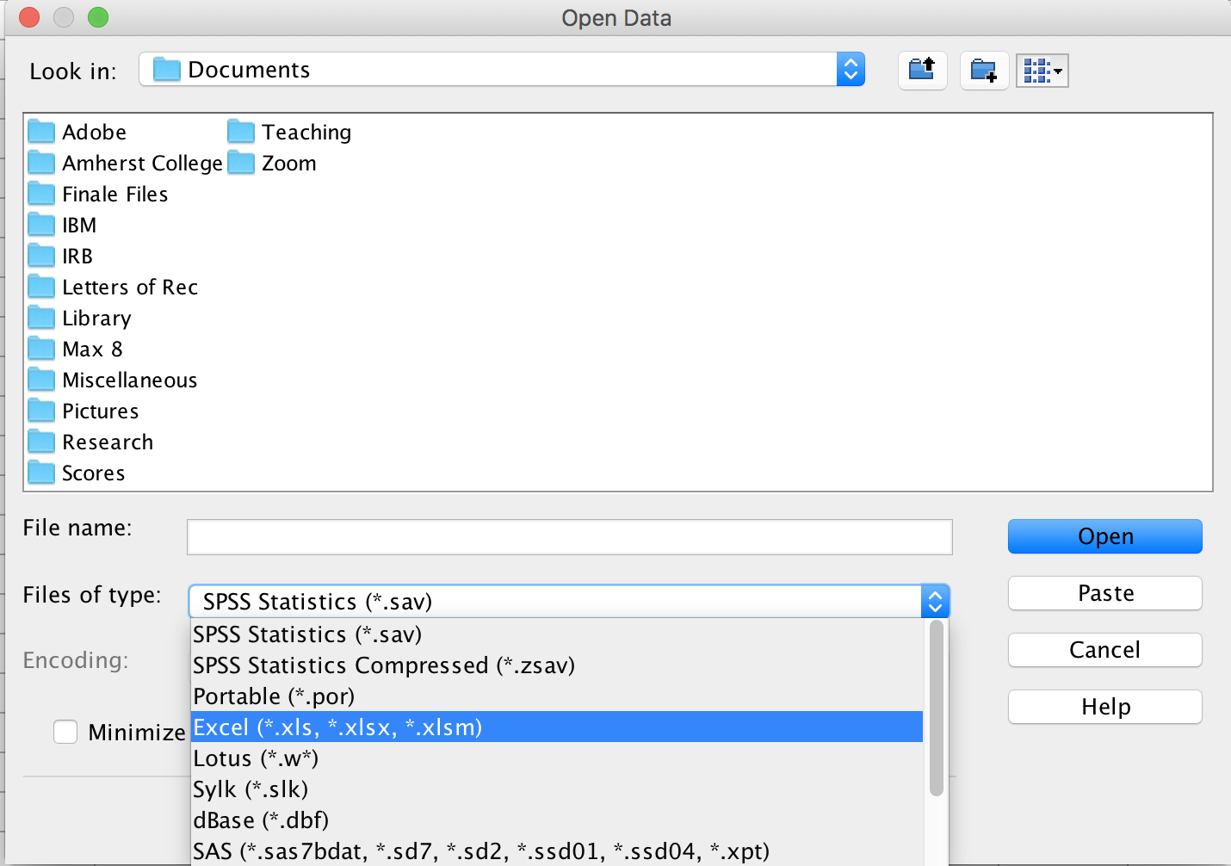
Importing your data file from Excel
Click File → Open
Click the box that says Files of type:
Then click on Excel
  This will show you only Excel files
Then navigate to the folder that holds your data

Slide 9
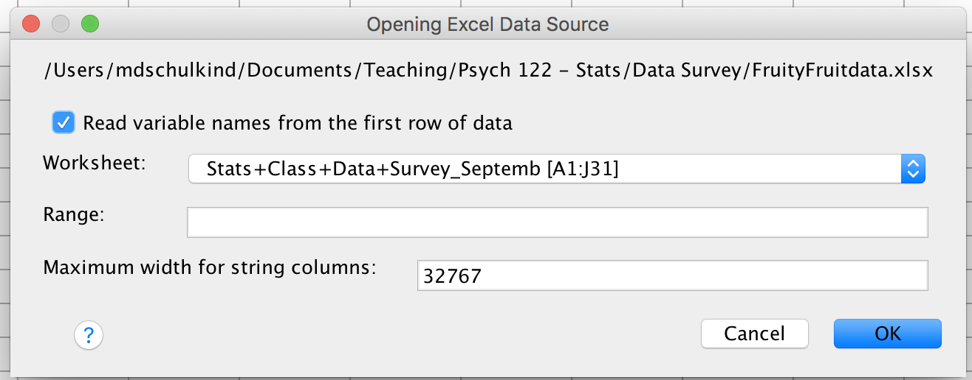
Importing your Excel file into SPSS
You will see a screen that looks like this.
Click ‘OK’

Slide 10
Save your Excel file as an SPSS file
Click File → Save as
Name the data set WhateverYouWant
Click OK

Slide 11
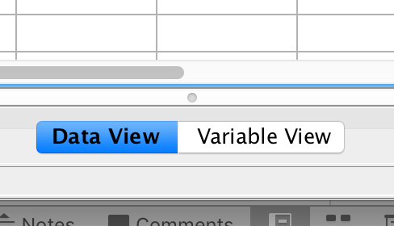
Checking your SPSS file
The bottom middle of the SPSS data window will have two little boxes side-by-side.
Data View shows you the data
Click Variable View to see a list of variables and their attributes

Slide 12
Checking your SPSS file
Check the column labeled Type to make sure your variables are labeled correctly.
  Numerical is numerical
  String for alphanumeric categories
Click Save to save any changes you have made.

Slide 13
Double-check your SPSS Dataset
Are all of your variables included?
Are all of your variables labeled properly?
Are all of your subjects included?

Slide 14
Your data are now saved in SPSS

Slide 15
Saving your SPSSDataset
This is the MOST IMPORTANT thing you will ever do in your life.

Slide 16

Now you are ready to analyze your data

Slide 17

Now you are ready to analyze your data

Slide 18
Components of an Analysis Plan
A list of the questions you want to address
  E.G.: Did type of high school influence creativity?
A specification of the Independent and Dependent variables (or predictors and dependent variables).
  IV = Type of high school
  DV = Creativity scores
What kind of analysis you are doing
  T-test? ANOVA? Correlation? Regression?
  Make your best guess…then I will help you.

Slide 19
How to conduct analyses in SPSS
Finding Means and Standard Deviations
Independent samples t-test
Paired samples t-test
One-way ANOVA (RM ANOVA)
Factorial ANOVA (RM Factorial ANOVA)
Correlation
Regression

Slide 20
Instrux for conducting different analyses in SPSS
Finding Means and Standard Deviations
Independent samples t-test
Paired samples t-test
One-way ANOVA (RM ANOVA)
Factorial ANOVA (RM Factorial ANOVA)
Correlation
Regression

Slide 21
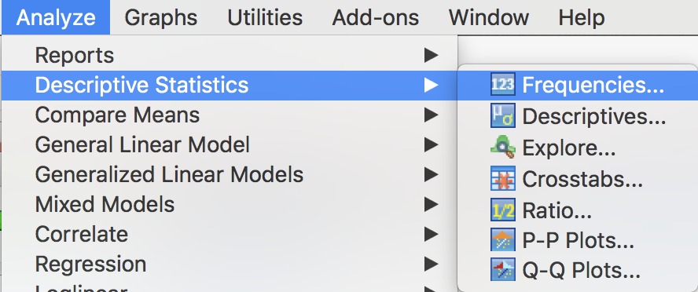
Means and Standard Deviations
Go to Analyze→ Descriptive Statistics → Frequencies

Slide 22
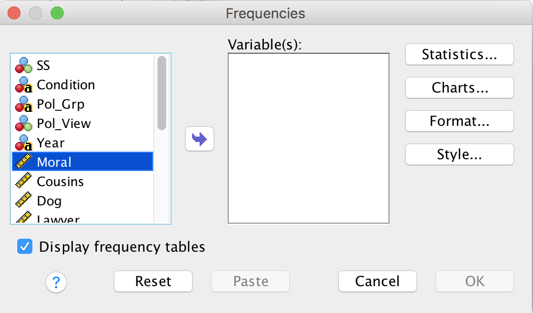
Means and Standard Deviations
Find yourDV on the variable list and click it.
  Slide it into the Variable(s) box by clicking the arrow.
Click the button labeled Statistics in the upper left

Slide 23
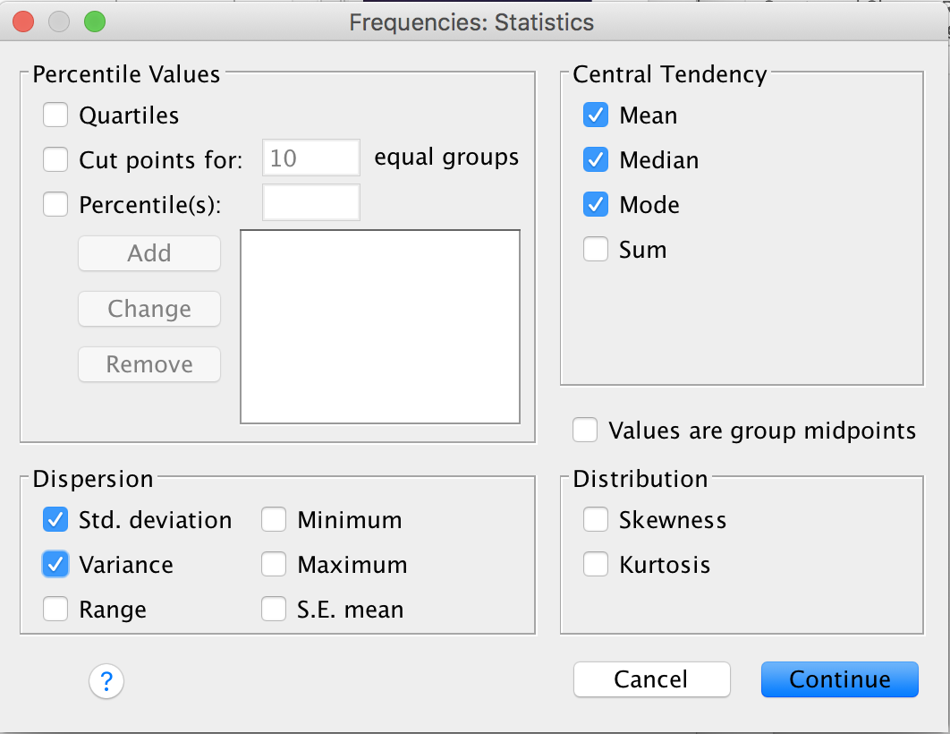
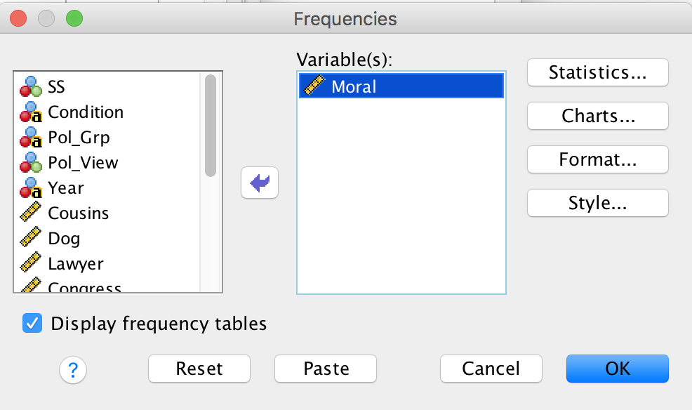
Means and Standard Deviations
Select the Statistics you want to see
  Mean, Median, Mode, Std. Deviation, Variance
Click Continue.
Then click OK.

Slide 24
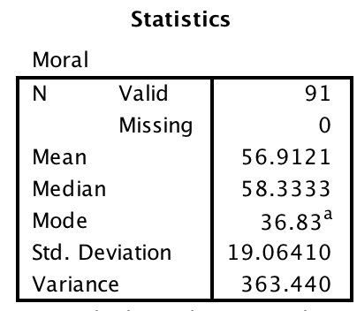
Means and Standard Deviations

Slide 25
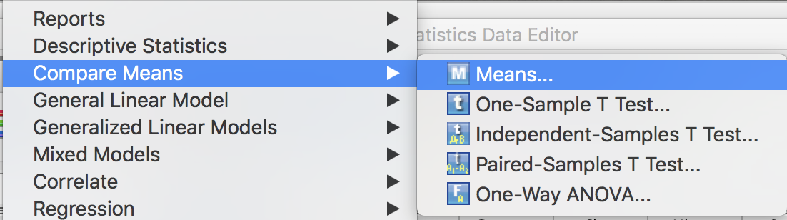
Means and Standard Deviations: By Groups
Go to Analyze → Compare Means → Means

Slide 26
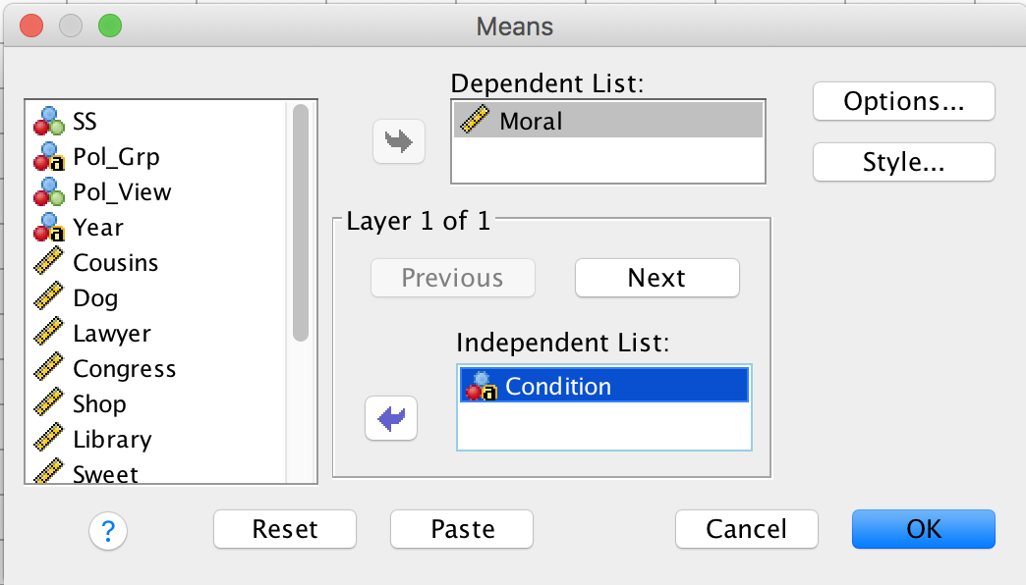
Means and Standard Deviations: By Groups
Choose yourDV and slide it into the top box.
Choose yourIV and slide it into the bottom box.
If you have a 2nd IV, click Next and slide the 2nd IV into the lower box (etc.)
Click OK

Slide 27
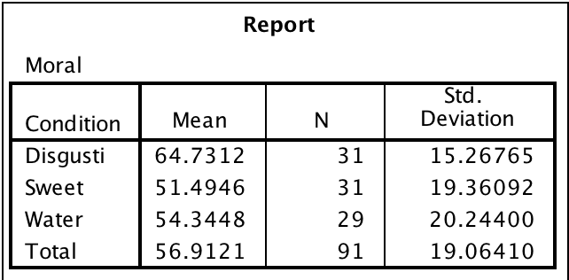
Means and Standard Deviations: By Groups

Slide 28
Instrux for conducting different analyses in SPSS
Finding Means and Standard Deviations
Independent samples t-test
Paired samples t-test
One-way ANOVA (RM ANOVA)
Factorial ANOVA (RM Factorial ANOVA)
Correlation
Regression

Slide 29
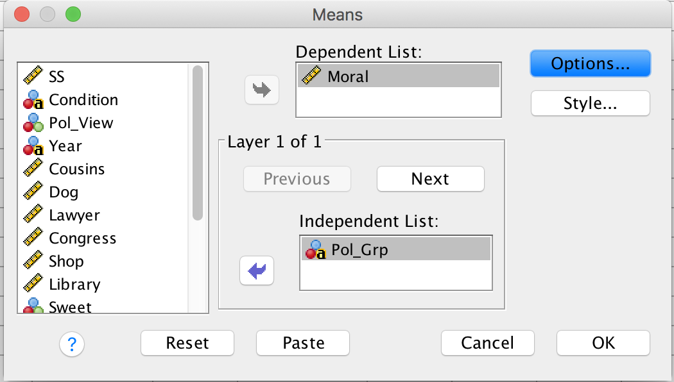
Independent Samples t-test
  First, let’s find the means and standard deviation of your dependent variable rating for the conservative and liberal groups.
    Analyze → Compare Means → Means
    Slide yourDV into the box labeled Dependent Variable
    Slide yourIV into the box labeled Independent Variable
    Click OK.

Slide 30
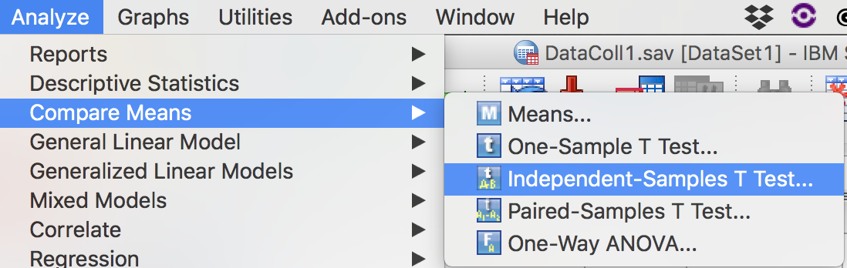
Independent Samples t-test
Analyze → Compare Means→ Independent Samples T-Test

Slide 31
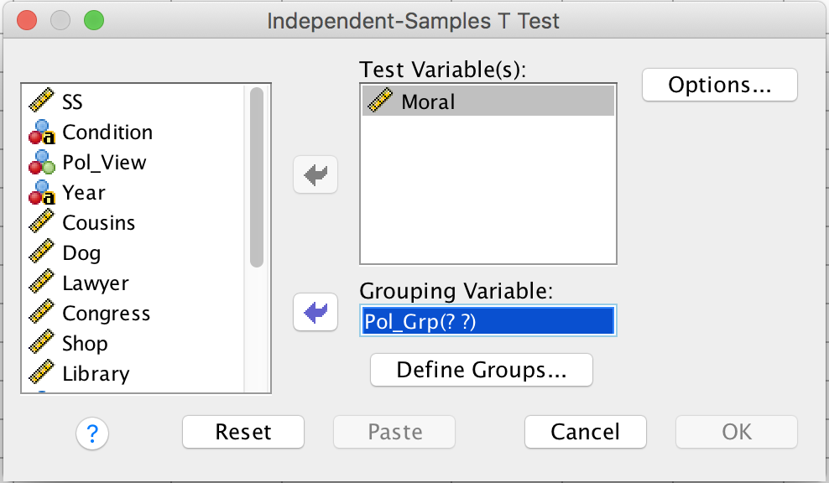
Independent Samples t-test
Slide yourDV into the box labeled Test Variable
Slide yourIV into the box labeled Grouping Variable
Then click Define Groups

Slide 32
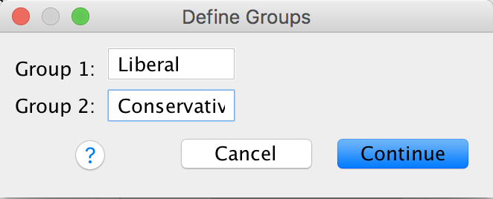
Independent Samples t-test
Enter level1 and level2 in the boxes labeled Group 1 and Group 2.
The order does not matter, but the spelling does!!!
Then click Continue.
Then click OK.

Slide 33
Instrux for conducting different analyses in SPSS
Finding Means and Standard Deviations
Independent samples t-test
Paired samples t-test
One-way ANOVA (RM ANOVA)
Factorial ANOVA (RM Factorial ANOVA)
Correlation
Regression

Slide 34
Paired Samples t-test
First, let’s find the means for our two groups.
Go to Analyze→ Descriptive Statistics → Frequencies

Slide 35
Paired Samples t-test
Find yourDV on the variable list and click it.
  Slide it into the Variable(s) box by clicking the arrow.
Click the button labeled Statistics in the upper left

Slide 36
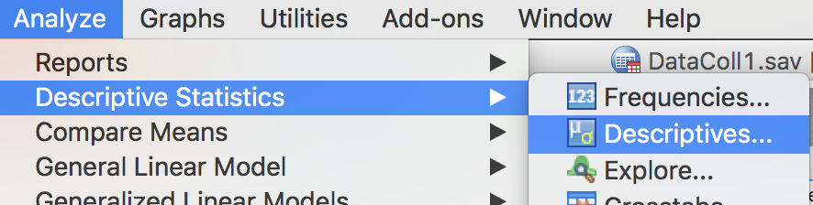
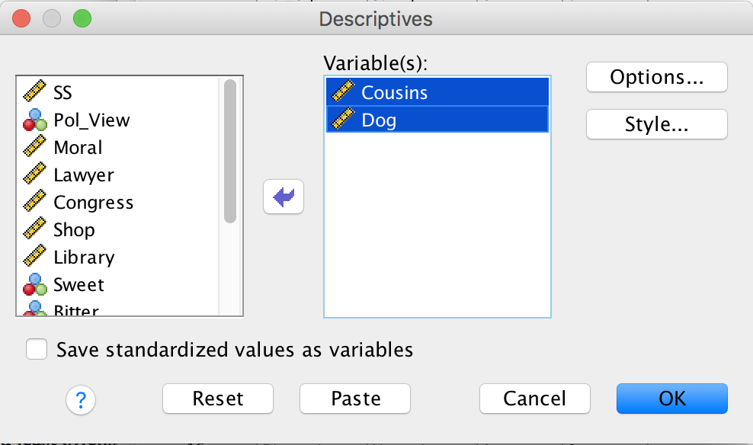
Paired Samples t-test
First, let’s find the mean and standard deviation for the two variables.
  Analyze → Descriptive Statistics→ Descriptives
  Slide yourDV1 and yourDV2 into the box labeled Variable(s).
  Then click OK.

Slide 37
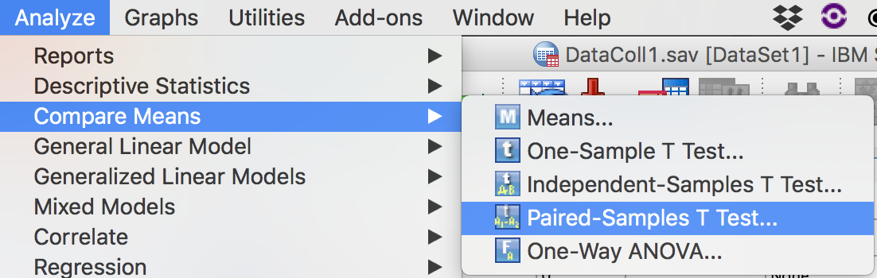
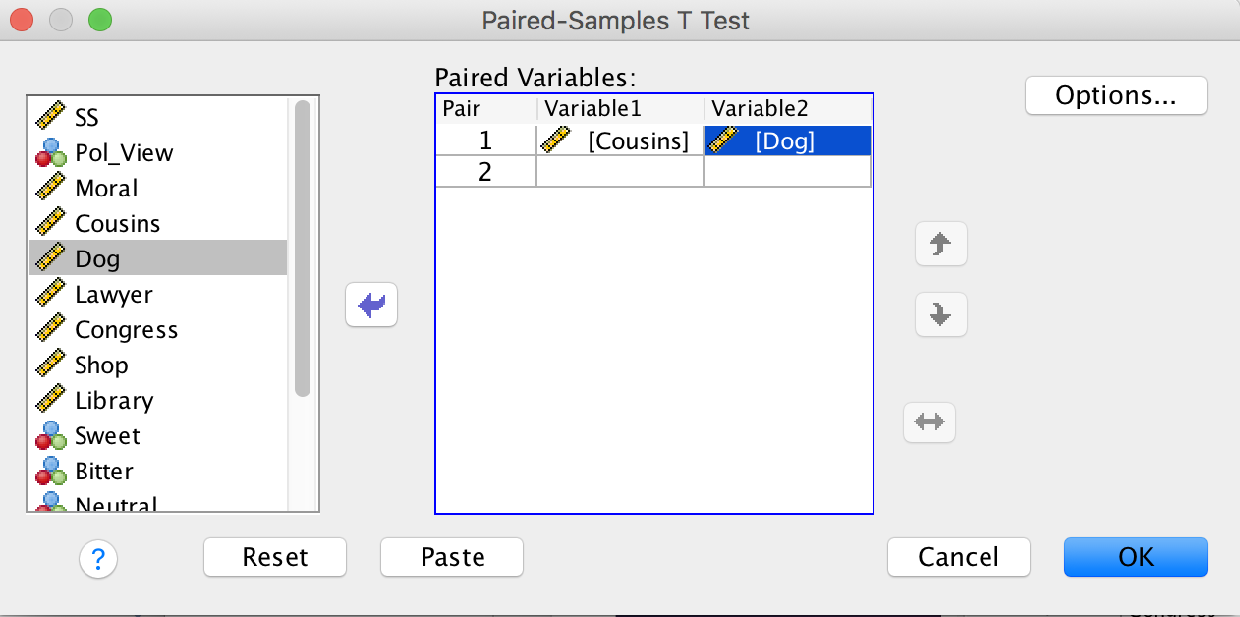
Paired Samples t-test
Now, we can conduct the t-test.
  Analyze → Compare Means→ Paired t-test
  Slide yourDV1 and yourDV2 into the box labeled Paired Variables
  Click OK.

Slide 38
Instrux for conducting different analyses in SPSS
Finding Means and Standard Deviations
Independent samples t-test
Paired samples t-test
One-way ANOVA (RM ANOVA)
Factorial ANOVA (RM Factorial ANOVA)
Correlation
Regression

Slide 39
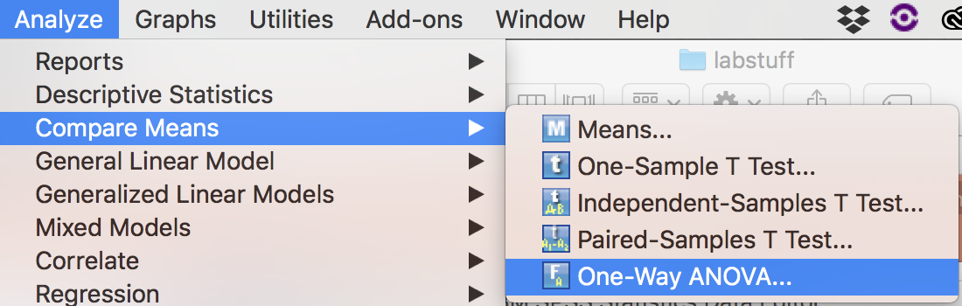
One-Way ANOVA
Analyze → General Linear Model → Univariate

Slide 40
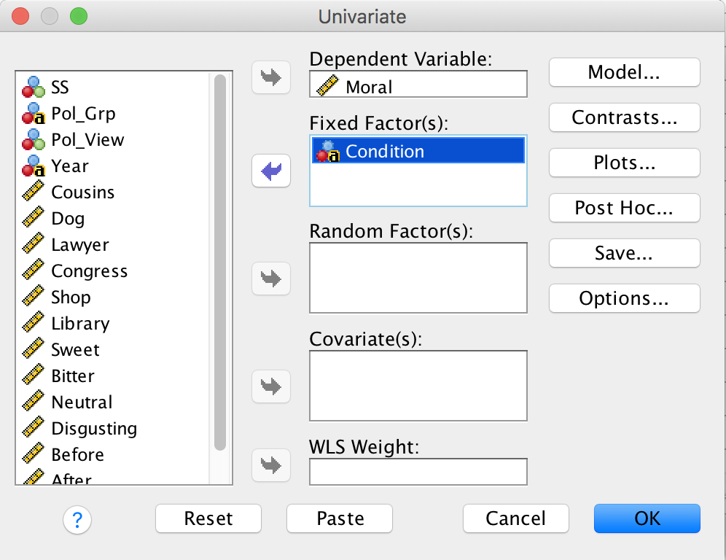
One-Way ANOVA
Slide yourDV into the Dependent Variable box.
Slide yourIV into the box labeled Fixed Factor(s).
Then click Options.

Slide 41
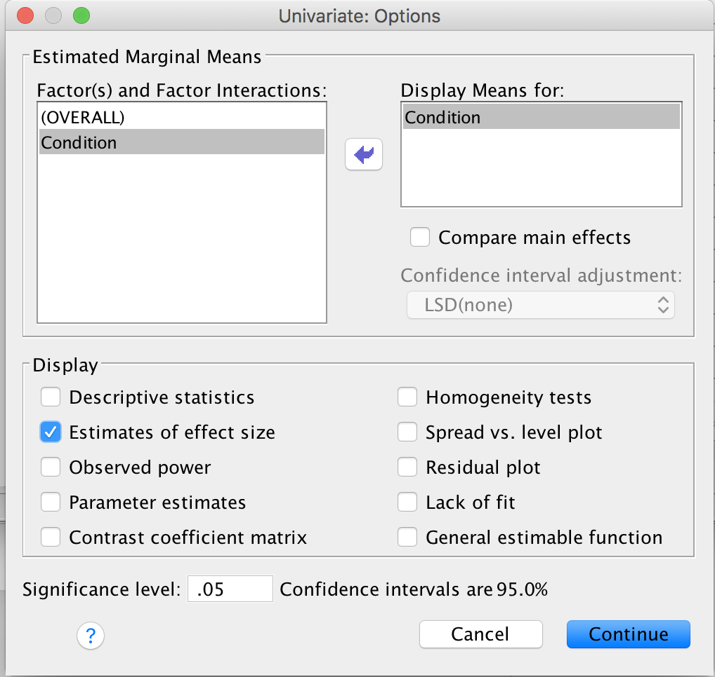
One-Way ANOVA
Slide yourIV into the box labeled Display Means for
Then click the check box labeled Estimates of effect size
Then click Continue.

Slide 42
One-way ANOVA
Then click OK.

Slide 43
Instrux for conducting different analyses in SPSS
Finding Means and Standard Deviations
Independent samples t-test
Paired samples t-test
One-way ANOVA (RM ANOVA)
Factorial ANOVA (RM Factorial ANOVA)
Correlation
Regression

Slide 44
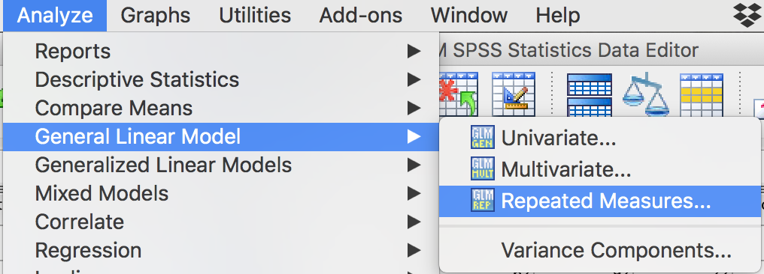
Repeated Measures ANOVA
Analyze → General Linear Model → Repeated Measures

Slide 45
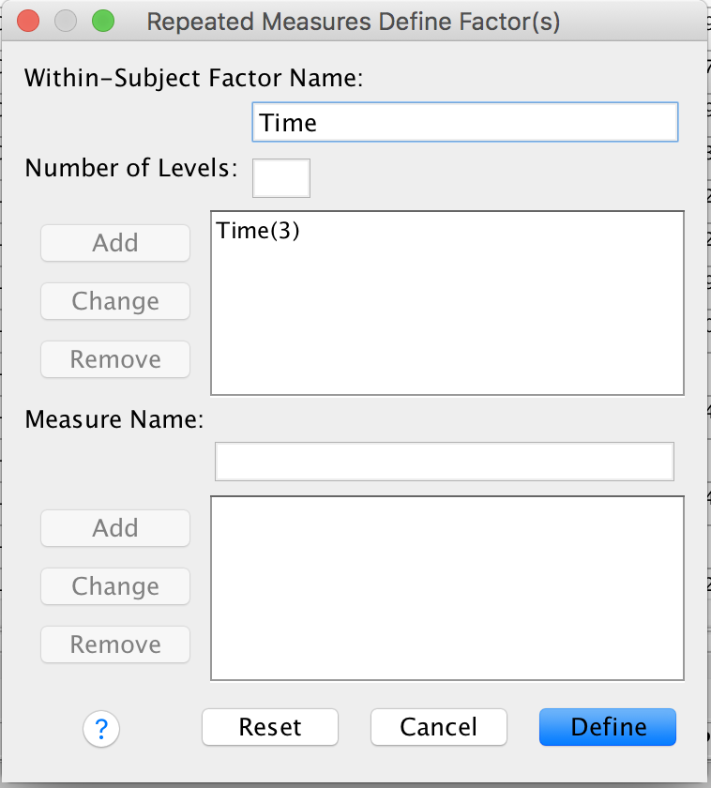
Repeated Measures ANOVA
You need to name your RM factor. Let’s call it Time. Type Time in the box labeled Within-Subject Factor Name.
Time has 3 levels, so enter 3 in the box labeled Number of Levels.
Click Add.
Click Define.

Slide 46
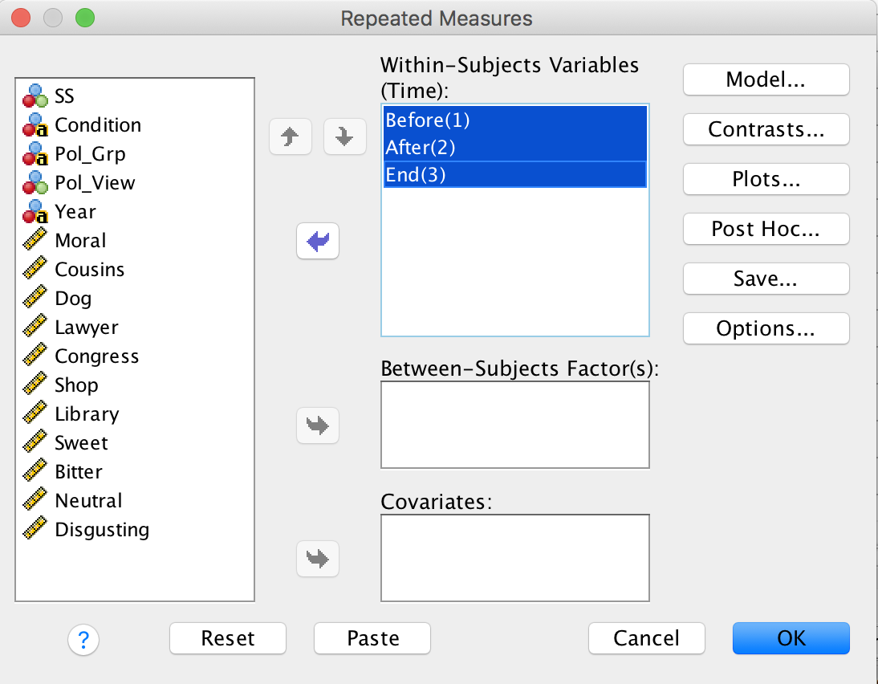
Repeated Measures ANOVA
We need to tell SPSS what variables constitute our three levels of Time.
Slide Before, After, and End into the box labeled Within Subjects Variables (Time).
Then click Options.

Slide 47
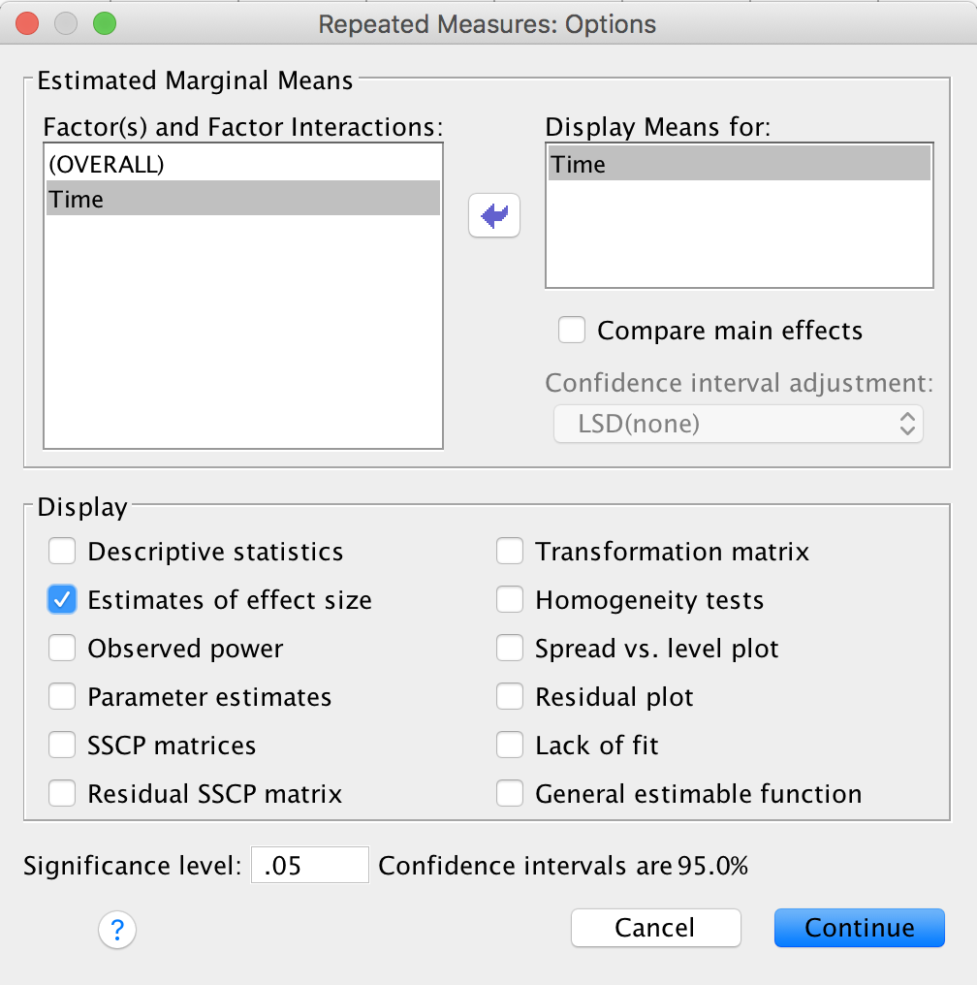
Repeated Measures ANOVA
Slide Time into the box labeled Display Means for
Then click the check box labeled Estimates of effect size
Then click Continue.

Slide 48
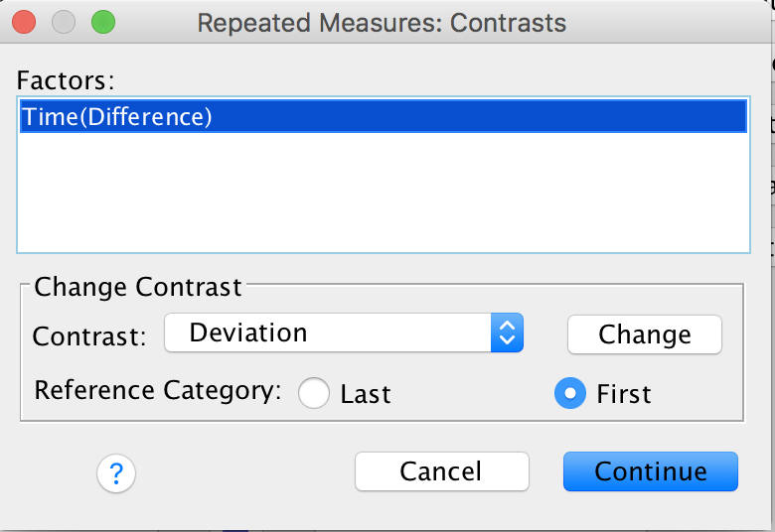
Repeated Measures ANOVA
We can’t click on Post-hoc because SPSS doesn’t do post-hoc tests for RM variables.
So, click on Contrasts, instead.
Find Difference in the Contrast box; then click Change.
Click Continue.
Then click OK on the main screen.

Slide 49
Instrux for conducting different analyses in SPSS
Finding Means and Standard Deviations
Independent samples t-test
Paired samples t-test
One-way ANOVA (RM ANOVA)
Factorial ANOVA (RM Factorial ANOVA)
Correlation
Regression

Slide 50
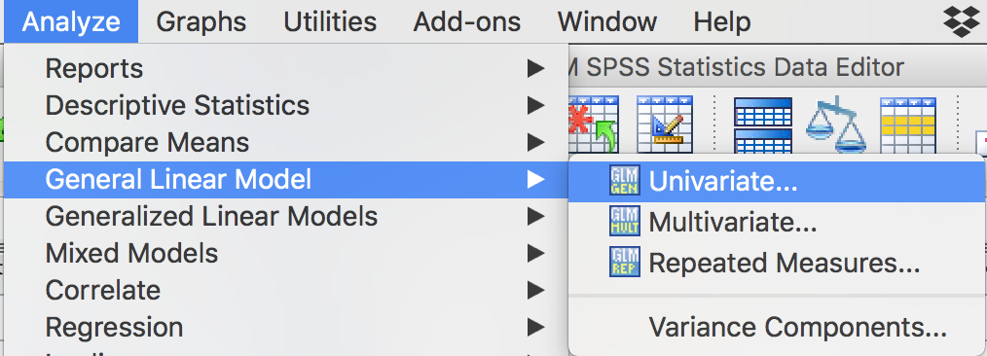
Factorial ANOVA
Analzye → General Linear Model → Univariate

Slide 51
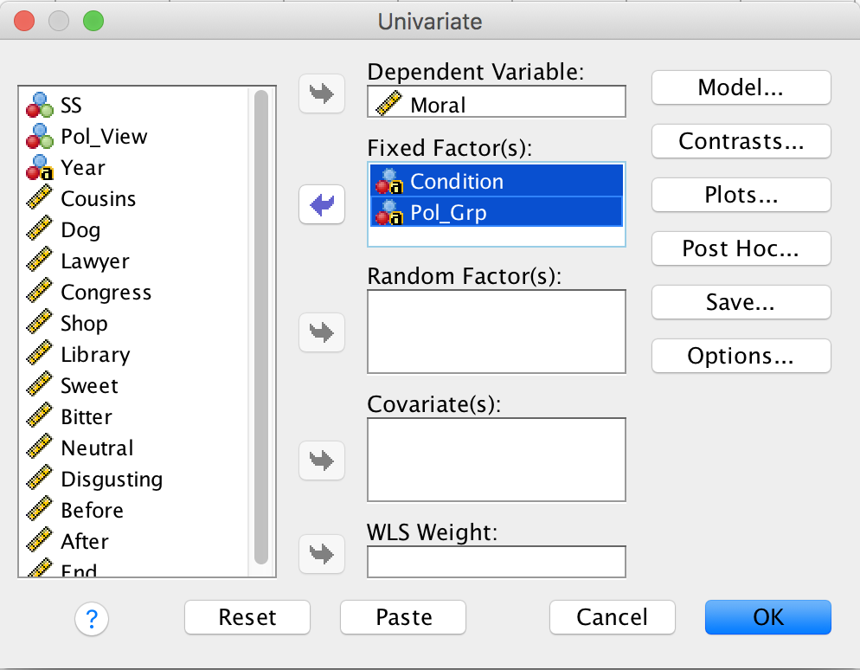
Factorial ANOVA
Slide yourDV into the Dependent Variable box.
Slide yourIV1 AND yourIV2 into the box labeled Fixed Factor(s).
Then click Options.

Slide 52
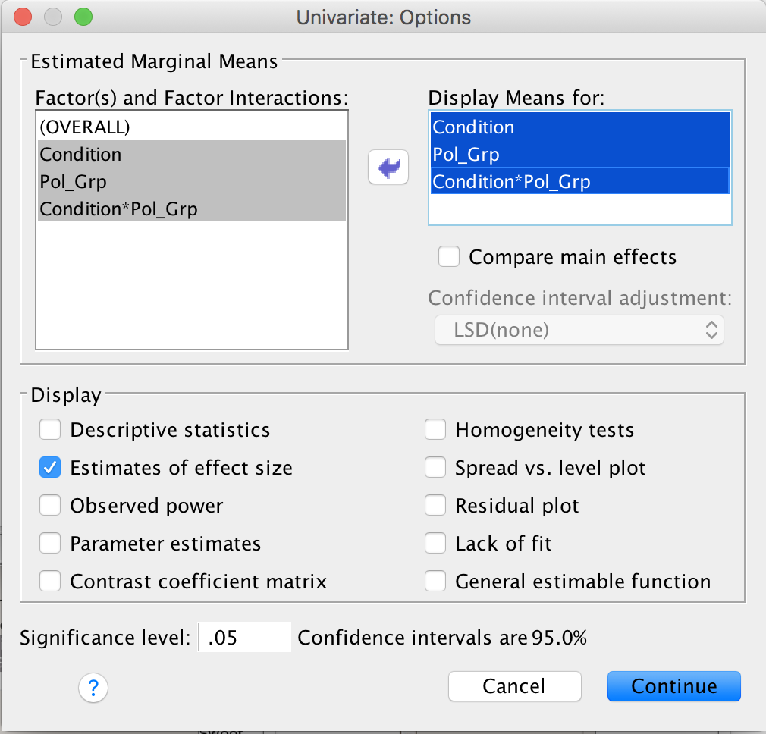
Factorial ANOVA
Slide all three factors (yourIV1; yourIV2; yourIV1*yourIV2) into the box labeled Display Means for
Then click the check box labeled Estimates of effect size
Then click Continue.

Slide 53
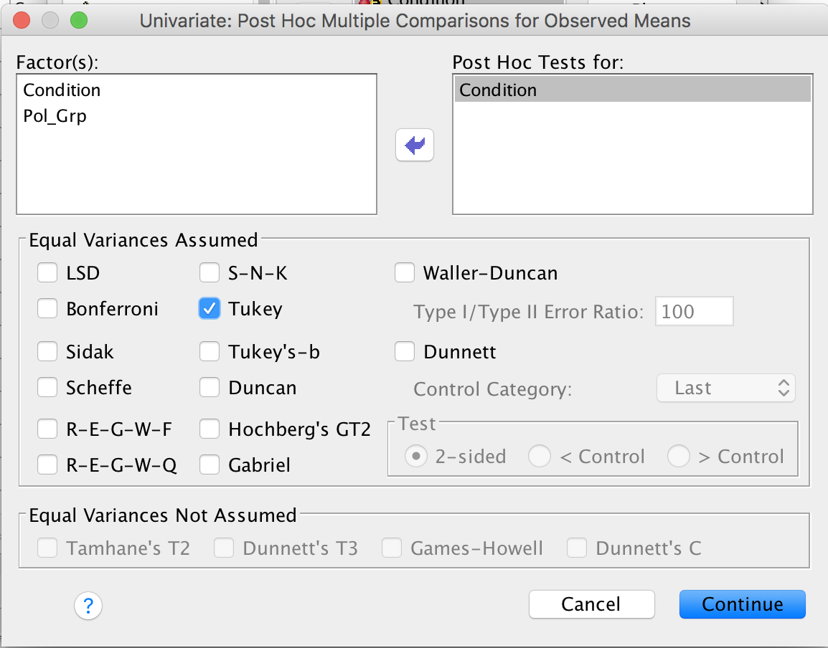
Factorial ANOVA
Then click Post-Hoc.
Slide yourIV1 and yourIV2 into the box labeled Post Hoc Tests for
Then click the check box for Tukey.
Then click Continue.
Then click OK on the main screen.

Slide 54
Instrux for conducting different analyses in SPSS
Finding Means and Standard Deviations
Independent samples t-test
Paired samples t-test
One-way ANOVA (RM ANOVA)
Factorial ANOVA (RM Factorial ANOVA)
Correlation
Regression

Slide 55
Repeated Measures Factorial ANOVA
Analyze → General Linear Models → Repeated measures

Slide 56
Repeated Measures Factorial ANOVA
We need to name our RM factor. Let’s call it Time. Type Time in the box labeled Within-Subject Factor Name.
Time has 3 levels, so enter 3 in the box labeled Number of Levels.
Click Add.
Repeat these steps for any additional repeated measures IVs.
Click Define.

Slide 57
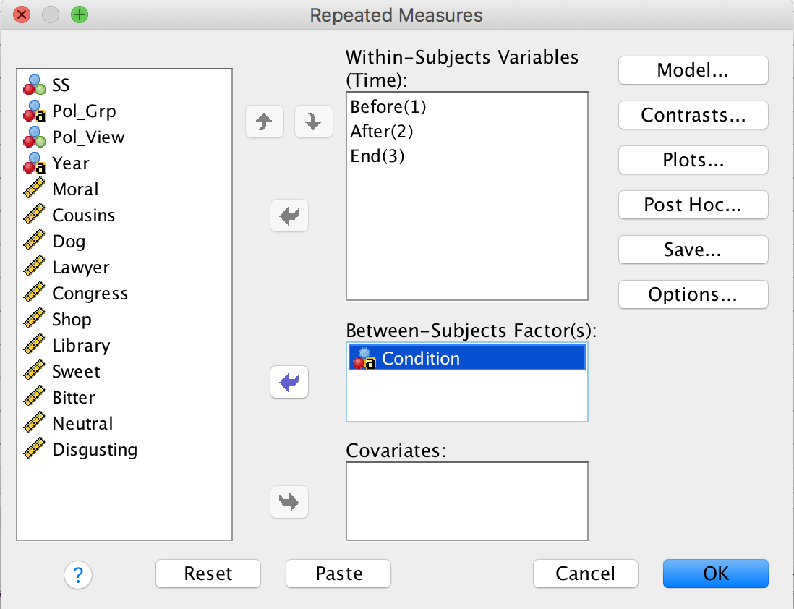
Repeated Measures Factorial ANOVA
Slide the levels of your IV (Before, After, and End in this example) into the box labeled Within Subjects Variables (Time).
Do the same for any other repeated measures IV.
If you have a between subjects IV, slide it into the into the box labeled Between-Subjects Factor(s) (Condition in this example).
Then click Options.

Slide 58
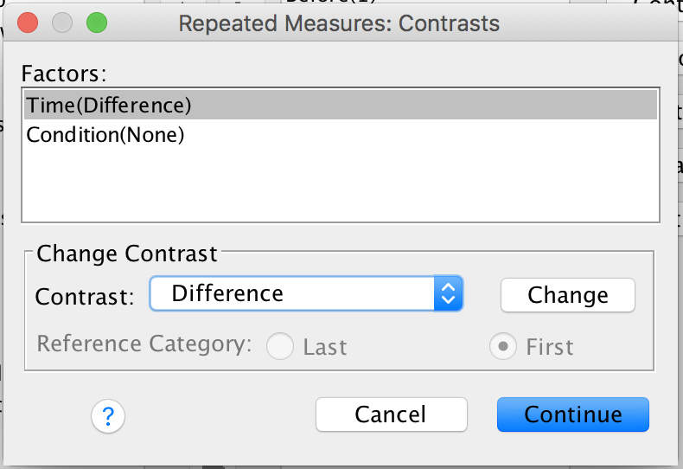
Repeated Measures Factorial ANOVA
SPSS doesn’t do post-hoc tests for RM variables.
So, click on Contrasts, instead.
Find Difference in the Contrast box; then click Change.
Click Continue.

Slide 59
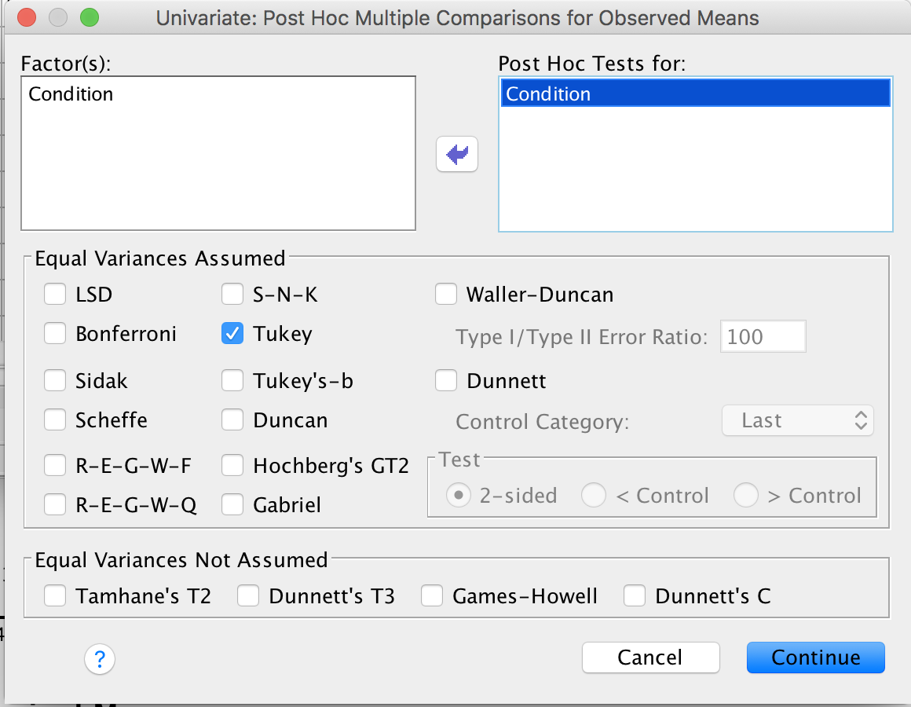
Repeated Measures Factorial ANOVA
If you have a between subjects IV, click Post-Hoc.
Slide Condition into the box labeled Post Hoc Tests for .
Then click the check box for Tukey .
Then click Continue.
Then click OK on the main page.

Slide 60
Instrux for conducting different analyses in SPSS
Finding Means and Standard Deviations
Independent samples t-test
Paired samples t-test
One-way ANOVA (RM ANOVA)
Factorial ANOVA (RM Factorial ANOVA)
Correlation
Regression

Slide 61
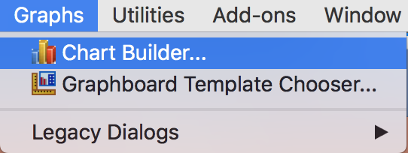
Correlation
Start by creating a scatter plot for yourDV1 and yourDV2.
  Graphs → Chart Builder
Click OK.

Slide 62
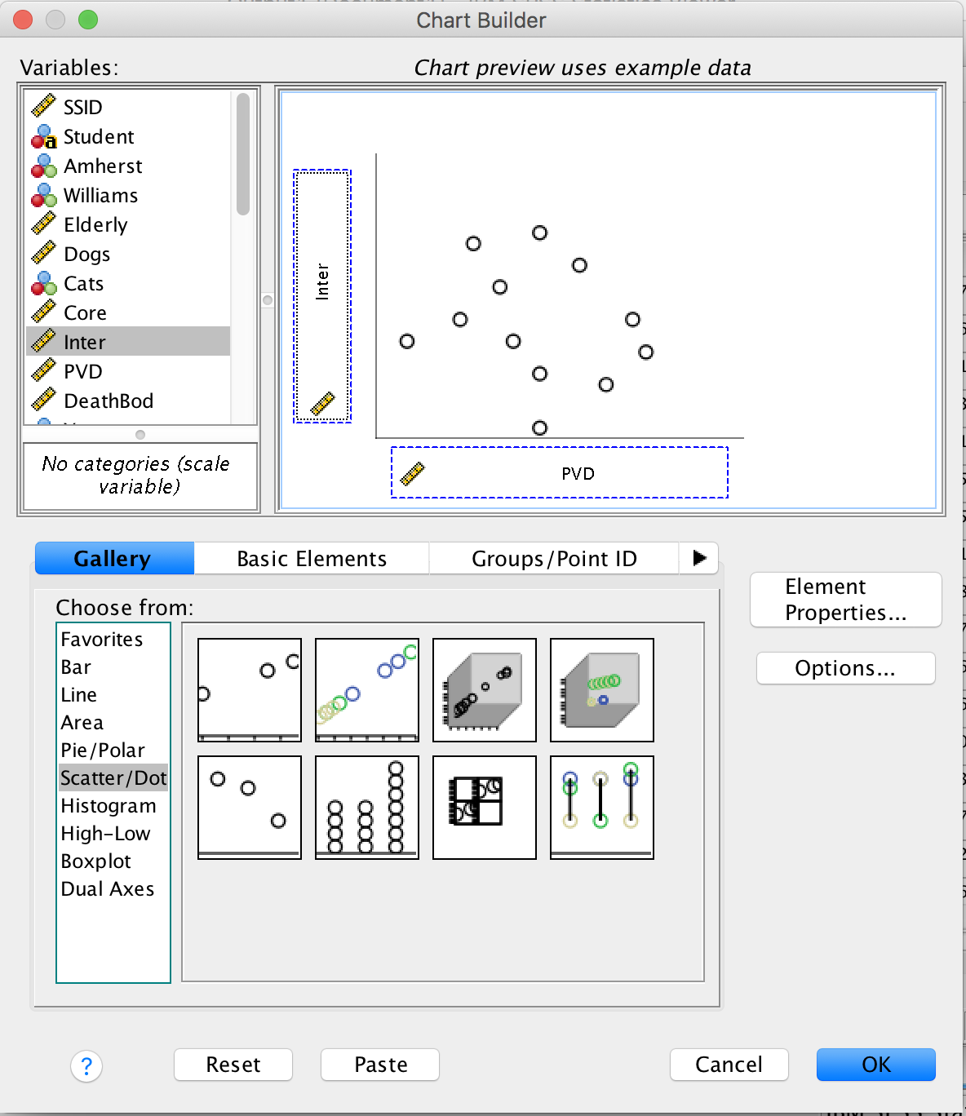
Correlation
Click Scatter/Dot.
Click on the square on the top left and drag into the Chart Window
Drag yourX and yourY into the X-axis and Y-axis boxes (it doesn’t matter which is which).
Click OK.

Slide 63
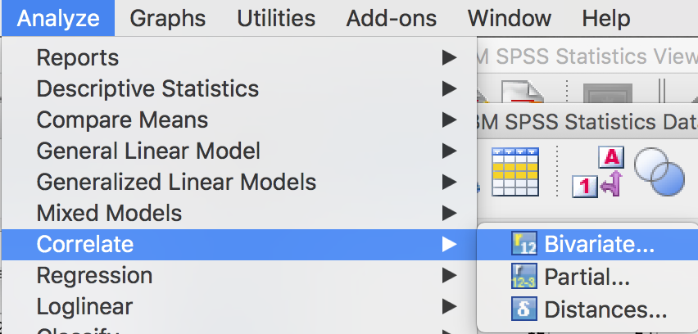
Correlation
Now let’s compute the correlation between these variables.
Analyze → Correlate → Bivariate

Slide 64
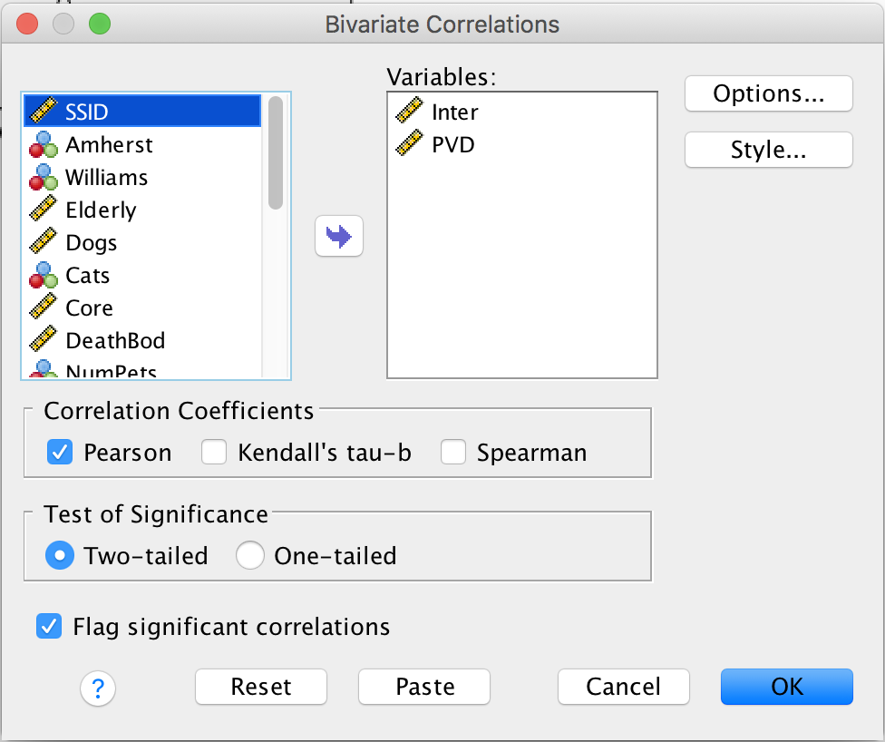
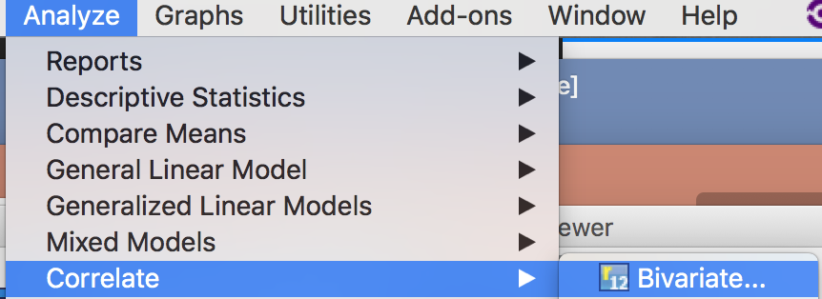
Correlation
Slide yourX and yourY into the Variables box.
Then press OK.

Slide 65
Instrux for conducting different analyses in SPSS
Finding Means and Standard Deviations
Independent samples t-test
Paired samples t-test
One-way ANOVA (RM ANOVA)
Factorial ANOVA (RM Factorial ANOVA)
Correlation
Regression

Slide 66
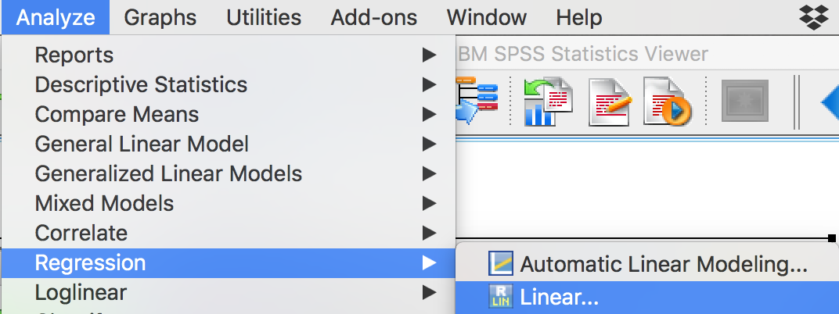
Regression
Analyze → Regression → Linear

Slide 67
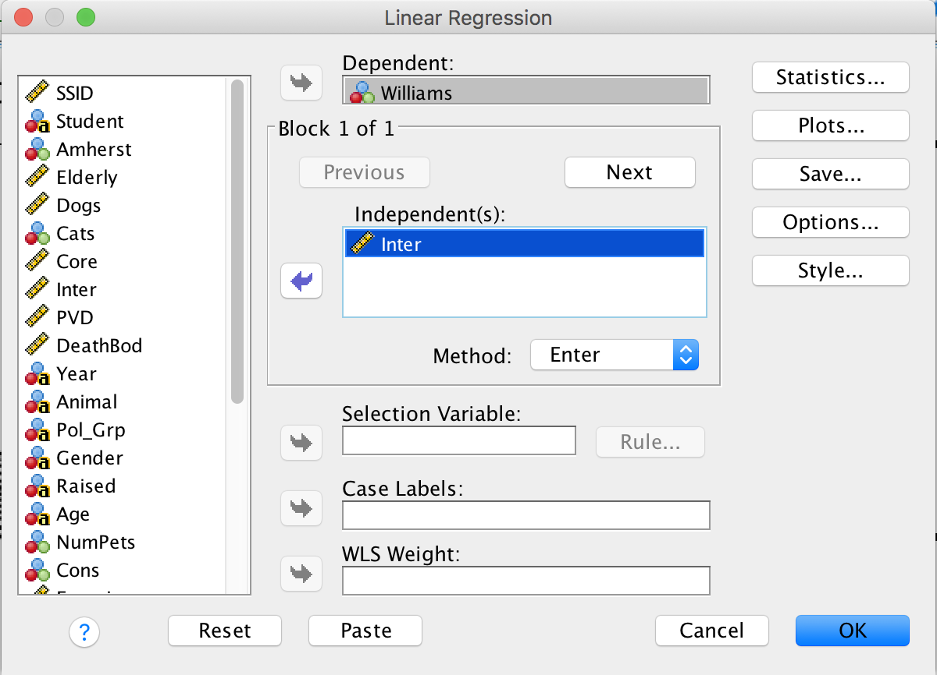
Regression
Slide yourY into the Dependent (DV) box.
Slide yourX1 into the Indendent(s) (IV) box.
Repeat for any additional X variables.
Click OK.

