Slide 1
Instrux for conducting different analyses in SPSS
Finding Means and Standard Deviations
Independent samples t-test
Paired samples t-test
One-way ANOVA (RM ANOVA)
Factorial ANOVA (RM Factorial ANOVA)
Correlation
Regression

Slide 2
One-Way ANOVA
Analyze → General Linear Model → Univariate

Slide 3
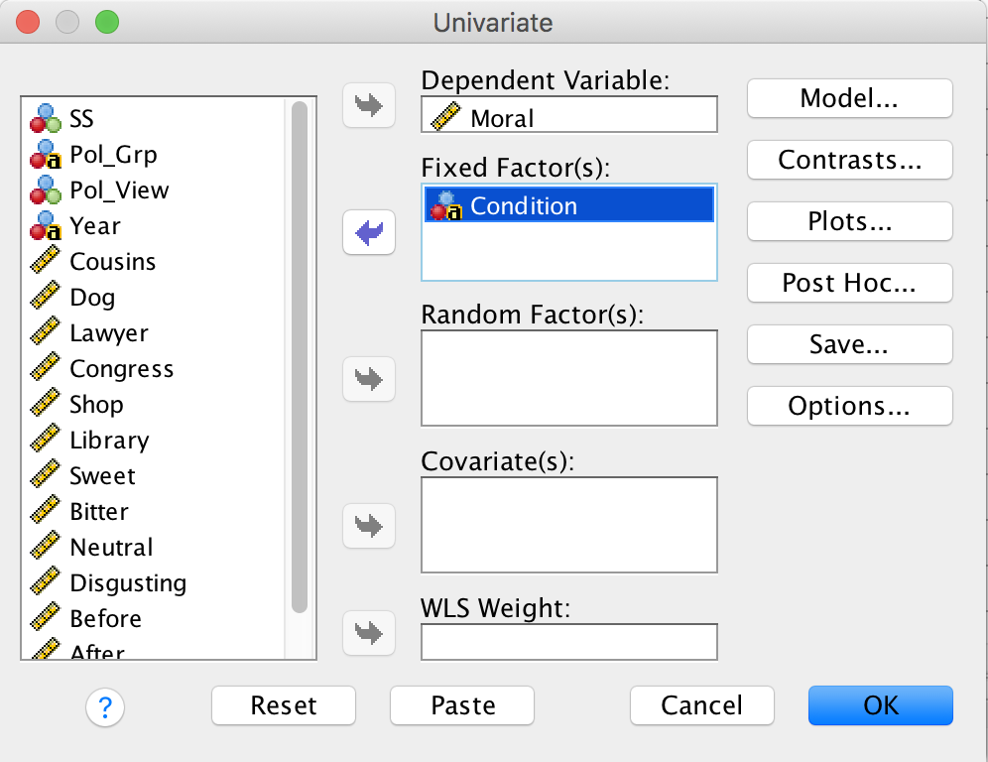
One-Way ANOVA
Slide yourDV into the Dependent Variable box.
Slide yourIV into the box labeled Fixed Factor(s).
Then click Options.

Slide 4
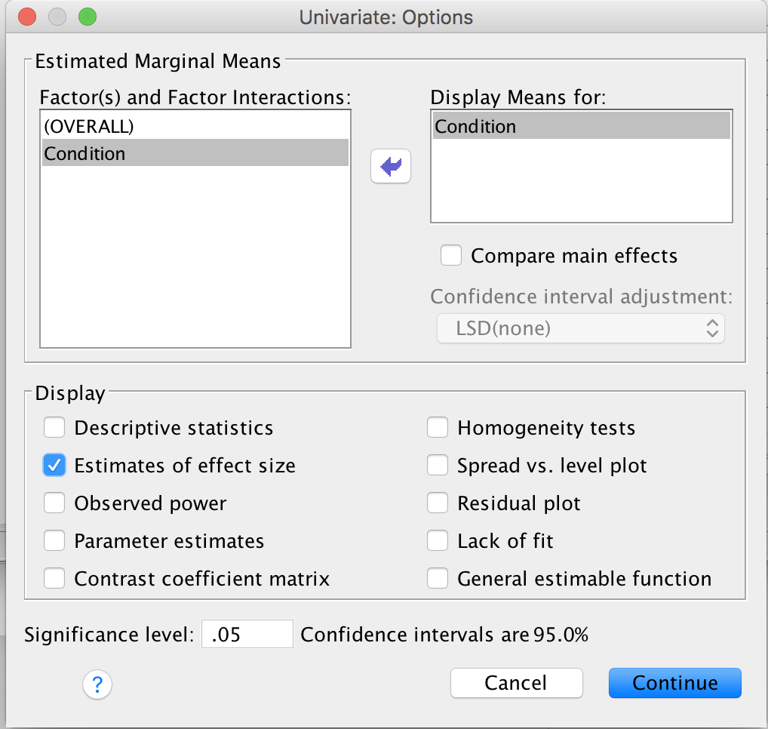
One-Way ANOVA
Slide yourIV into the box labeled Display Means for
Then click the check box labeled Estimates of effect size
Then click Continue.

Slide 5
One-way ANOVA
Then click OK.

