Slide 1
Instrux for conducting different analyses in SPSS
Finding Means and Standard Deviations
Independent samples t-test
Paired samples t-test
One-way ANOVA (RM ANOVA)
Factorial ANOVA (RM Factorial ANOVA)
Correlation
Regression

Slide 2
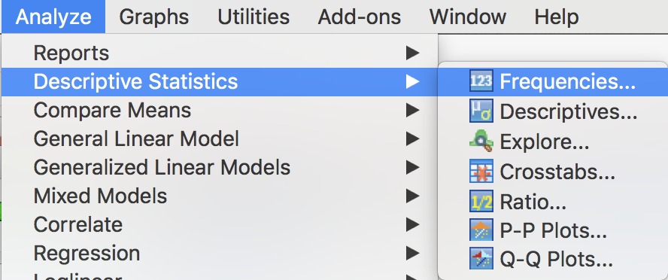
Means and Standard Deviations
Go to Analyze→ Descriptive Statistics → Frequencies

Slide 3
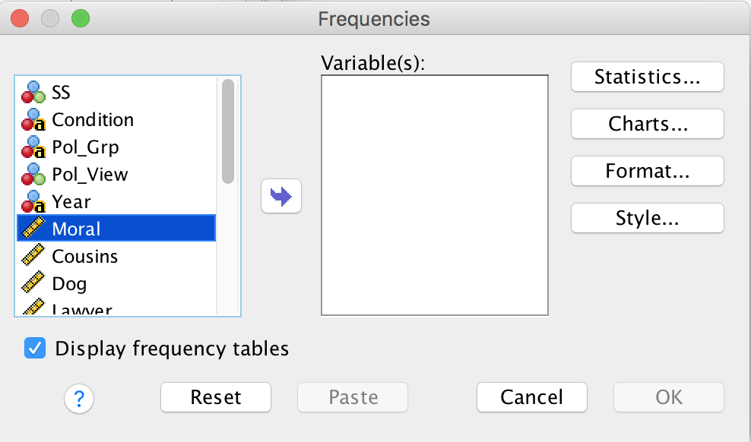
Means and Standard Deviations
Find yourDV on the variable list and click it.
  Slide it into the Variable(s) box by clicking the arrow.
Click the button labeled Statistics in the upper left

Slide 4
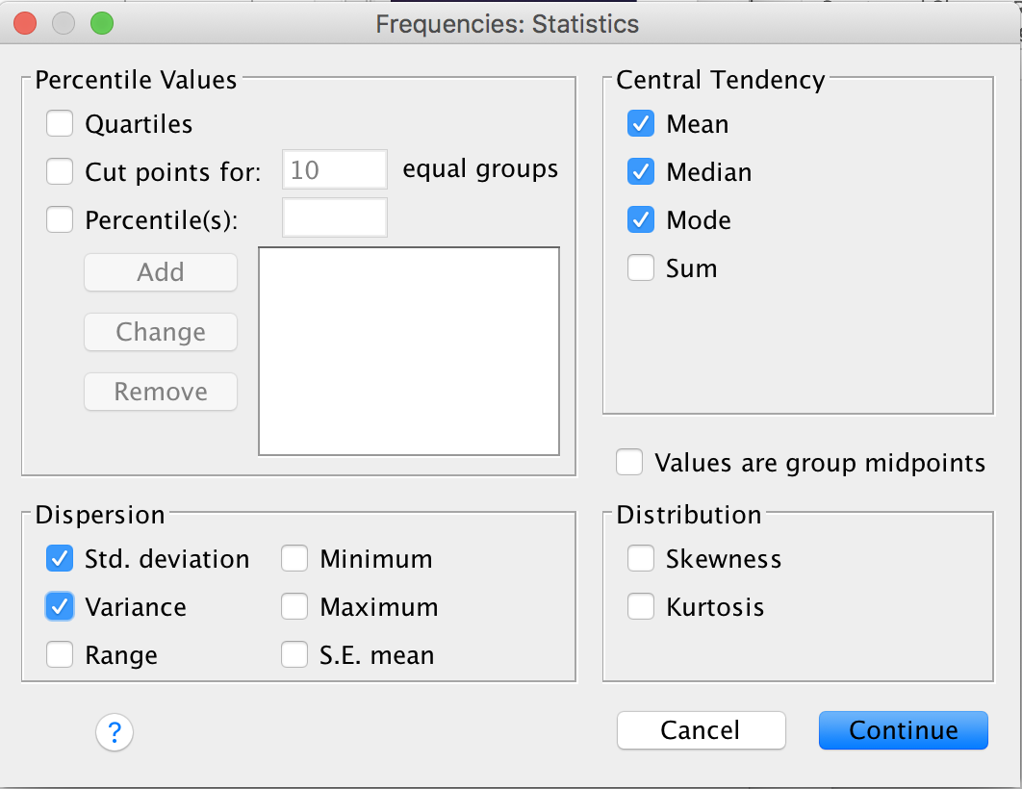
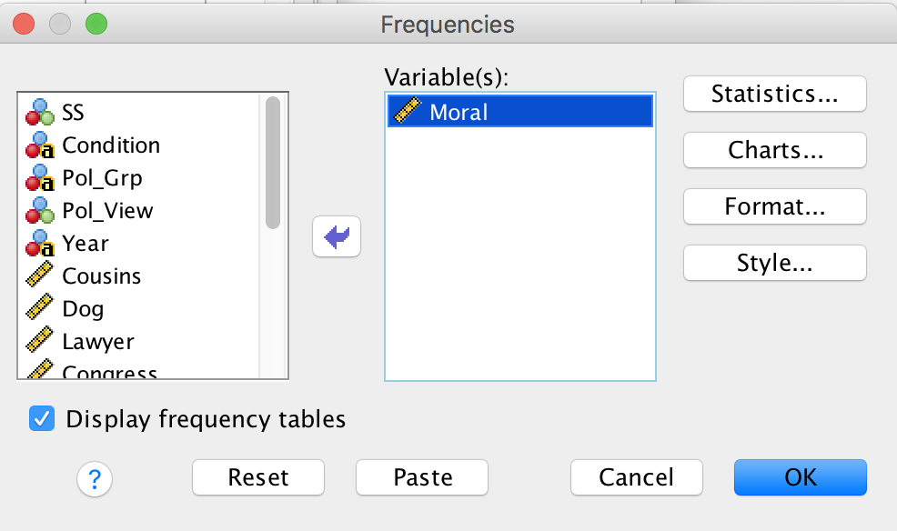
Means and Standard Deviations
Select the Statistics you want to see
  Mean, Median, Mode, Std. Deviation, Variance
Click Continue.
Then click OK.

Slide 5
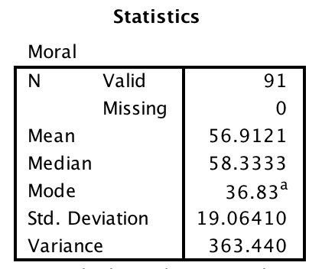
Means and Standard Deviations

Slide 6
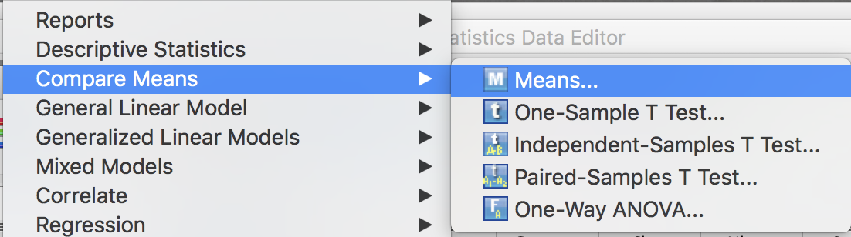
Means and Standard Deviations: By Groups
Go to Analyze → Compare Means → Means

Slide 7
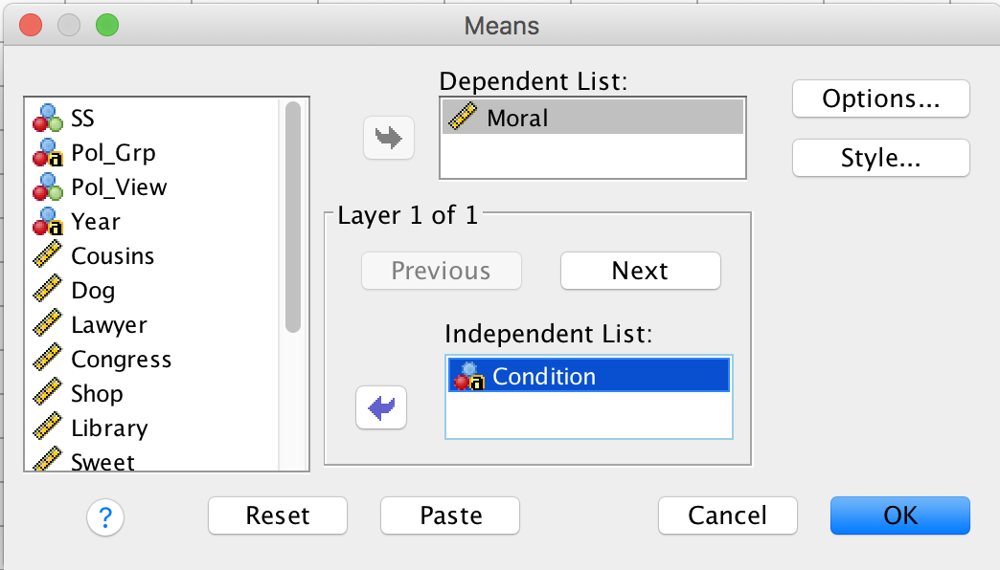
Means and Standard Deviations: By Groups
Choose yourDV and slide it into the top box.
Choose yourIV and slide it into the bottom box.
If you have a 2nd IV, click Next and slide the 2nd IV into the lower box (etc.)
Click OK

Slide 8
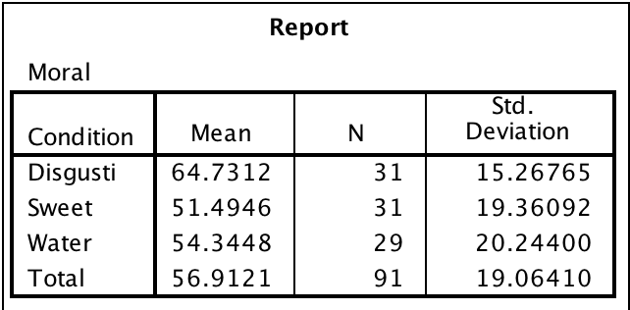
Means and Standard Deviations: By Groups

