Slide 1
Instrux for conducting different analyses in SPSS
Finding Means and Standard Deviations
Independent samples t-test
Paired samples t-test
One-way ANOVA (RM ANOVA)
Factorial ANOVA (RM Factorial ANOVA)
Correlation
Regression

Slide 2
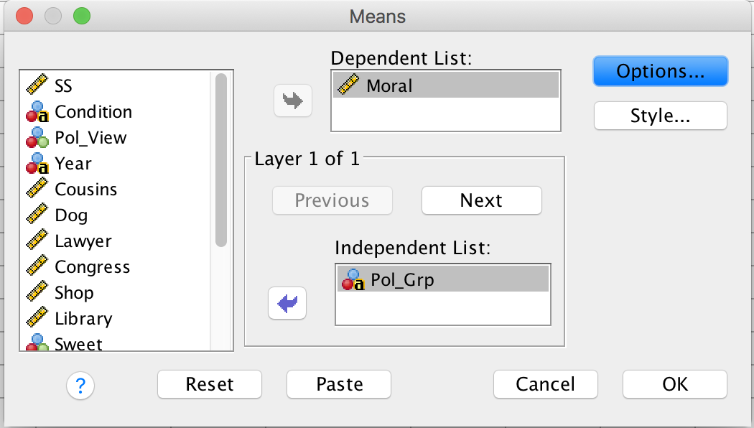
Independent Samples t-test
First, let’s find the means and standard deviation of your dependent variable rating for the conservative and liberal groups.
Analyze → Compare Means → Means
Slide yourDV into the box labeled Dependent Variable
Slide yourIV into the box labeled Independent Variable
Click OK.

Slide 3
Independent Samples t-test
Analyze → Compare Means→ Independent Samples T-Test

Slide 4
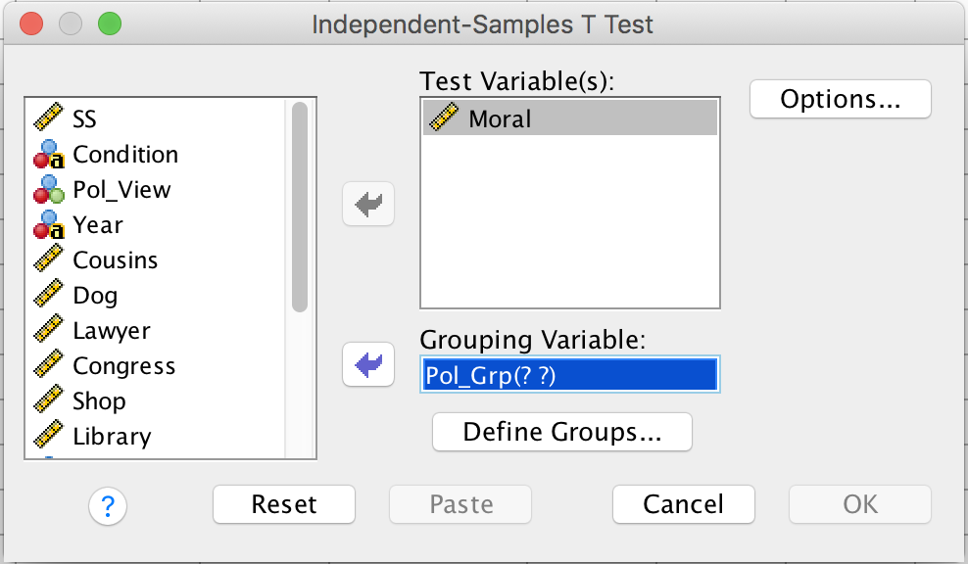
Independent Samples t-test
Slide yourDV into the box labeled Test Variable
Slide yourIV into the box labeled Grouping Variable
Then click Define Groups

Slide 5
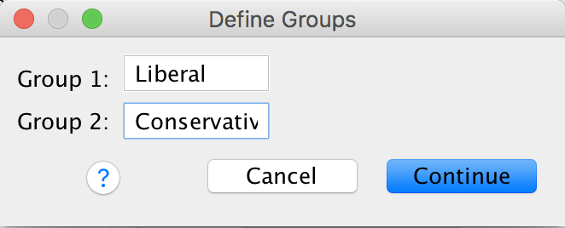
Independent Samples t-test
Enter level1 and level2 in the boxes labeled Group 1 and Group 2.
The order does not matter, but the spelling does!!!
Then click Continue.
Then click OK.

