Slide 1
Instrux for conducting different analyses in SPSS
Finding Means and Standard Deviations
Independent samples t-test
Paired samples t-test
One-way ANOVA (RM ANOVA)
Factorial ANOVA (RM Factorial ANOVA)
Correlation
Regression

Slide 2
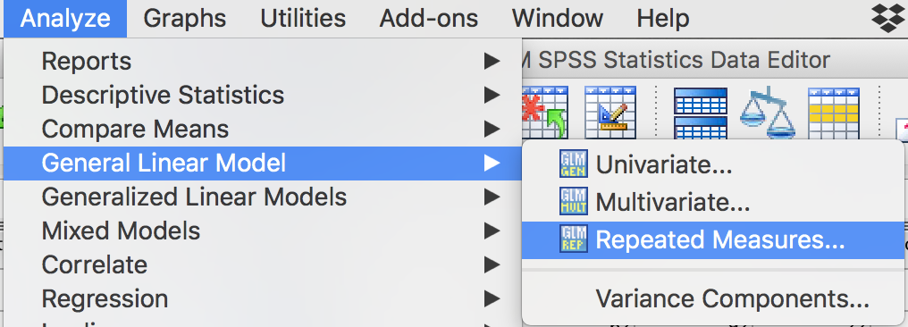
Repeated Measures ANOVA
Analyze → General Linear Model → Repeated Measures

Slide 3
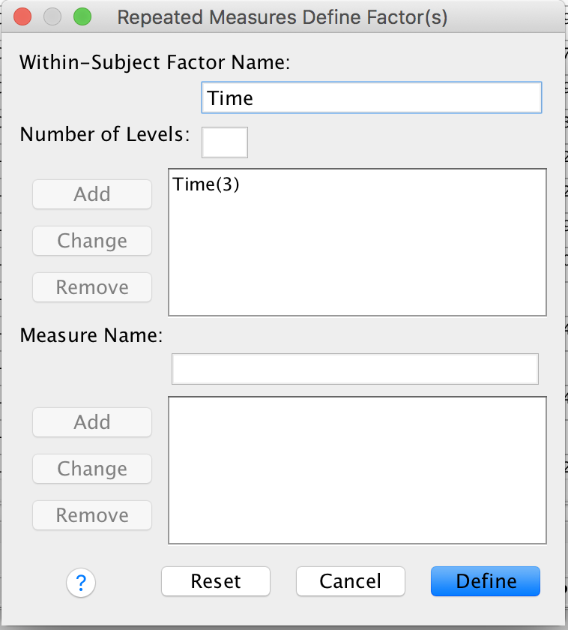
Repeated Measures ANOVA
You need to name your RM factor. Let’s call it Time. Type Time in the box labeled Within-Subject Factor Name.
Time has 3 levels, so enter 3 in the box labeled Number of Levels.
Click Add.
Click Define.

Slide 4
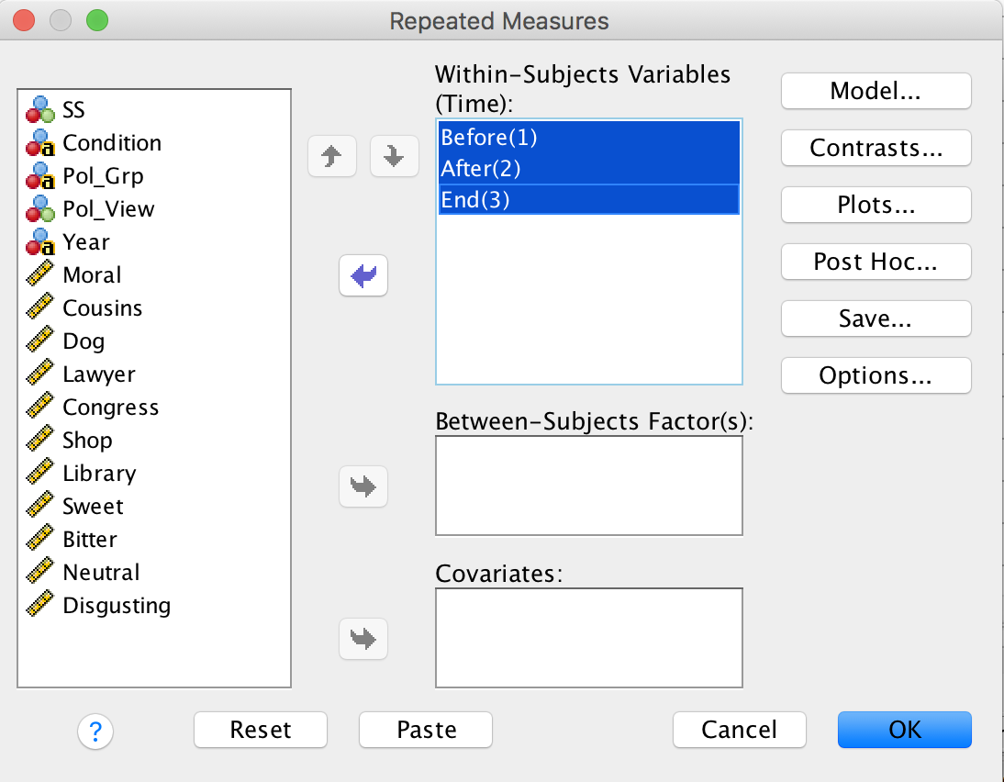
Repeated Measures ANOVA
We need to tell SPSS what variables constitute our three levels of Time.
Slide Before, After, and End into the box labeled Within Subjects Variables (Time).
Then click Options.

Slide 5
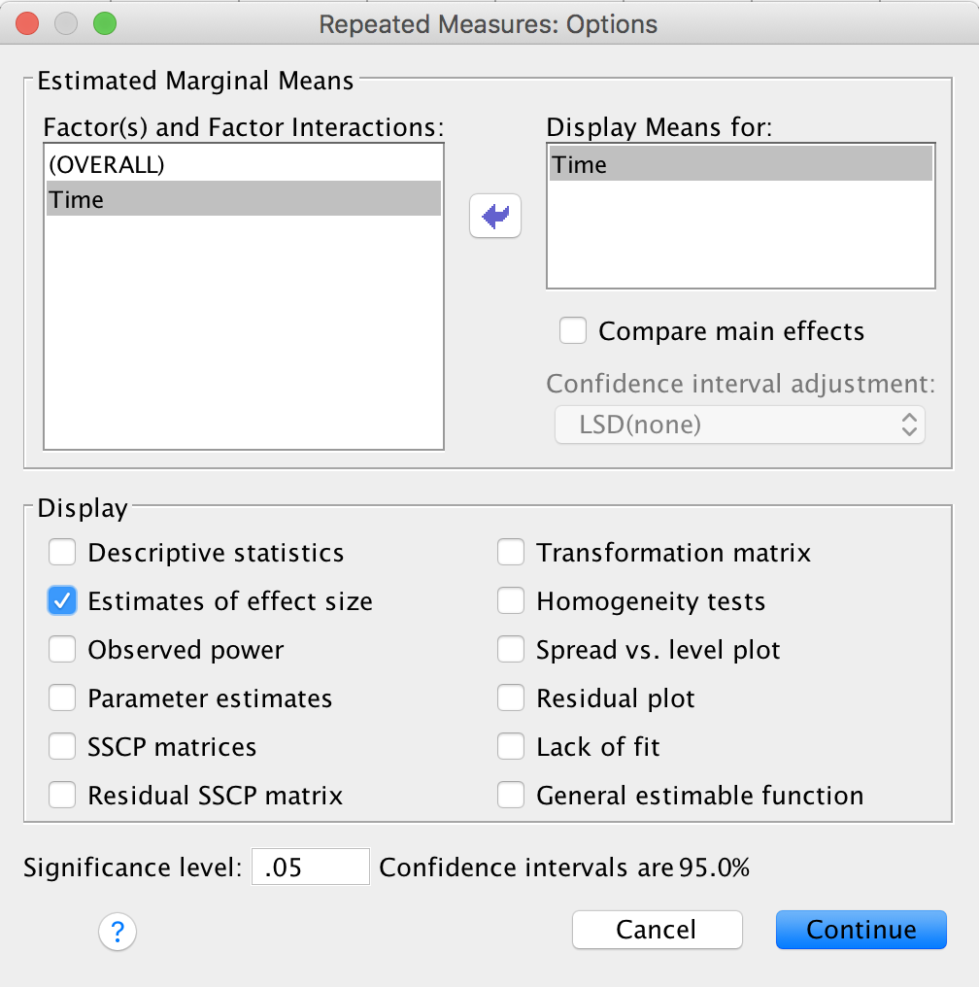
Repeated Measures ANOVA
Slide Time into the box labeled Display Means for
Then click the check box labeled Estimates of effect size
Then click Continue.

Slide 6
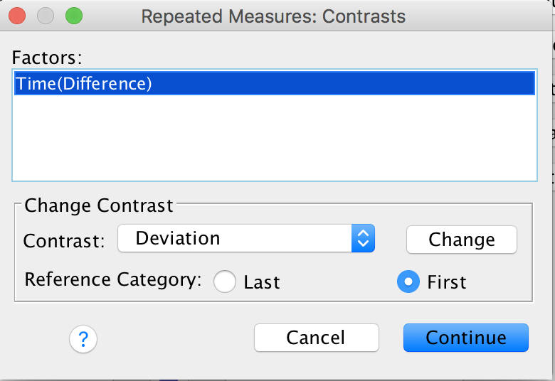
Repeated Measures ANOVA
We can’t click on Post-hoc because SPSS doesn’t do post-hoc tests for RM variables.
So, click on Contrasts, instead.
Find Difference in the Contrast box; then click Change.
Click Continue.
Then click OK on the main screen.

