Slide 1
Instrux for conducting different analyses in SPSS
Finding Means and Standard Deviations
Independent samples t-test
Paired samples t-test
One-way ANOVA (RM ANOVA)
Factorial ANOVA (RM Factorial ANOVA)
Correlation
Regression

Slide 2
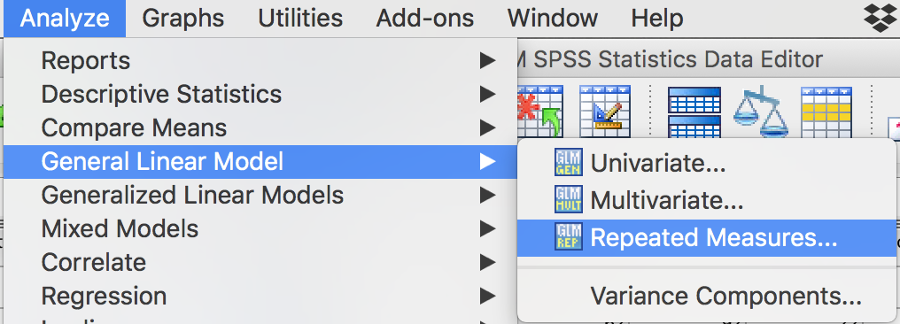
Repeated Measures Factorial ANOVA
Analyze → General Linear Models → Repeated measures

Slide 3
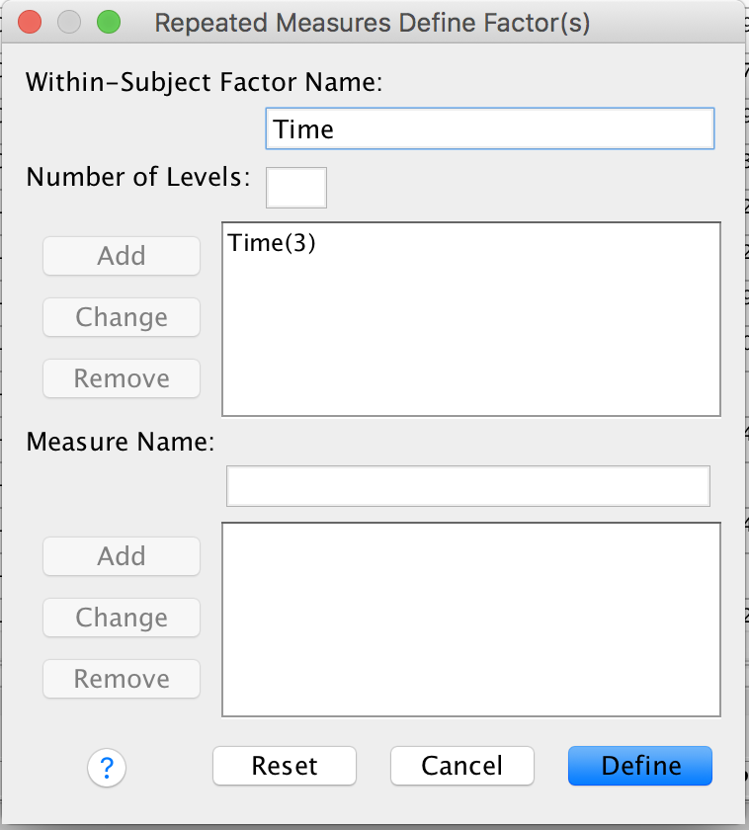
Repeated Measures Factorial ANOVA
We need to name our RM factor. Let’s call it Time. Type Time in the box labeled Within-Subject Factor Name.
Time has 3 levels, so enter 3 in the box labeled Number of Levels.
Click Add.
Repeat these steps for any additional repeated measures IVs.
Click Define.

Slide 4
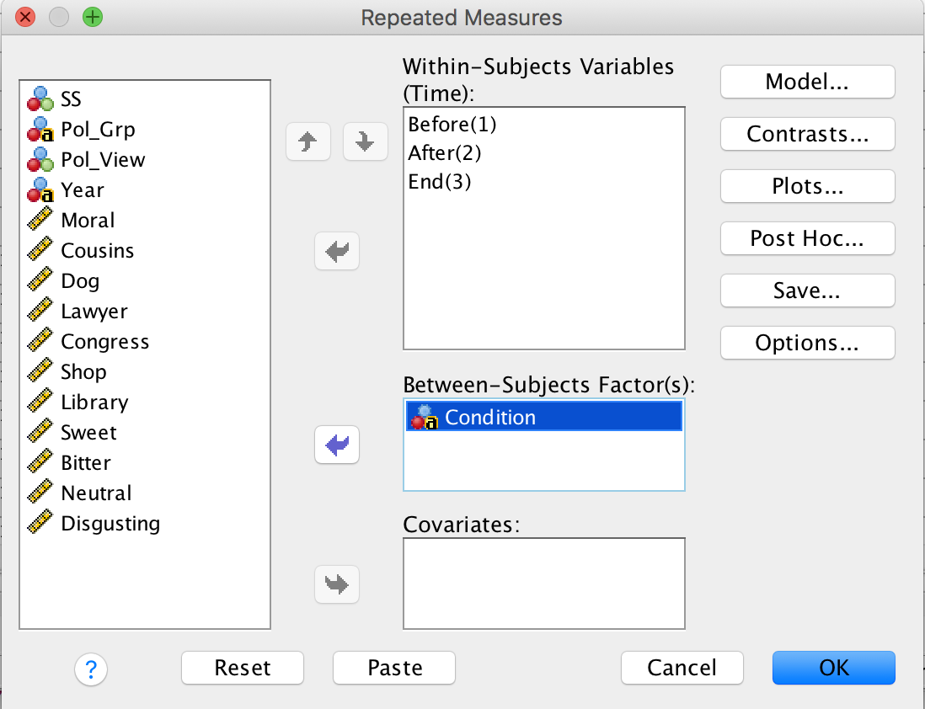
Repeated Measures Factorial ANOVA
Slide the levels of your IV (Before, After, and End in this example) into the box labeled Within Subjects Variables (Time).
Do the same for any other repeated measures IV.
If you have a between subjects IV, slide it into the into the box labeled Between-Subjects Factor(s) (Condition in this example).
Then click Options.

Slide 5
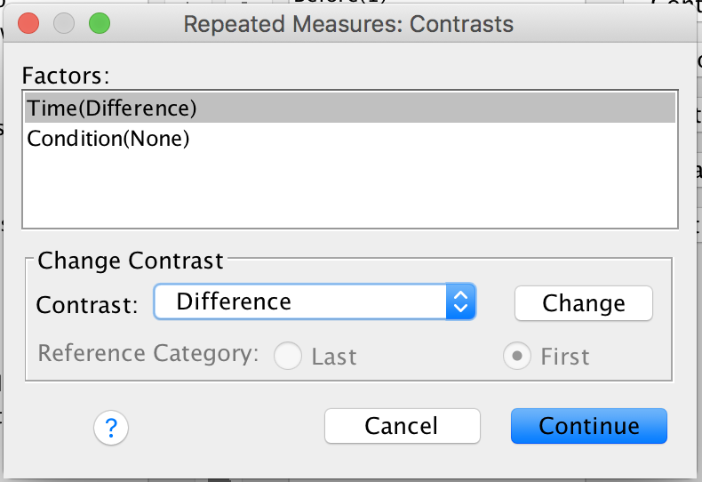
Repeated Measures Factorial ANOVA
SPSS doesn’t do post-hoc tests for RM variables.
So, click on Contrasts, instead.
Find Difference in the Contrast box; then click Change.
Click Continue.

Slide 6
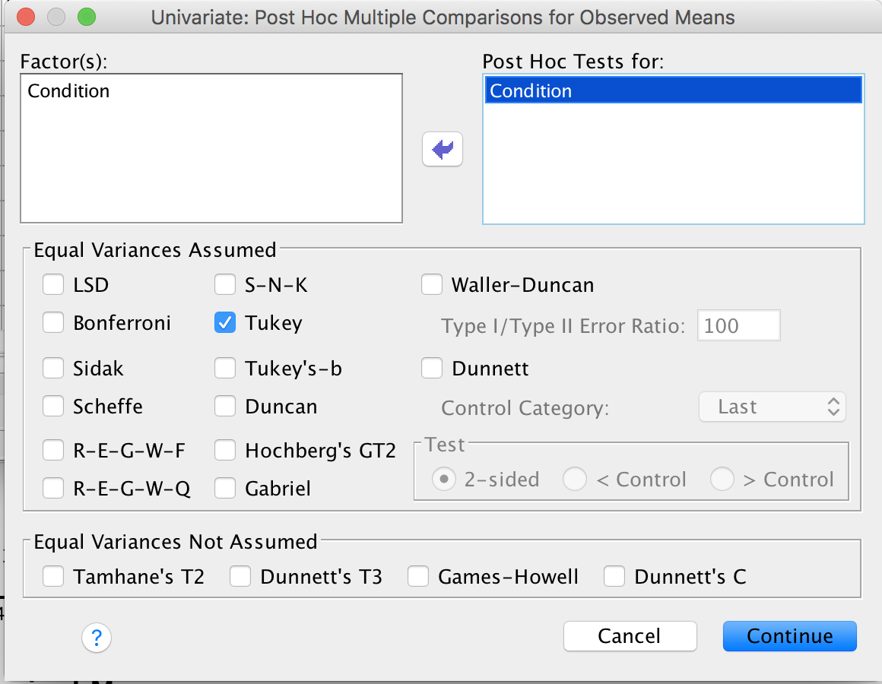
Repeated Measures Factorial ANOVA
If you have a between subjects IV, click Post-Hoc.
Slide Condition into the box labeled Post Hoc Tests for .
Then click the check box for Tukey .
Then click Continue.
Then click OK on the main page.

