Slide 1
Reporting your results
From SPSS to the Results section

Slide 2
How to reports results from SPSS
Finding Means and Standard Deviations
Independent samples t-test
Paired samples t-test
One-way ANOVA (RM ANOVA)
Factorial ANOVA (RM Factorial ANOVA)
Correlation
Regression

Slide 3
How to reports results from SPSS
Finding Means and Standard Deviations
Independent samples t-test
Paired samples t-test
One-way ANOVA (RM ANOVA)
Factorial ANOVA (RM Factorial ANOVA)
Correlation
Regression

Slide 4
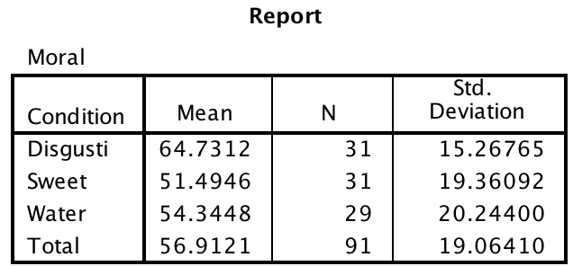
Means and Standard Deviations
_______________________________________
Whereas the disgusting condition yielded a mean disgust rating of 64.7 (SD = 15.3), the sweet condition yielded a mean disgust rating of 51.5 (SD = 19.4) and the water condition yielded a mean disgust rating of 54.3 (SD = 20.2).

Slide 5
How to reports results from SPSS
Finding Means and Standard Deviations
Independent samples t-test
Paired samples t-test
One-way ANOVA (RM ANOVA)
Factorial ANOVA (RM Factorial ANOVA)
Correlation
Regression

Slide 6
Independent samples t-test

Slide 7
Independent samples t-test
An independent samples t-test indicate that there was no significant difference in morality ratings between liberals and conservatives, t (89) = 0.691, p = .492. Conservatives (M = 59.0, SD = 19.0) did not rate the vignettes as more immoral than liberals (M = 56.0, SD = 19.1).

Slide 8
How to reports results from SPSS
Finding Means and Standard Deviations
Independent samples t-test
Paired samples t-test
One-way ANOVA (RM ANOVA)
Factorial ANOVA (RM Factorial ANOVA)
Correlation
Regression

Slide 9
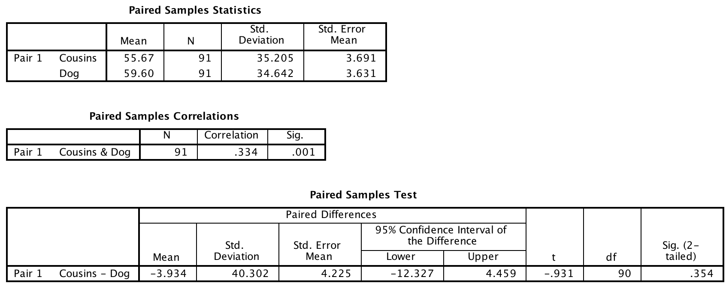
Paired Samples t-test

Slide 10
Paired samples t-test
An paired samples t-test indicate that there was not a significant difference in disgust ratings between the ‘cousins’ (M = 55.7, SD = 35.2) and ‘dog’ vignettes (M = 59.6, SD = 34.6), t (90) = -0.931, p = .354.

Slide 11
How to reports results from SPSS
Finding Means and Standard Deviations
Independent samples t-test
Paired samples t-test
One-way ANOVA (RM ANOVA)
Factorial ANOVA (RM Factorial ANOVA)
Correlation
Regression

Slide 12
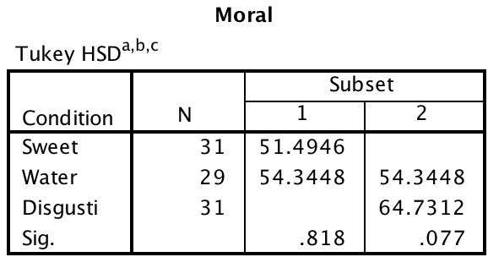
One-way between subjects ANOVA

Slide 13
One-way between subjects ANOVA
The one-way ANOVA indicated that there was a significant effect of condition on moral judgments, F (2, 88) = 4.437, p < .015, η² = .092. Post-hoc tests indicated that people in the disgusting jellybean condition (M = 64.7, SE= 3.30) had significantly harsher morality judgments than people in the sweet condition (M = 51.5, SD = 3.30). The water condition (M =54.3, SD = 3.4) did not differ significantly from either the disgusting condition or the sweet conditions.

Slide 14
How to reports results from SPSS
Finding Means and Standard Deviations
Independent samples t-test
Paired samples t-test
One-way ANOVA (RM ANOVA)
Factorial ANOVA (RM Factorial ANOVA)
Correlation
Regression

Slide 15
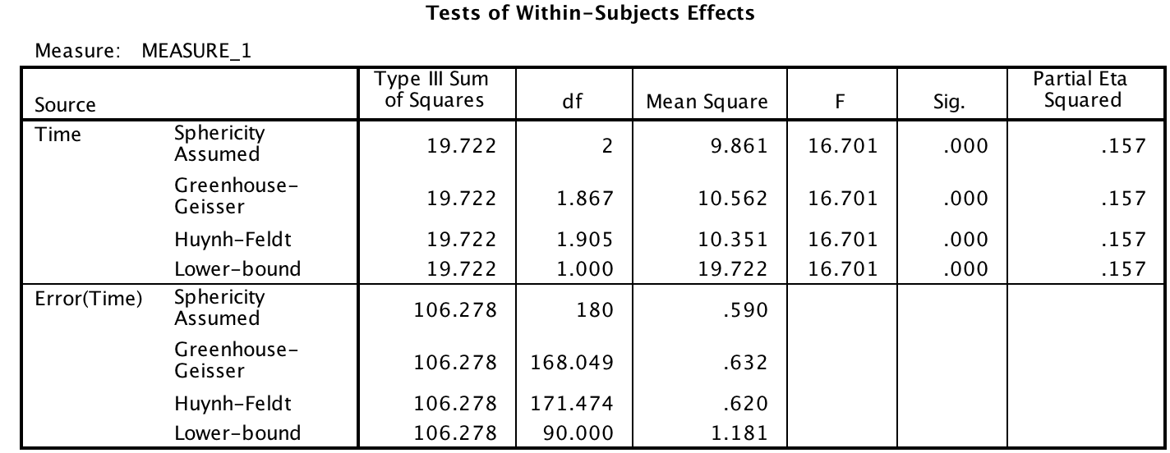
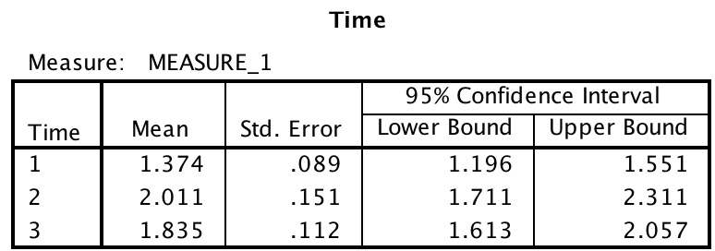
One-way repeated measures ANOVA

Slide 16
One-way repeated measures ANOVA
The repeated measures one-way ANOVA indicated that there was a significant effect of timing on feelings of disgust, F (2, 180) = 16.701, p < .001, η² = .157. Post-hoc tests indicated that people experienced less disgust at the beginning of the experiment (M = 1.37, SE = 0.09) than they did after consuming the jelly bean (M = 2.01, SE = 0.15) or at the end of the experiment (M =1.83, SE = 0.11). The latter two conditions did not differ from one another.

Slide 17
How to reports results from SPSS
Finding Means and Standard Deviations
Independent samples t-test
Paired samples t-test
One-way ANOVA (RM ANOVA)
Factorial ANOVA (RM Factorial ANOVA)
Correlation
Regression

Slide 18
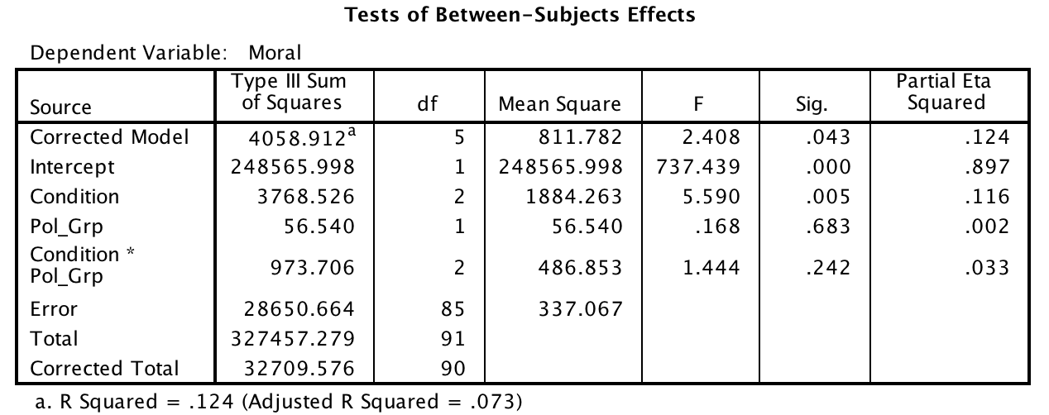
Factorial between subjects ANOVA

Slide 19
Factorial between subjects ANOVA
A 3 x 2 ANOVA was conducted to examine whether morality judgments were influenced by condition and political views. The omnibus test was significant, F (5, 85) = 2.408, MSE = 337.07, p = .043, η² = .124; at least one of our independent variables affected morality judgments. There was a significant main effect of condition, F (2, 85) = 5.590, MSE = 337.07, p < .005, η² = .116; participants had harsher judgements in the disgusting condition than in the water or sweet condition. The main effect of political views was not significant, F (1, 85) = 0.168, MSE = 337.07, p = .683, η² = .002; conservative participants gave harsher judgments than liberal participants did. The interaction of condition and political views was not significant, F (2, 85) = 1.444, MSE = 337.07, p = .242, η² = .033.

Slide 20
How to reports results from SPSS
Finding Means and Standard Deviations
Independent samples t-test
Paired samples t-test
One-way ANOVA (RM ANOVA)
Factorial ANOVA (RM Factorial ANOVA)
Correlation
Regression

Slide 21
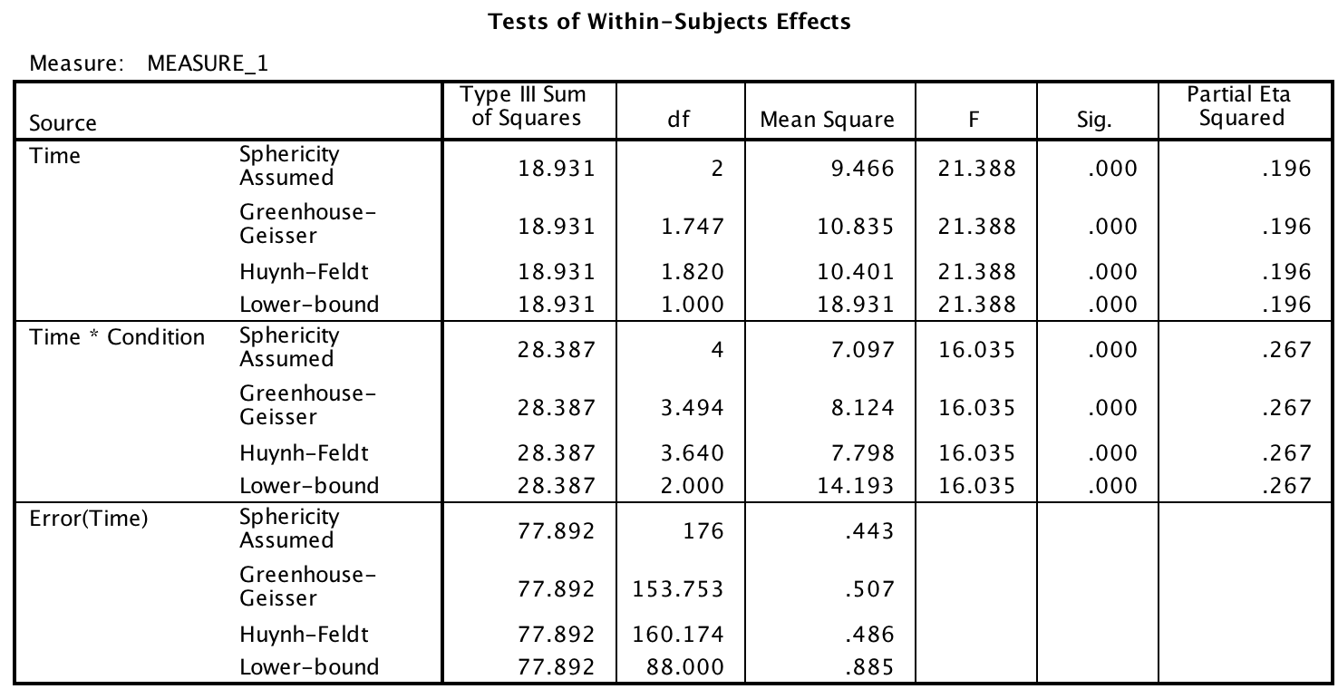
Repeated measures factorial ANOVA

Slide 22
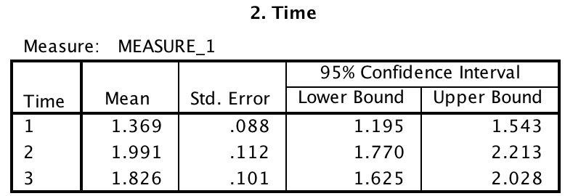
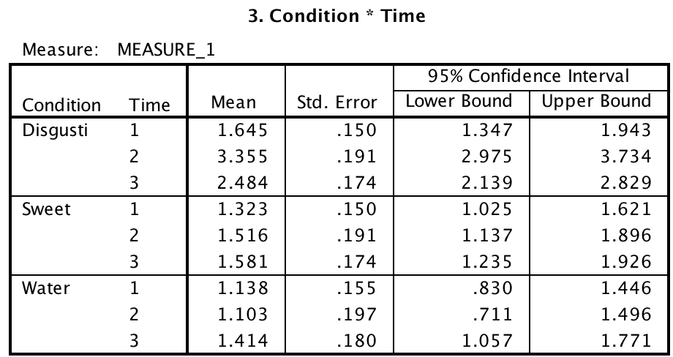
Repeated measures factorial ANOVA

Slide 23
Repeated measures factorial ANOVA
A 3 x 2 ANOVA was conducted to examine whether judgments of disgust varied as a function of timing and condition (see Figure 1). There was a significant main effect of timing, F (2, 176) = 21.388, MSE = 0.44, p < .001, η² = .196; participants felt more disgust after the manipulation and at the end of the experiment than they did in the beginning. The main effect of condition was not significant, F (2, 88) = 22.163, MSE = 0.63, p = .001, η² = .335; disgust ratings were higher in the disgusting condition than in the sweet or water conditions. The interaction of timing and political views was not significant, F (4, 176) = 16.035, MSE = 0.44, p < .001, η² = .267. Examining the means in Figure 1 suggests that disgust ratings changed over the course of the experiment, but only in the disgusting condition.

Slide 24
How to reports results from SPSS
Finding Means and Standard Deviations
Independent samples t-test
Paired samples t-test
One-way ANOVA (RM ANOVA)
Factorial ANOVA (RM Factorial ANOVA)
Correlation
Regression

Slide 25
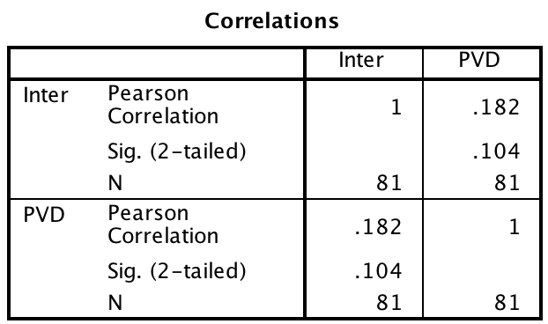
Correlation
There was not a significant correlation between interpersonal disgust and perceived vulnerability to disease, r (79) = .18, p = .104.

Slide 26
How to reports results from SPSS
Finding Means and Standard Deviations
Independent samples t-test
Paired samples t-test
One-way ANOVA (RM ANOVA)
Factorial ANOVA (RM Factorial ANOVA)
Correlation
Simple Regression / Multiple Regression

Slide 27
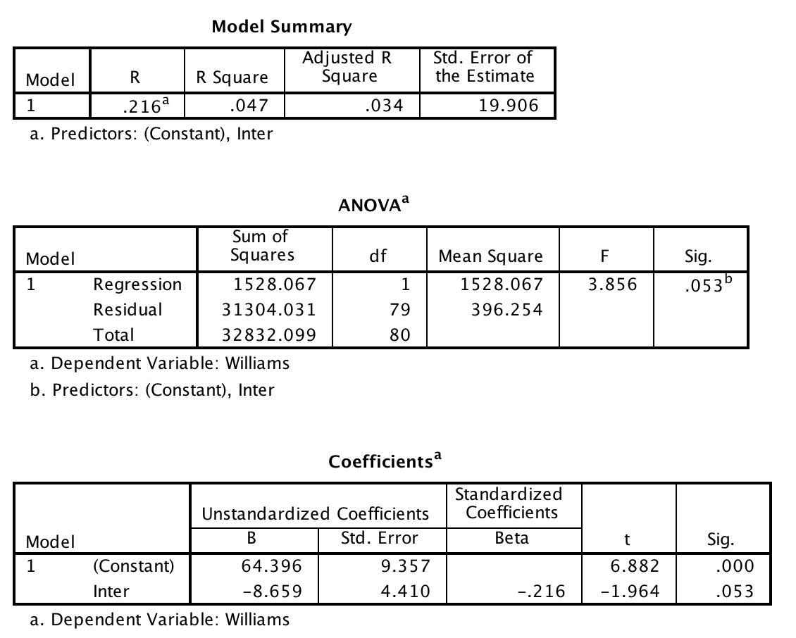
Simple regression

Slide 28
Simple regression
A simple regression indicated that interpersonal disgust explained a marginally significant amount of the variance in Williams college student attitudes, F (1, 79) = 3.856, p = .053, r² = .034. The r² indicates that interpersonal disgust explains 3.4% of the variance in Williams College attitude ratings. The slope of the regression equation was marginally significant (b= -8.659, p = .053) suggesting a significant inverse relationship between interpersonal disgust and attitude ratings.

Slide 29
How to reports results from SPSS
Finding Means and Standard Deviations
Independent samples t-test
Paired samples t-test
One-way ANOVA (RM ANOVA)
Factorial ANOVA (RM Factorial ANOVA)
Correlation
Simple Regression / Multiple Regression

Slide 30
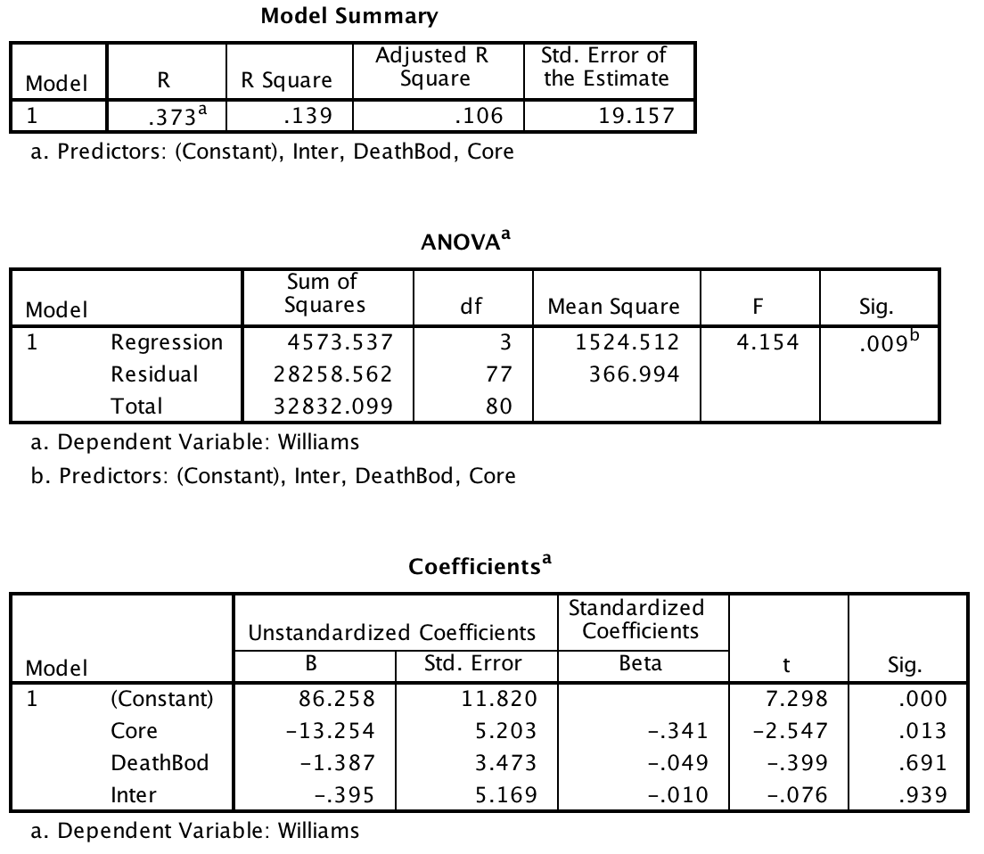
Multiple regression

Slide 31
Multiple regression
A multiple regression analysis indicated that core, interpersonal, and death/body disgust sensitivity explained a significant amount of the variance in attitudes towards Williams college students, F (3, 7) = 4.154, p < .01, R² = .106. The R² indicates that the disgust sensitivity variables explain 10.6% of the variance in attitude ratings. The slope of the regression equation was significant for core disgust (β = -13.254, p = .013), indicating that the more sensitive a person is to core disgust the less they like Williams College students. The slope was not significant for either death/body (β = -1.387, p = .69) or interpersonal disgust (β = -0.395, p = .94) or death/body disgust.

