Slide 1
How to reports results from SPSS
Finding Means and Standard Deviations
Independent samples t-test
Paired samples t-test
One-way ANOVA (RM ANOVA)
Factorial ANOVA (RM Factorial ANOVA)
Correlation
Regression

Slide 2
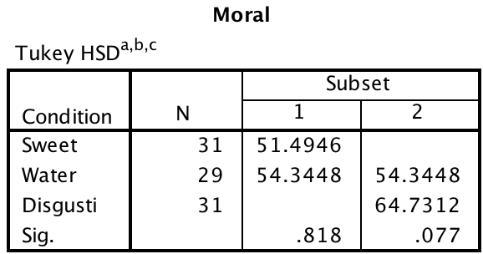
One-way between subjects ANOVA

Slide 3
One-way between subjects ANOVA
The one-way ANOVA indicated that there was a significant effect of condition on moral judgments, F (2, 88) = 4.437, p < .015, η² = .092. Post-hoc tests indicated that people in the disgusting jellybean condition (M = 64.7, SE= 3.30) had significantly harsher morality judgments than people in the sweet condition (M = 51.5, SD = 3.30). The water condition (M =54.3, SD = 3.4) did not differ significantly from either the disgusting condition or the sweet conditions.

