Slide 1
How to reports results from SPSS
Finding Means and Standard Deviations
Independent samples t-test
Paired samples t-test
One-way ANOVA (RM ANOVA)
Factorial ANOVA (RM Factorial ANOVA)
Correlation
Regression

Slide 2
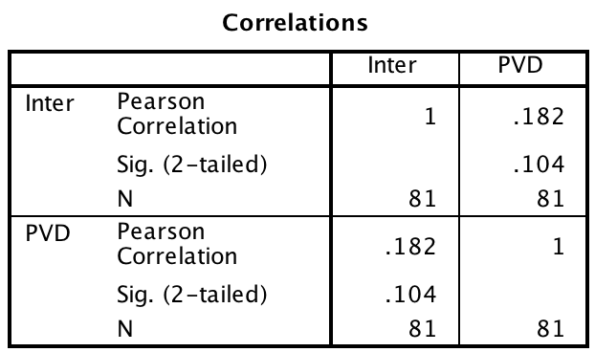
Correlation
There was not a significant correlation between interpersonal disgust and perceived vulnerability to disease, r (79) = .18, p = .104.

