Slide 1
How to reports results from SPSS
Finding Means and Standard Deviations
Independent samples t-test
Paired samples t-test
One-way ANOVA (RM ANOVA)
Factorial ANOVA (RM Factorial ANOVA)
Correlation
Regression

Slide 2
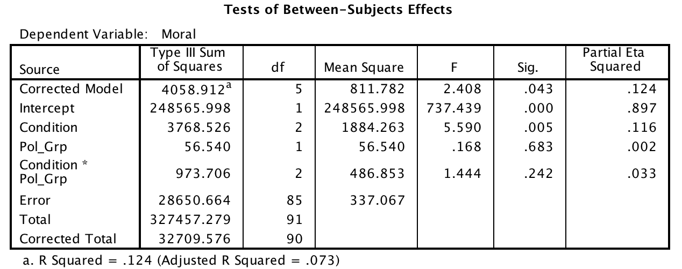
Factorial between subjects ANOVA

Slide 3
Factorial between subjects ANOVA
A 3 x 2 ANOVA was conducted to examine whether morality judgments were influenced by condition and political views. The omnibus test was significant, F (5, 85) = 2.408, MSE = 337.07, p = .043, η² = .124; at least one of our independent variables affected morality judgments. There was a significant main effect of condition, F (2, 85) = 5.590, MSE = 337.07, p < .005, η² = .116; participants had harsher judgements in the disgusting condition than in the water or sweet condition. The main effect of political views was not significant, F (1, 85) = 0.168, MSE = 337.07, p = .683, η² = .002; conservative participants gave harsher judgments than liberal participants did. The interaction of condition and political views was not significant, F (2, 85) = 1.444, MSE = 337.07, p = .242, η² = .033.

