Slide 1
How to reports results from SPSS
Finding Means and Standard Deviations
Independent samples t-test
Paired samples t-test
One-way ANOVA (RM ANOVA)
Factorial ANOVA (RM Factorial ANOVA)
Correlation
Simple Regression / Multiple Regression

Slide 2
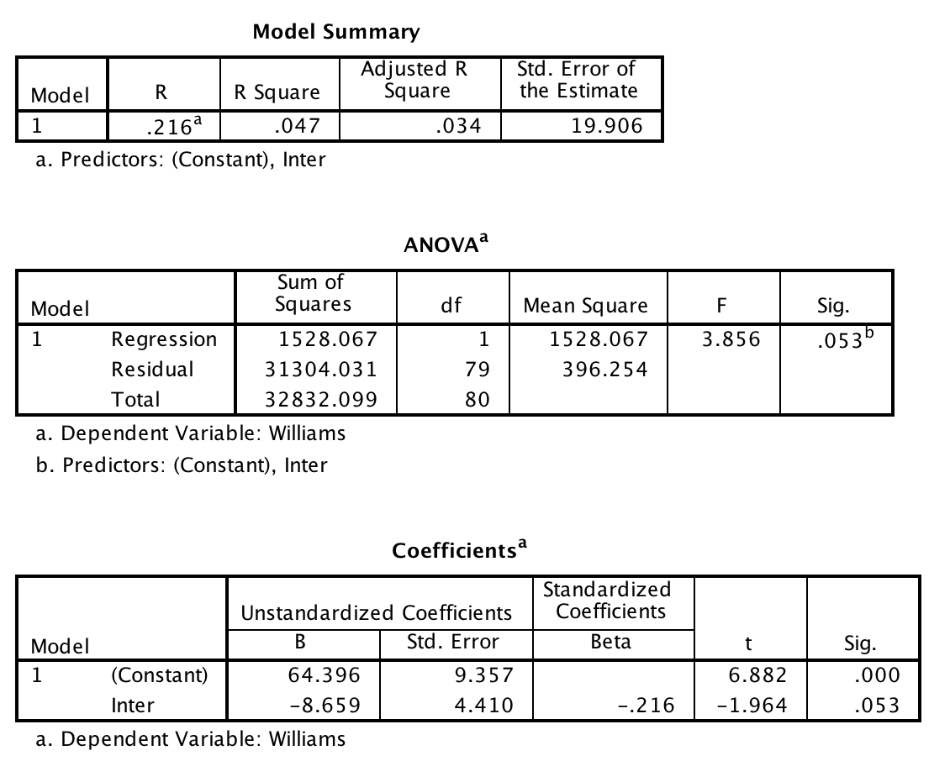
Simple regression

Slide 3
Simple regression
A simple regression indicated that interpersonal disgust explained a marginally significant amount of the variance in Williams college student attitudes, F (1, 79) = 3.856, p = .053, r² = .034. The r² indicates that interpersonal disgust explains 3.4% of the variance in Williams College attitude ratings. The slope of the regression equation was marginally significant (b= -8.659, p = .053) suggesting a significant inverse relationship between interpersonal disgust and attitude ratings.

