Slide 1
Introduction Feedback
General suggestions

Slide 2
Empirical Proposal
General suggestions

Slide 3
Open with something about why the topic is important
Reference the Big Question
In creativity literature, there has been an extensive debate about the extent to which creativity is a fixed trait or something that can be nurtured. Mia H.
However, as collaboration becomes more integral to modern work environments, understanding how group dynamics, such as shared identity and teamwork, influence creativity is crucial. Big J.
Definition of creativity
Doesn’t have to be right at the top, but not a bad entry point.

Slide 4
Transitions are tough

Slide 5
Transitions are tough…MUCH, MUCH BETTER

Slide 6
Transitions are tough
…Yet, this evidence does not confirm that creative performance is malleable because it reflects that creativity is better in those who already possess a strong belief in their creativity.
However, Fodor and Greenier (1995) do show significant evidence that external factors such as positive feedback can affect creativity. Big Li’l

Slide 7
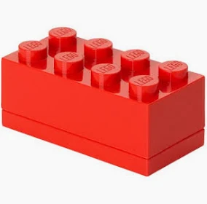
How to present a study
Use evidence from the literature to support your arguments!!!
Main research question
Method
Results
What the results tell us about the main research question.
Transition to the next piece of your argument

Slide 8
How to present a study…EXCELLENT!!!!
Use evidence from the literature to support your arguments!!!
Main research question
Method
Results
What the results tell us about the main research question.
Transition to the next piece of your argument

Slide 9
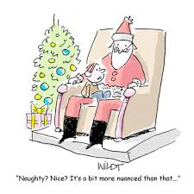
Things to avoid
Starting a paragraph with a citation…Much Better!
Doesn’t tend to generate good transitions
The word nuanced…Are you trying to kill me?
Say what you mean; this word tends to be used when you’re not really sure what you mean
First person pronouns…Pretty good.
I; me; my; we; our
Use ‘The current study…’ instead of ‘Our study’

Slide 10
Opening Paragraph: Roses and Thorns
Do | Avoid
Start with a definition of creativity. | The ‘dawn of time’ opening
Use your definition as a bridge to the main argument. | A complete overview of the paper in the first paragraph.

Slide 11
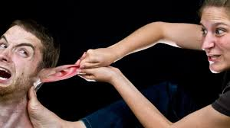
Avoid Unnecessary Adjectives and Adverbs
Critical
Crucial
Incredible
Vital
Important
Instead, use argument and evidence to sell the reader.

Slide 12
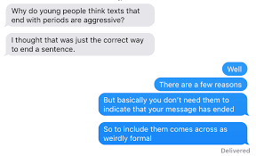
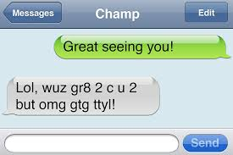
The texting generation gap

Slide 13
Proper citation in the text – Single Author
Parenthetical Citation | (Janis, 1972)
In-text Citation | Janis (1972)
Reference Section | Janis, I. L. (1972). Victims of Groupthink: A psychological study of foreign-policy decisions and fiascoes. The Journal of American History, 60(3), 857. https://doi.org/10.2307/1917768

Slide 14
Proper citation in the text – Two Authors
Parenthetical Citation | (Sordia & Martskvishvili, 2022)
In-text Citation | Sordia and Martskvishvili (2022)
Reference Section | Sordia, N., & Martskvishvili, K. (2022). Creative self and fear of rejection: The role of feedback-related individual characteristics in creativity. Journal of Individual Differences, 43, 115-123. https://doi.org/10.1027/1614-0001/a000365

Slide 15
Proper citation in the text – Three or more Authors
Parenthetical Citation | (Xia, et al., 2022)
In-text Citation | Xia, et al. (2022)
Reference Section | Xia, T., An, Y., & Guo, J. (2022). Bilingualism and creativity: Benefits from cognitive inhibition and cognitive flexibility. Frontiers in Psychology, 13. https://doi.org/10.3389/fpsyg.2022.1016777
AL. is an abbreviation for alia; so it needs a period.

Slide 16
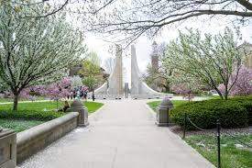
Last thing about in text citations
Two citations in the same Parentheses
(Ashby, et al., 2003; Runco & Bahleta, 1987)
Purdue University
In text citations
Reference section

Slide 17
Using citations economically
Instead of… | Try this…
One study conducted a meta-analysis of 24 other birth order studies, using a multilevel approach (Alabassi et. al, 2020). It compared the results of prior studies | Alabassi, et al. (2020) conducted a meta-analysis of 24 birth order studies using a multilevel approach. They compared the results of prior studies…

Slide 18
Using citations economically
Instead of… | Try this…
The Alptekin and Sarikaya (2022) study examined this by administering Torrance Tests of Creative Thinking (TToCT)… | Alptekin and Sarikaya (2022) examined this by administering Torrance Tests of Creative Thinking (TToCT)…
Adjectives 🤬 | NOUNS!!! 🥳

Slide 19
Phrases to avoid I
When describing results:
It was found that The subjects in the high stress group performed worse than those in the low stress group.
The results/authors showed that Viewing abstract art yielded more responses on an unusual uses task.

Slide 20
Phrases to avoid II
When describing the goals of an experiment:
The authors sought to determine investigated whether feedback would affect creativity.
Ditto for ‘aimed to’; ‘tried to’; and so forth.

Slide 21
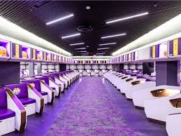
Foul Language
Don’t be like EH18!!!
Don’t use words like A$$e$
It’s just not appropriate
Leave the potty mouth for the locker room, please.

