Slide 1
Welcome to Cognition!
Your lives will never be the same!!!
(in a good way)

Slide 2
Outline
Provide a brief overview of the scientific method.
Define cognition and its various components.
Sensation
Perception
Learning
Memory
Review the philosophical antecedents of cognitive psychology.
Outline the broads themes that unite the discipline and the methods cognitive psychologists use to study behavior.

Slide 3
More cognition…more Problems
Problem #1: The problem is US.
"Man will occasionally stumble over the truth, but most of the time he will pick himself up and continue on."
~ Winston Churchill
“In science it often happens that scientists say, "You know that's a really good argument; my position is mistaken," and then they would actually change their minds and you never hear that old view from them again. They really do it. It doesn't happen as often as it should, because scientists are human and change is sometimes painful. But it happens every day. I cannot recall the last time something like that happened in politics or religion.”
~ Carl Sagan

Slide 4
More cognition…more Problems
Problem #2: The problem is OUR SUBJECTS.
"Under the most rigorously controlled conditions of pressure, temperature, volume, humidity, and other variables, the organism will do as it darn well pleases."
~ Anonymous

Slide 5
More cognition…more Problems
Problem #3: The problem is
The behavior of interest is internal.

Slide 6
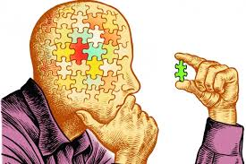
Scientific Method
Observation/Question:
Some interesting phenomenon exists in the world.
Hypothesis:
Speculation as to the cause of the interesting phenomenon
Experimentation:
Experimental Group: includes critical manipulation
Control Group: identical BUT for the critical manipulation
Theory construction:
Based on many experiments
More general than a hypothesis
Repeatable in different paradigms/contexts

Slide 7
Quick Example of the Scientific Method
Observation/Question:
How do we code information in short term memory?
Hypotheses:
sensory (analog) code
propositional (digital) code
Experimentation:
Theory construction:
Working memory
List A | List B

Slide 8
Quick Example of the Scientific Method
Observation/Question:
How do we code information in short term memory?
Hypotheses:
sensory (analog) code
propositional (digital) code
Experimentation:
Theory construction:
Working memory
List A | List B
Short Words | Long Words

Slide 9
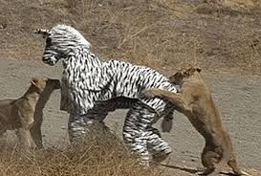
Last Problem
Problem #4: Science ain’t perfect
As an adolescent I aspired to lasting fame, I craved factual certainty… so I became a scientist. This is like becoming an archbishop so you can meet girls.
~ Matt Cartmill

Slide 10
Evaluating Cognition Experiments
Operational Definitions
Were key variables isolated?
Confounds
Covariation
Third variables
How good is the story?
Alternative explanations
Internal consistency

Slide 11
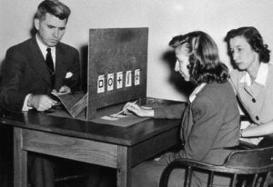
Evaluating Cognition Theories
Must be Falsifiable
ESP
Must be a plausible alternative
Applicable to other experimental paradigms and/or real world situations
Parsimony

Slide 12
Science is hard!!!!
Here is your first test as cognitive psychologists. I want each of you to say a single-digit number. I will respond with another number. Your job is to determine the rule that governs my behavior.
Notes:
Simple Rule = Add 1.

Slide 13
Science is hard!!!!
Here is your first test as cognitive psychologists. I want each of you to say a single-digit number. I will respond with another single-digit number. Your job is to determine the rule that governs my behavior.
Observation | Reality

Slide 14
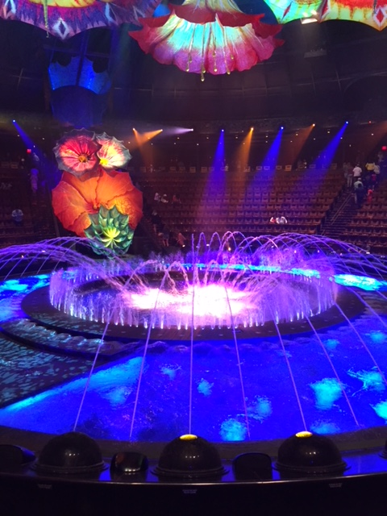
Definition of Cognition
The (study of) mental processes that (typically) people (typically) use to gather, organize, store, retrieve and apply information.
Sensation – gathering information about the environment
Encoding – translating information from world into language of the brain
Perception – interpreting environmental stimulation
Learning/Memory – storage and retrieval of this information; also involves encoding
Thinking - problem solving, decision making, language, etc.

Slide 15
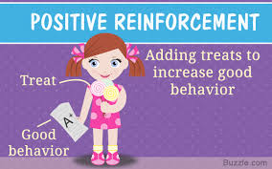
History of Cognitive Science
Empiricism – The mysteries of the world are open to careful, objective observation. (Aristotle)
Tabula Rasa
Associationism
Rationalism – Cogito, ergo sum (Descartes).
Activity of brain produces consciousness or vice versa; mind/brain problem
Objective reality?
EX: my aunt and uncle

Slide 16
History of Cognitive Science II
Introspectionism – The mysteries of cognition are open to careful, inward observation.
Problems: Disagreements / Falsifiability
Bias
Modern empiricism – A systematic observation of what other organisms do is the way to learn about human behavior.
Problems: subconscious bias

Slide 17
Rules of Evidence: Cognitivism v Behaviorism
Behaviorism – (John Watson / B.F. Skinner)
Associationism ‘to the Extreme’
Refusal to presume internal states;
Therefore, measure only observable behavior
Golden Rule: A stimulus elicits a behavior because, in the past history of the organism, that response was rewarded.
Problems with behaviorism
Limits questions, goals, creativity (free will)
Post-hoc explanations
Unsatisfactory explanations (beans)
Does not capture all human behaviors
Language acquisition

Slide 18
Cognitive Revolution: Rationalism meets empiricism!
Rationalist part:
Cogito ergo cognition.
Empiricist part:
Behaviorism: Stim===============>Resp
Cognition: Stim==>Mental Process=>Resp
Goal: Learn about a mental process by determining what interferes with it.
Cognition is the study of failure
EX: TOT, rehearsal
Golden Rule: We infer the existence of internal states based on observable, external behavior.

Slide 19
Big Questions in Cognitive Psychology?
Attention
What is it and how much do we have?
Automaticity vs. Controlled Processing
3x2 vs. 356 x 231 – How do we differentiate them?
Data-driven vs. Conceptually-driven processing
When and to what extent does what we know influence what we see, hear, remember? Ex: Duuuuuuuuuke
Representation
How is the world translated and stored?
Is all information formatted the same way?
Implicit vs. Explicit Memory/Perception
Does the environment affect cognition without our awareness?

Slide 20
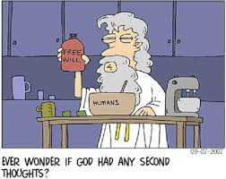
Big Questions in Cognitive Psychology?
Metacognition
How much do we know about what we know?
Nature vs. Nurture
What are we born with, and what do we pick up along the way?
Do all people think the same way?
Free-Will vs. Determinism
Are we free to make our own choices?
Mind-Brain Problem
Is consciousness a divine gift or does it result from biological activity?
Ecological Validity
To what extent does the simplified world of the lab capture the complexity of behavior outside the lab?

Slide 21
Last Big Question in Cognitive Psychology?
The role of inference / reconstruction in cognition.
Does our perception of the world match the physical reality of the environment?
Do our brains faithfully record the past, or does our memory reflect our current/past biases?

