Slide 1
Sensation & Perception

Slide 2
Outline: Sensation and Perception
Define key terms
Describe the relationship between the physical world and its psychological representation (i.e., sensation).
Discuss how we use psychological representations to identify objects (i.e., perception).
template theory
feature theory
prototype theory
Gestalt psychology
Distinguish between top-down and bottom-up processing.
Outline Gibson's 'Direct Perception' approach.

Slide 3
Key Terms
Sensation – receiving physical stimulation and translating it into the electrical language of the nervous system
Perception – interpreting and recognizing sensory information
Key Questions:
    How do we encode information? How is a physical object in the world (distal stimulus) turned into a psychological object (proximal stimulus) in our mind/brain?
    What is the nature of the psychological representations of physical objects?
    How do we use this information to identify objects?

Slide 4
Distal v Proximal Stimuli
Sense | Distal Stimulus | Proximal Stimulus | Our Perception
Vision | Varying pattern of reflected light | Pattern of neural activity | Color
Audition | Varying pattern of air pressure | Pattern of neural activity | Music
Taste | Medley of chemicals | Pattern of neural activity | Chocolate
Smell | Whisper of chemicals | Pattern of neural activity | Frying Bacon
Touch | Skin stretch / indentetation | Pattern of neural activity | Squeeze; Pain

Slide 5
Distal v Proximal Stimuli
Sense | Distal Stimulus | Proximal Stimulus | Our Perception
Vision | Varying pattern of reflected light | Pattern of neural activity | Color
Audition | Varying pattern of air pressure | Pattern of neural activity | Music
Taste | Medley of chemicals | Pattern of neural activity | Chocolate
Smell | Whisper of chemicals | Pattern of neural activity | Frying Bacon
Touch | Skin stretch / indentetation | Pattern of neural activity | Squeeze; Pain
Important Questions:
  Can you think of any other senses?
  Does food have taste? Does light have color?
  Perception vs. imagery

Slide 6
How do we go from distal to proximal?
 | Rods | Cones
How many? | Population of U.S. | Population of N.Y.
What do they react to? | Movement | Color
When do they work best? | Night | Day
Where are they? | Periphery | Center
Specialization | Sensitivity | Acuity
Why this difference in specialization? | Many rods======> One ganglion | One cone======> One ganglion
How do they work | Light bleaches photopigment that by a quasi-mysterious process stimulates a nerve impulse.

Slide 7
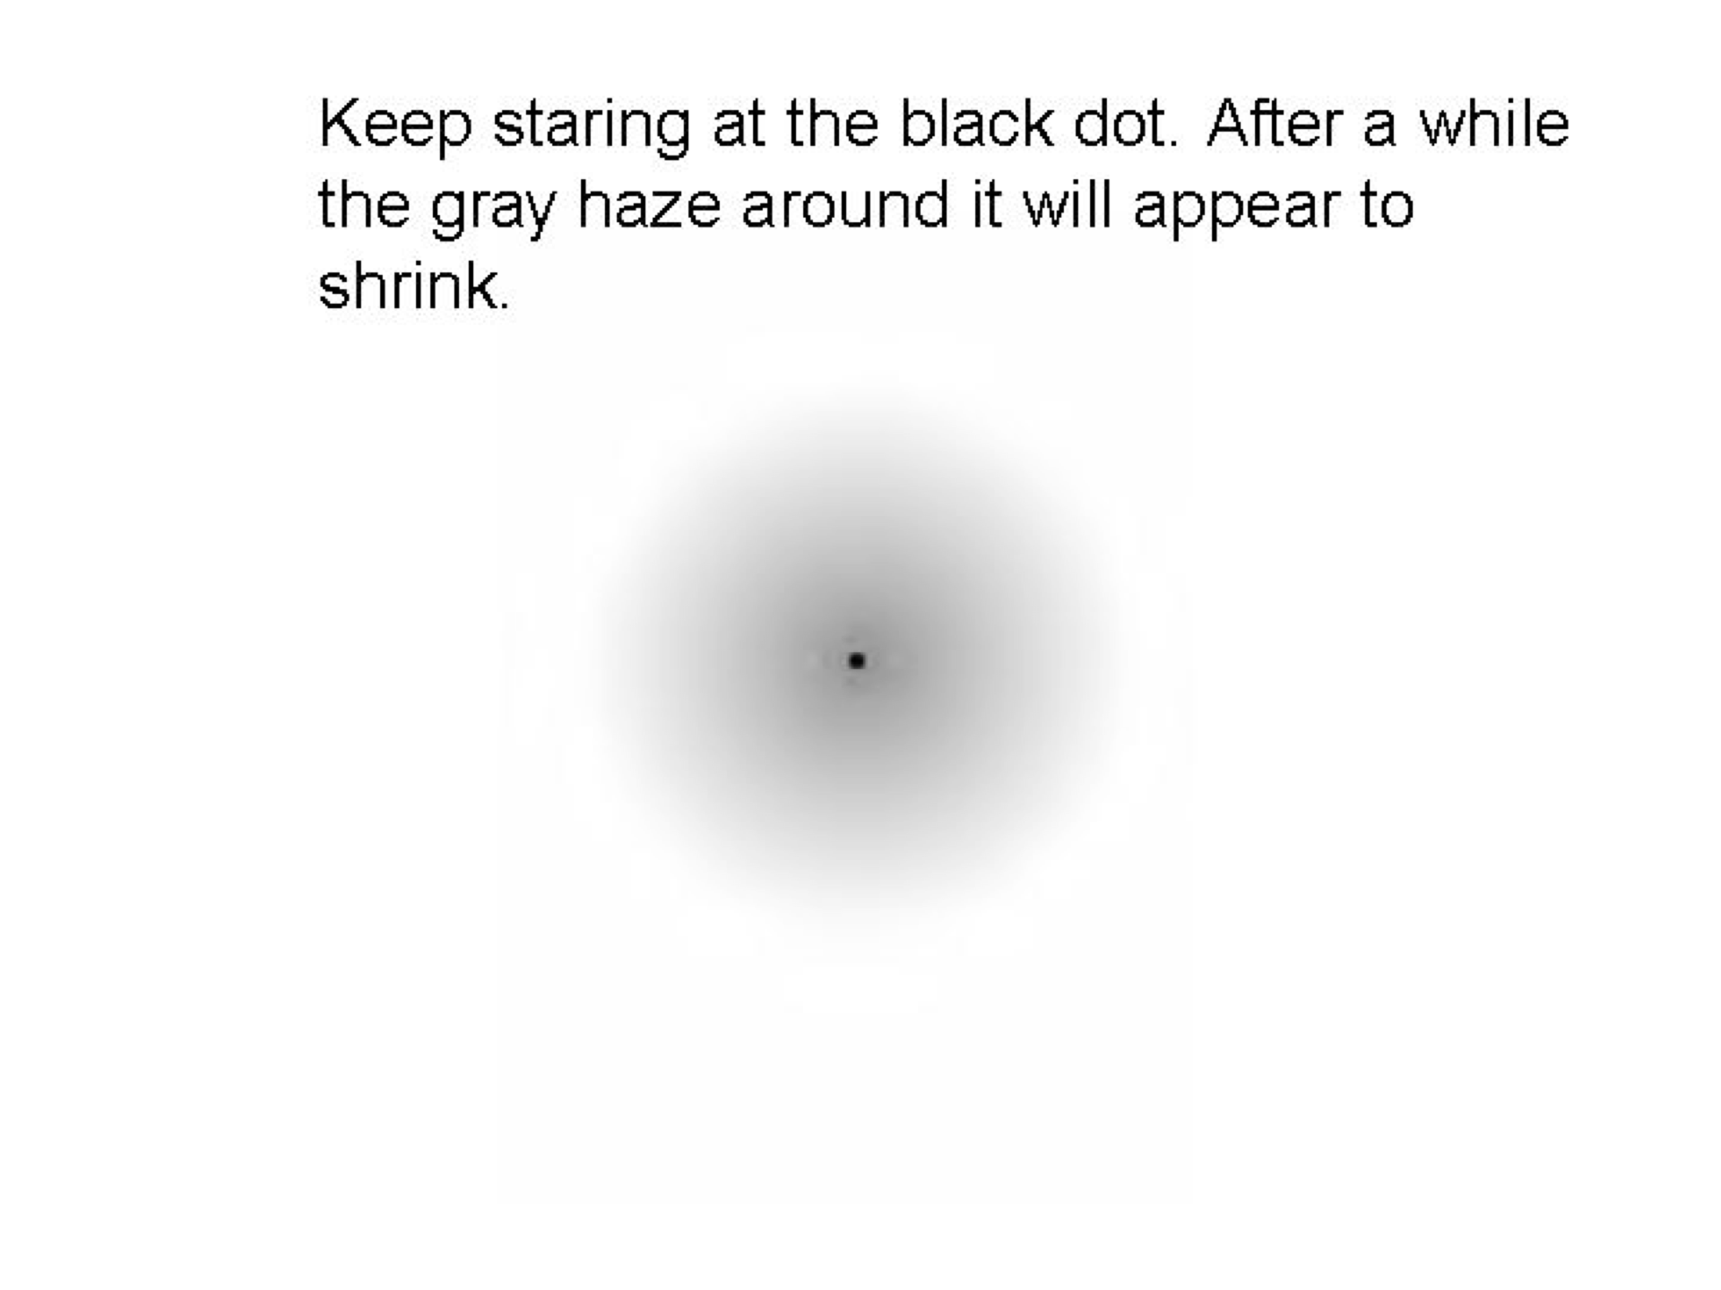
Distribution of rods and cones

Slide 8
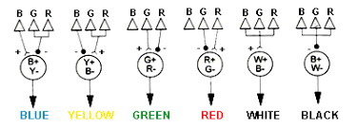
Color Vision
Different types of cones
respond to different wavelengths of light.
Red light =========> Red cone activity ⇑
Blue light =========> Blue cone activity ⇑
Cones work in teams:
red-green & blue-yellow
Red light =========> Red cone activity ⇑
Green cone activity ⇓
Evidence: Color afterimages

Slide 9
Why aren’t these kind of afterimages more common?
Your eyes don’t just sit there!!!
integrates information over saccade.
ballistic movements that your eye makes.
Why do our eyes move?
Nervous system is keyed to detect changes and/or enhance boundaries

Slide 10
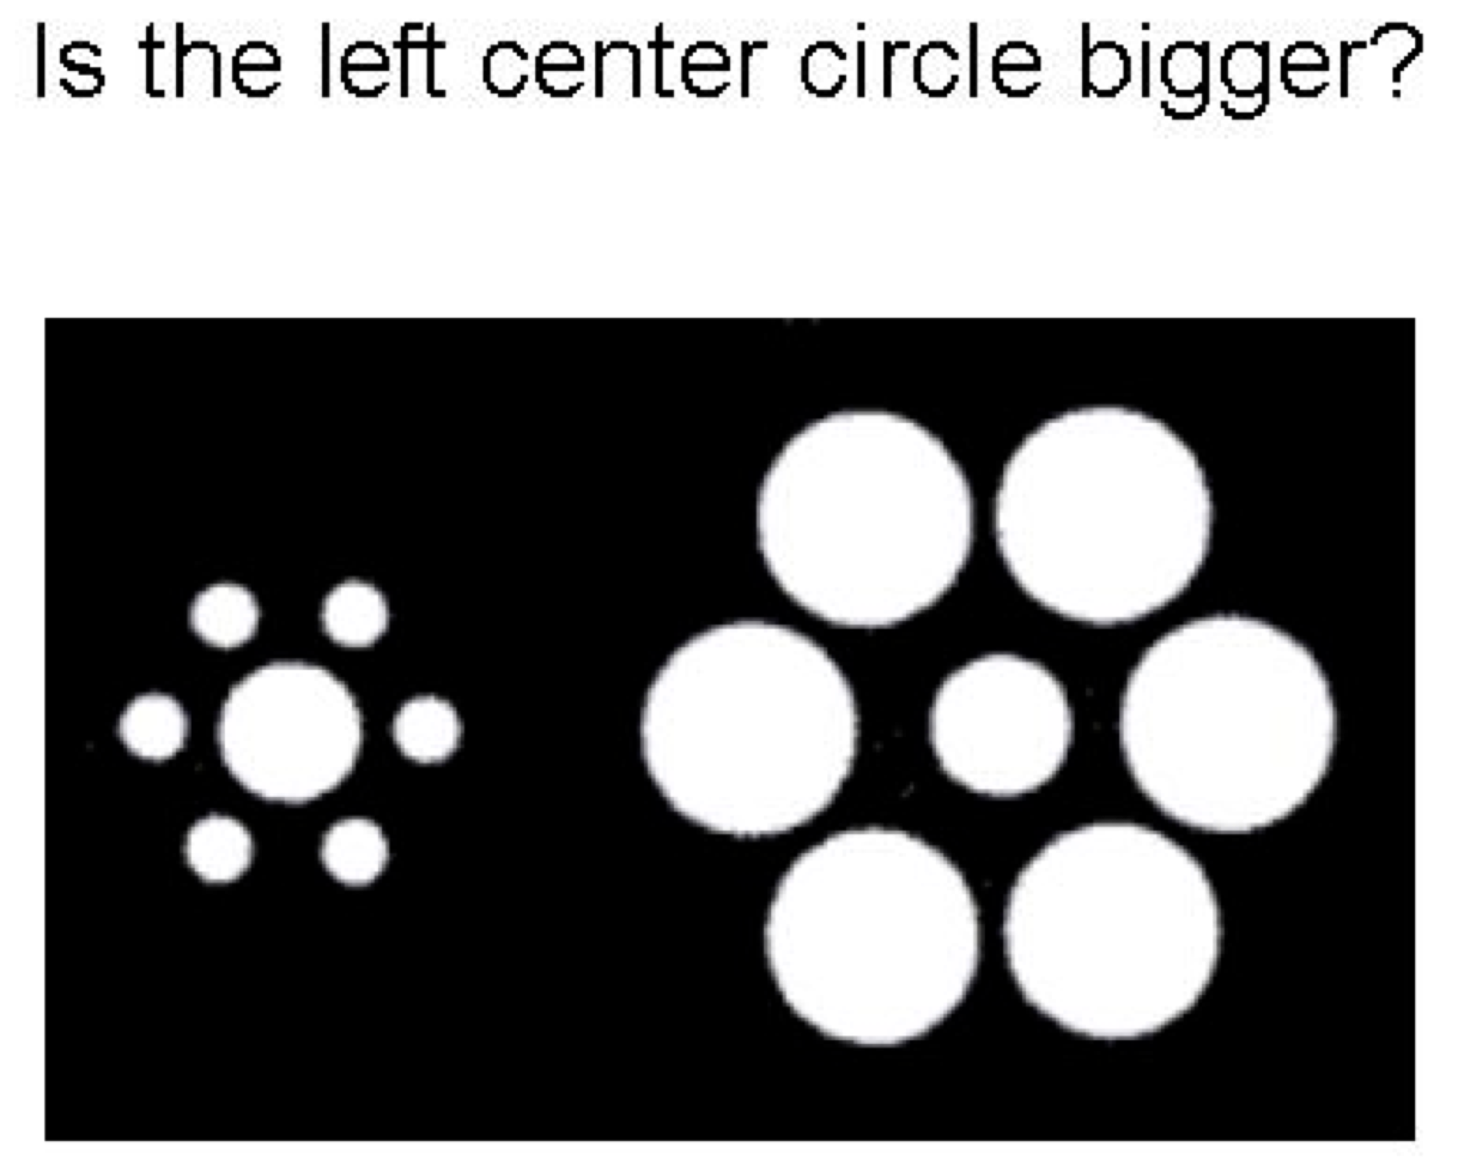
Evidence that nervous system enhances boundaries

Slide 11

Evidence that nervous system enhances boundaries

Slide 12
Evidence that nervous system enhances boundaries

Slide 13
Change / Repetition Blindness
Repetition blindness
Change blindness
  moviemistakes.com

Slide 14
Change Blindness CogLab - Accuracy

Slide 15
Change Blindness CogLab - Latency

Slide 16
Simons & Levin (1998)
Theoretical Question:
  Is focused attention sufficient to detect changes to our physical environment?
Empirical Question:
  Will observers notice a change in appearance in a real-world, dynamic, 3-d display?
Background Literature:
  People have trouble detecting changes in ‘flicker’ paradigm and ‘actor’ paradigm but…
Alternative explanations:
  Is CB a function of limited attention?
  Central vs. peripheral information
  Predictability by naïve subjects

Slide 17
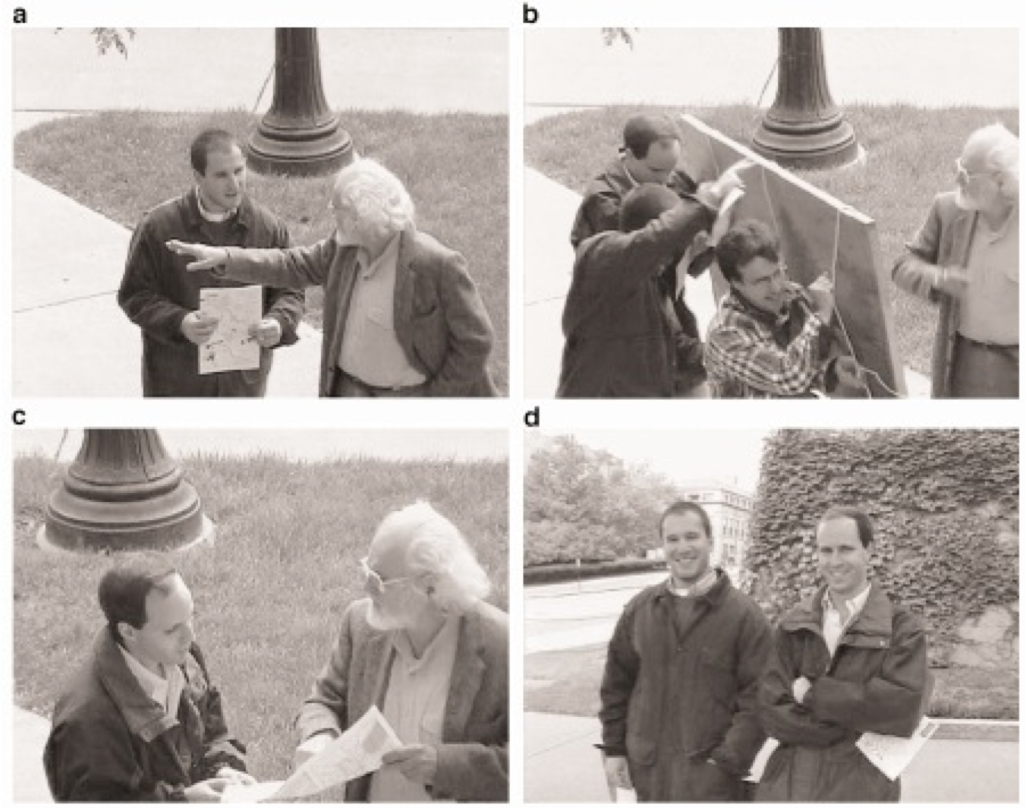
Simons & Levin (1998): Experiment 1
Results:
    Did subjects notice the change?
    Age difference
    Cognitive vs. social explanation

Slide 18
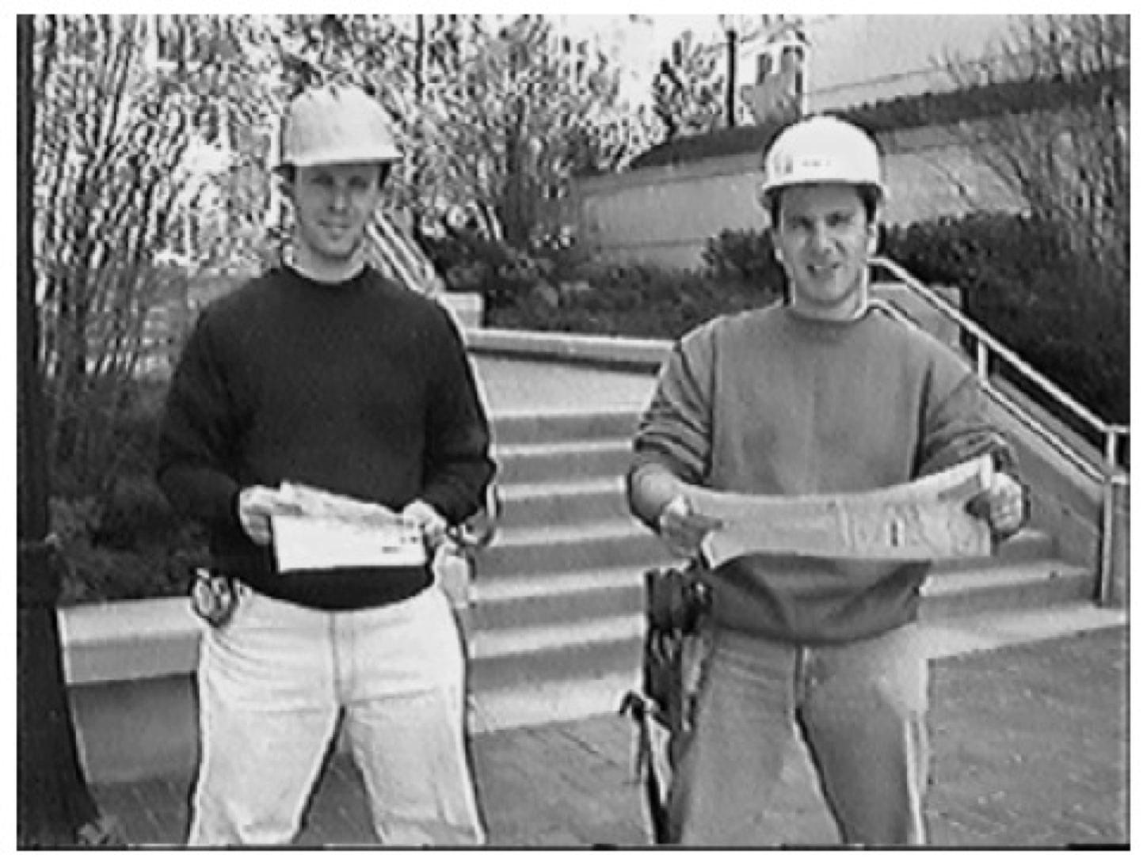
Simons & Levin (1998): Experiment 2
Results:
    Did subjects notice the change?
    Cognitive vs. social explanation

Slide 19
Simons & Levin (1998): Discussion
What are alternative explanations for their data?
Did the social context dis/encourage reporting the change?
Locus of attention / sufficient attention
Which experimental phenomenon do you find more compelling / interesting: Simons and Levin (1998) or the CogLab experiment?
If we do not retain information that is clearly in our view and that we pay attention to, why don’t we make noticeable errors more frequently?
What kinds of changes would you expect to be detected (or fail to be detected) in this paradigm? What does that tell us about perception?

Slide 20
Reading Response

Slide 21
Ventura, et al. (2022)
Theoretical Question:
Empirical Question:
Background Literature:
  What is the ORE?
  What is holistic processing?
  How does holistic processing produce the ORE?
    Why does this happen?
  Pluses and minuses for holistic processing

Slide 22
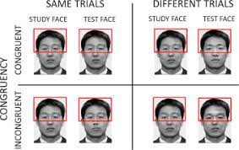
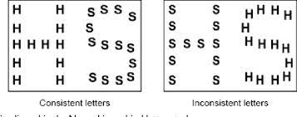
Ventura, et al. (2022)
Theoretical Question:
Empirical Question:
Background Literature:
  What is the ORE?
  What is holistic processing?
  How does holistic processing produce the ORE?
    Why does this happen?
  Pluses and minuses for holistic processing

Slide 23
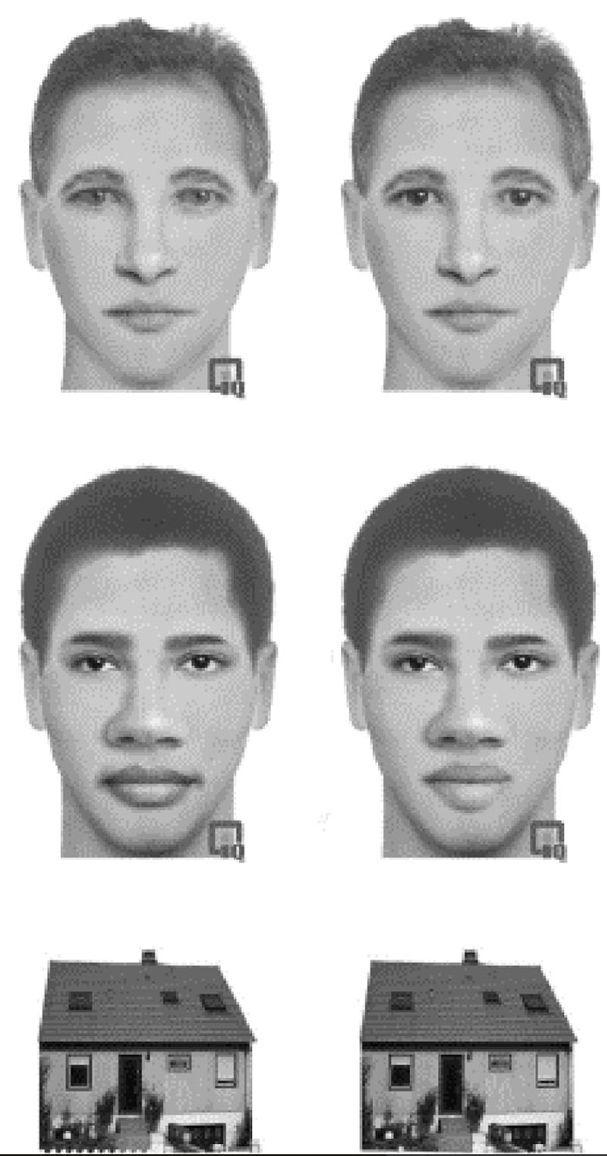
Ventura, et al. (2022)
Method:
  What were the IVs?
    Stimulus type
    Inversion
  What were the DVs?
    Change Detection
    Change Localization
  Other Predictor variables
    Contact with other races

Slide 24
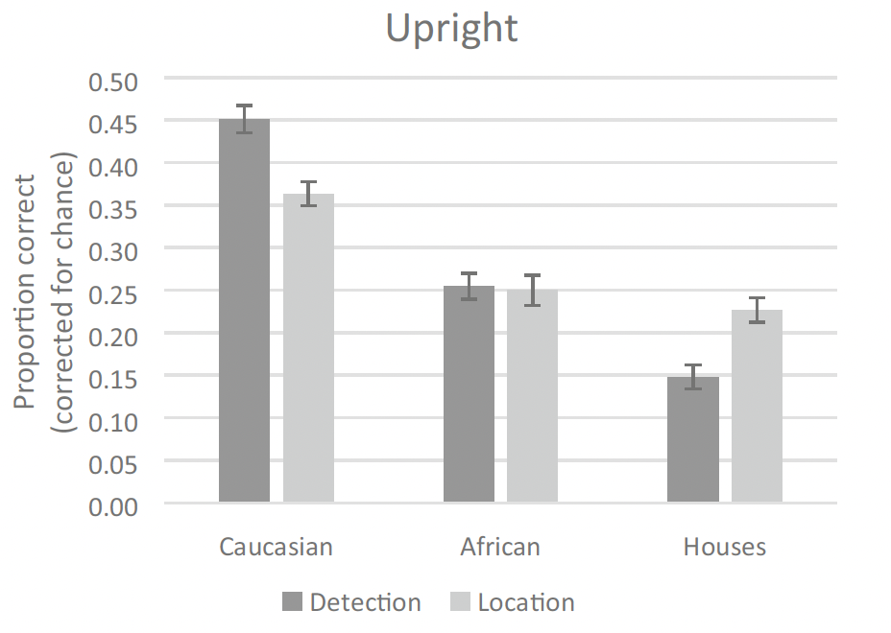
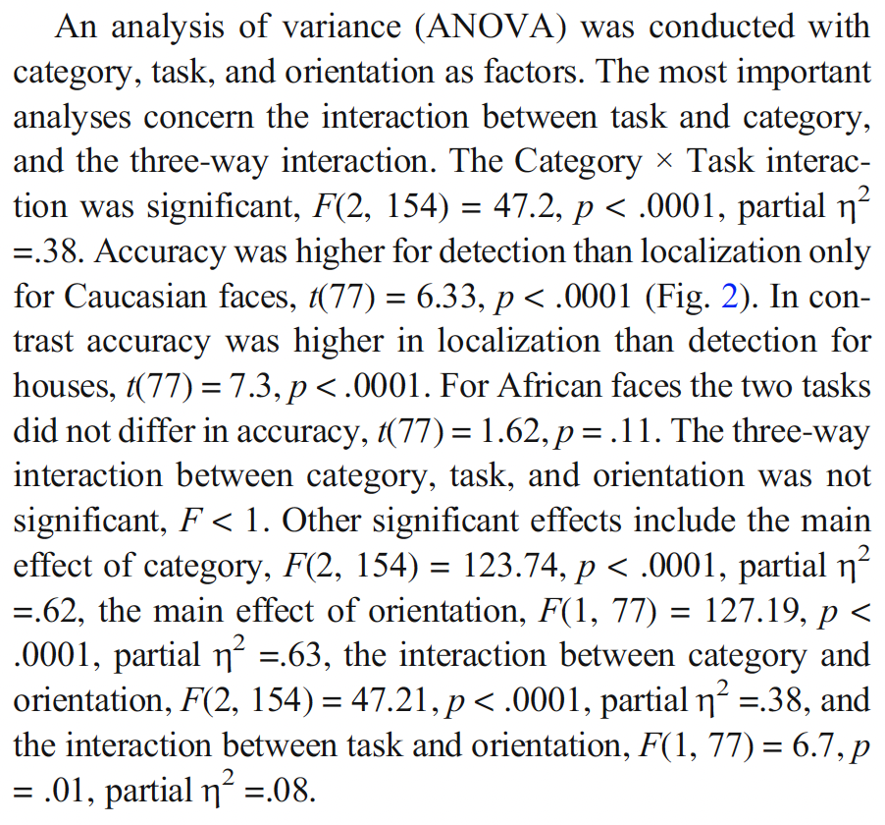
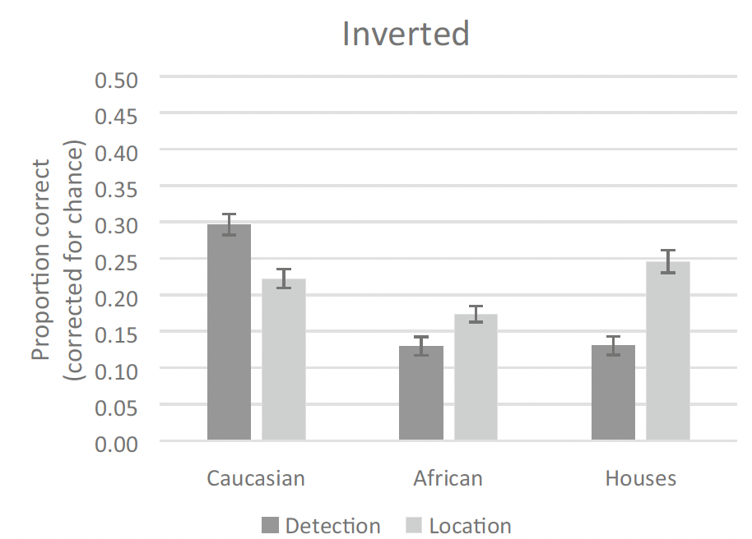
Ventura, et al. (2022)
Intact faces:
Results:

Slide 25
Ventura, et al. (2022)
Did exposure modulate these effects?
  Early exposure was positively correlated with detection, but not localization
  No other correlations were significant
  Are these results consistent with predictions?

Slide 26
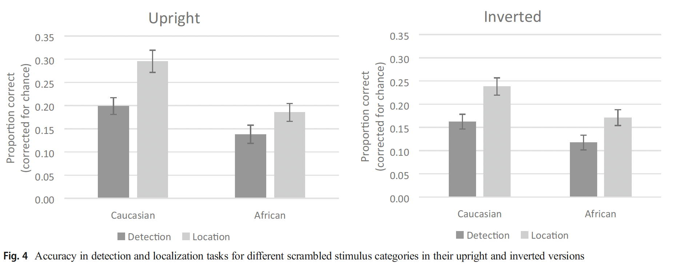
Ventura, et al. (2022)
Scrambled Faces

Slide 27
Ventura, et al. (2022)
Take-home message

Slide 28
How do we recognize objects in the environment?
Why is object recognition important?
EX: Vermicious Knid
Template Matching – Our brains store a template of every object we have ever encountered
Problems:
Space Intensive
Not very fast
Not very flexible
Parsimony/Explanatory

Slide 29
Feature Models
Recognition by Components (Biederman)
Break an image down into its constituent components, called geons
Look for edges and concave surfaces
Identify geons and their interconnections
Compare with stored representation
How does this address problems with template model?
Flexibility
Space
Speed

Slide 30
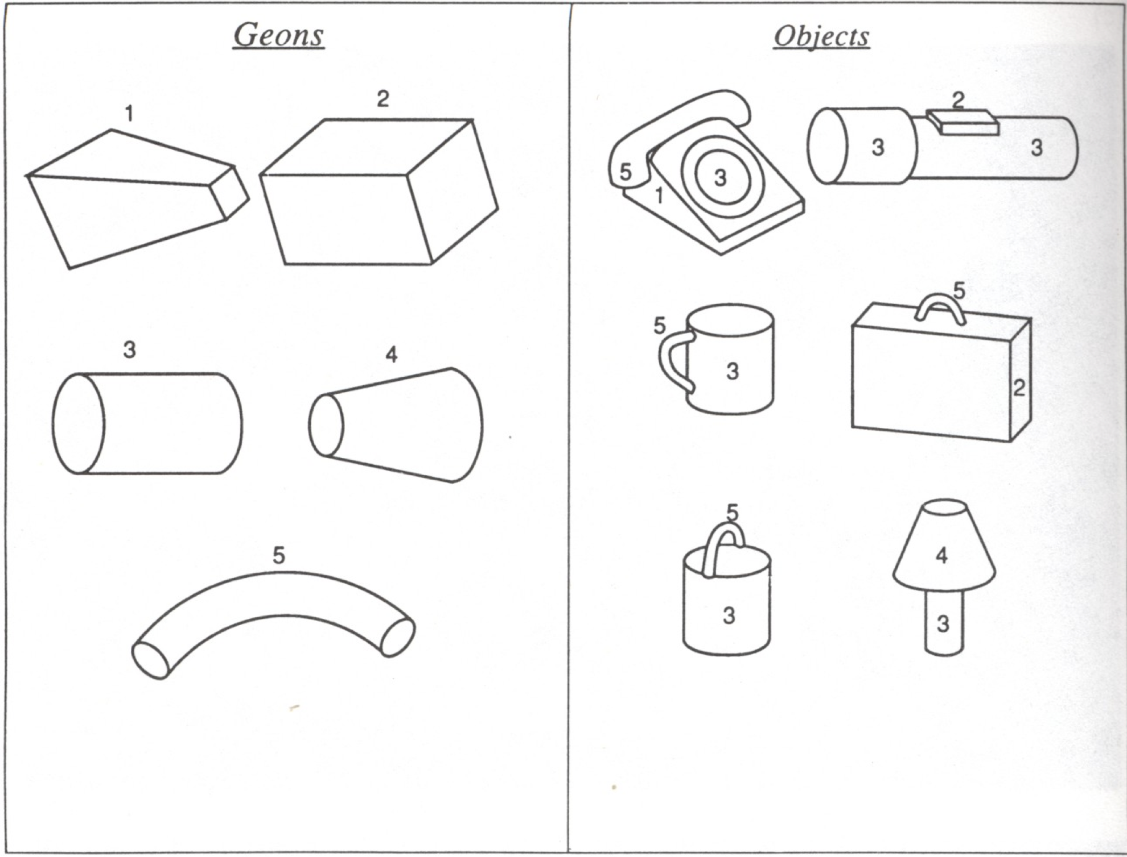
Recognition by Components - Geons

Slide 31
Feature Models
Recognition by Components (Biederman)
Break an image down into its constituent components, called geons
Look for edges and concave surfaces
Identify geons and their interconnections
Compare with stored representation
How does this address problems with template model?
Flexibility
Space
Speed

Slide 32
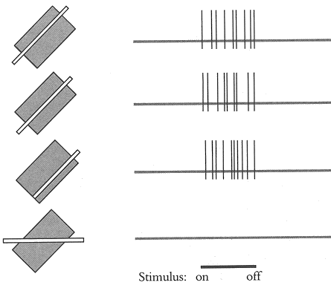
Evidence that supports RBC – Hubel and Wiesel

Slide 33
More evidence to support RBC

Slide 34
More evidence to support RBC

Slide 35
More evidence to support RBC

Slide 36
Feature Theories - Agnosias
Agnosia – the inability to identify objects that is unrelated to problems with low-level S&P. Agnosia is an INTEGRATION problem.
Ex: Can’t name what a pen is, but can use the pen to draw a picture of a pen
Prosopagnosia – Inability to identify faces
Emotional agnosia – inability to infer emotional states
Why might the existence of agnosias be used as an argument in favor of feature theories?

Slide 37
Protoype Theory
GuidingPrinciple – Categories are organized around a “prototype” or best exemplar. Items are related by "family resemblance”
Bird or Dogs or Colors
Evidence:
  People are faster to verify “Robin is a bird” than “Ostrich is a bird”.
  People remember "good" exemplars better than "bad" exemplars (but more false alarms, as well)
Rebuttal:
  Robins have more bird features than ostriches.
Re-rebuttal:
  Works for "colors”;
  Prototype need not be a real object.

Slide 38
Top-down v Bottom-up Processing
Conceptual v Data-driven Processing
Top-Down: we use conceptual information to interpret the physical properties of the stimulus that in turn influences our ability to identify the object.
Bottom-Up: we use the physical properties of the stimulus to determine the nature of the object.
Dominant view: much of perception is Top-Down. That is, what we know affects what we see.

Slide 39
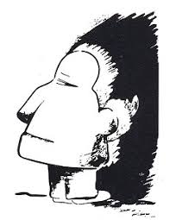
Evidence for Top-Down Processing – Ambiguous Figures

Slide 40

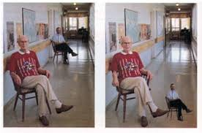
Evidence for Top-Down Processing – Size Constancy

Slide 41
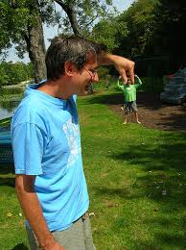
Evidence for Top-Down Processing – Size Constancy

Slide 42


Evidence for Top-Down Processing – Illusory Contours

Slide 43

Gestalt Psychology
If we use rules to make sense of the world, we should be able to specify those rules:
Law of Prägnanz
When in doubt, adopt the simplest possible interpretation

Slide 44
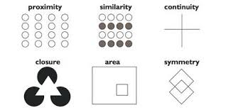
Gestalt Principles

Slide 45
Alternative View: Gibson’s Direct Perception
Affordances
recognize objects based on what they make available to us.
Species-specific
Invariants
Some things about the environment do not change. These things allow us to interpret the world.

Slide 46
Making myself YUGE!!!!
How would you interpret the situation from the perspective of
…the dominant view?
  of the two explanations, one is plausible based on what we know about how the world works and one is not.
…Direct perception?
  The world contains many, many sources about depth cues.

Slide 47
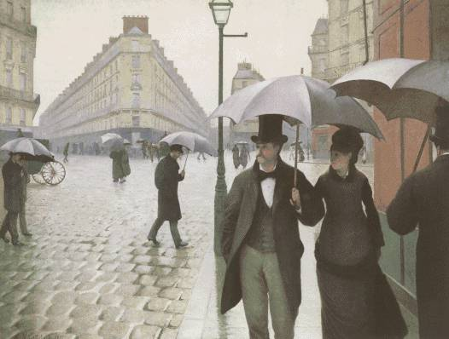
Monocular (one-eye) Depth Cues
Texture gradients
Relative size
Muller-Lyer Illusion
Interposition
Linear perspective (Ponzo Illusion)
Motion Parallax

Slide 48
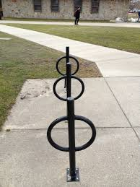
Monocular (one-eye) Depth Cues
Texture gradients
Relative size
Muller-Lyer Illusion
Interposition
Linear perspective (Ponzo Illusion)
Motion Parallax

Slide 49
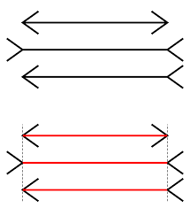
Monocular (one-eye) Depth Cues
Texture gradients
Relative size
Muller-Lyer Illusion
Interposition
Linear perspective (Ponzo Illusion)
Motion Parallax

Slide 50
Monocular (one-eye) Depth Cues
Texture gradients
Relative size
Muller-Lyer Illusion
Interposition
Linear perspective (Ponzo Illusion)
Motion Parallax

Slide 51

Monocular (one-eye) Depth Cues
Texture gradients
Relative size
Muller-Lyer Illusion
Interposition
Linear perspective (Ponzo Illusion)
Motion Parallax

Slide 52
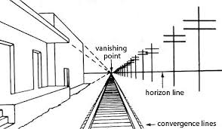
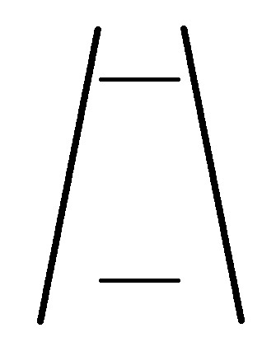
Monocular (one-eye) Depth Cues
Texture gradients
Relative size
Muller-Lyer Illusion
Interposition
Linear perspective (Ponzo Illusion)
Motion Parallax

Slide 53
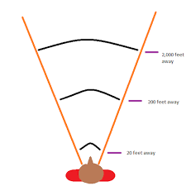
Monocular (one-eye) Depth Cues
Texture gradients
Relative size
Muller-Lyer Illusion
Interposition
Linear perspective (Ponzo Illusion)
Motion Parallax

Slide 54
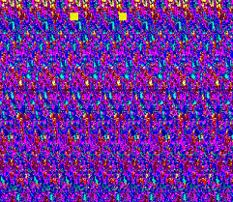
Binocular (two-eye) Depth Cues
Binocular convergence
Finger sausage
Binocular disparity (stereopsis)
3rd Eye books

Slide 55
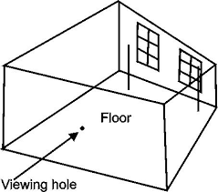
The curious example of the Ames Room

Slide 56
The curious example of the Ames Room

Slide 57
The curious example of the Ames Room

Slide 58
Kozlowski & Cutting (1977)
Identifying Gender from Point Light Displays
Introduction:
  Theoretical Question:
  Empirical Question:
Methods and Results:
E1: Is identification possible?
ID was relatively easy (one outlier)
E2: Is static display sufficient?
ID was difficult with static displays
E3: What did viewers use: armswing vs. speed?
Why is it important that armswing mattered more than speed?

Slide 59
Kozlowski & Cutting (1977)
More Experiments
E4: What did viewers use: lower vs. upper joints?
  Upper joints were more informative
E5: Necessary vs. sufficient
  No joint was necessary; no joint was sufficient
  Why is this result important?
Discussion
Why did I have you read this article?
Any particular model of perception?
Conscious vs. unconscious processes

Slide 60
Kozlowski & Cutting (1977)
More Discussion
What are some different ways that the experimenters used failure to illuminate cognitive processes?
Selected walkers with a ‘normal’ gate. Did this bias the results?
Twice mentioned no feedback, why was this so important to them?
Ecological validity? Who cares we never see point-light displays in our everyday environment?

Slide 61
Problems with Direct Perception
Are affordances really specified by the environment?
Circularity:
  What makes a bird a bird?
  Why does a bird afford “birdyness”?

