Slide 1
Attention

Slide 2
Outline: Attention
Define attention (as best we can) in terms of where it fits in the cognitive system and what it does.
Outline the questions that define the study of attention.
Describe the four functions of attention
Vigilance
Search
Selection
Division
Discuss how attention selects relevant stimuli and ignore irrelevant stimuli. Explore the limits of attention: automaticity.
Examine the literature on the influence of subliminal stimuli on behavior.

Slide 3
Definition(s) of Attention
Attention as Activity (Selection)
  How do we direct our mental energy to a particular object, concept, thought, etc.?
Attention as Fuel (Processing)
  How do we utilize our mental energy to achieve some goal?
The problem is that it's hard to separate these definitions. They are circular.
  Q: How do you increase attentional fuel?
      A:
    Q: What happens if more items are selected?
      A:

Slide 4
Key Questions
Is attention limited?
How much and what limits it?
What happens to "unselected" stimuli?
How does something become "automatic"?

Slide 5
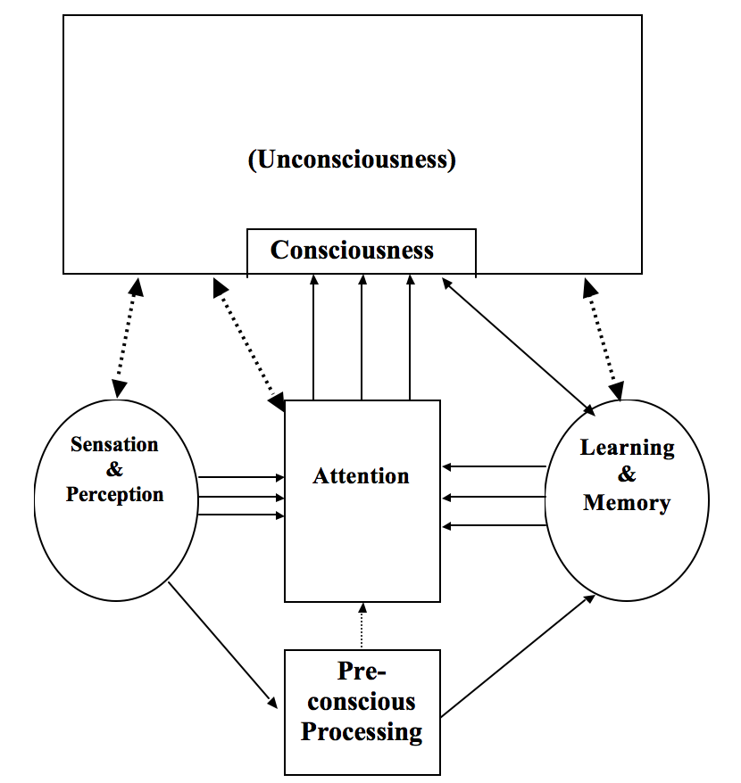
Where does attention ‘fit’ in the cognitive system?

Slide 6
Four functions (forms) of attention
Vigilance (may or may not be there)
Search (actively pursuing a target)
Selective Attention
Divided Attention
"One thing at a time and not very well.”
~ Hilda S. Schulkind

Slide 7
Four functions (forms) of attention
Vigilance (may or may not be there)
Search (actively pursuing a target)
Selective Attention
Divided Attention
"One thing at a time and not very well.”
~ Hilda S. Schulkind
Notes:
Scene with the Beefeaters; looking for something strange

Slide 8
Four functions (forms) of attention
Vigilance (may or may not be there)
Search (actively pursuing a target)
Selective Attention
Divided Attention
"One thing at a time and not very well.”
~ Hilda S. Schulkind

Slide 9
Four functions (forms) of attention
Vigilance (may or may not be there)
Search (actively pursuing a target)
Selective Attention
Divided Attention
"One thing at a time and not very well.”
~ Hilda S. Schulkind

Slide 10
Vigilance
The ability to attend to a field of stimulation over a prolonged period of time in which your goal is to detect the appearance of some target stimulus.
Factors that affect Vigilance
Fatigue
Affects criterion, not sensitivity
Subjects notice target, but aren't sure if it was real
Limited field
Accuracy over a small spatial area
Varying views on shape of attentional field
Onset of target
Things that appear suddenly are well detected. Why?
Expectation/Practice

Slide 11
Search
Difference between search and vigilance
Time
Definitiveness of target
Big Question:
Is search serial or parallel?
Notes:
PopOut

Slide 12
Feature Integration Theory (Triesman & Gelade, 1980)
Analyze the target in terms of its features.
Activate all stimuli in the field that contain the critical features.
Search activated stimuli for the target.
Positive features easier to detect than negative ones.

Slide 13
Selective v Divided Attention
The problem: You are at the ΠΒΦ kegger and it’s raucous - people hanging from chandeliers -when in walks this cutie. You make your way over there and begin to chat. How do you ignore the festivities and focus in on charming the cutie? (selective attention)

Slide 14
Selective v Divided Attention
The problem: You are at the ΠΒΦ kegger and it’s raucous - people hanging from chandeliers -when in walks this cutie. You make your way over there and begin to chat. How do you ignore the festivities and focus in on charming the cutie? (selective attention)
The other problem: Let’s face it, we’re young and we don’t want to prematurely limit our options. What if our cutie has a significant other? What if the cutie doesn't fancy us (yeah, right)? What if an even cuter cutie arrives at the party? Can we maintain a conversation with the cutie without totally losing contact with the rest of the scene? (divided attention)

Slide 15
Dichotic Listening Experiments:
Bringing the ΠΒΦ kegger into the lab
Subjects hear two distinct messages; one in each ear. Must “shadow” one of the messages. Like when you were six.
Volunteer #1 – Read a passage from the book.
Volunteer #2 – Shadow Volunteer #1
Volunteer #3 – Do the following:

Slide 16
Dichotic Listening Experiments:
Bringing the ΠΒΦ kegger into the lab
Subjects hear two distinct messages; one in each ear. Must “shadow” one of the messages. Like when you were six.
Notice a pattern?
What subject DO notice about the unattended message | What subjects FAIL to notice about the unattended message
Gender of the speaker | Content of the message (i.e., what the story is about)
CHANGE in gender of the speaker | Changes to a foreign language
Non-speech sounds | Switch to backwards speech
Change in volume

Slide 17
Bottleneck Theories of Attention
Early Selection models
Late selection models
Attenuation model

Slide 18
Early Selection Models
Sensory
Register
Attentional
Filter
Perceptual
Processes
Consciousness
Prof.
Whispering
Problems for early selection models:
a) Cocktail party effect
b) New car/friend effect

Slide 19
Late Selection Models
Sensory
Register
Percept
Proc. I
Attentional
Filter
Percept
Proc. II
Consciousness
Prof.
Whispering
Problem for late selection theory:
a) How do you distinguish between a lapse of attention and an ‘early’ filter?

Slide 20
Attenuation Model
Sensory
Register
Perceptual
Processes
Attentional
Filter
Consciousness
Prof.
Whispering

Slide 21
Attenuation Model
Left Ear
Once upon a time,
there were three
chuck, if a wood-
chuck could chuck
wood?
Right Ear
How much wood could a woodchuck
bears: Papa Bear, Mama Bear, and Baby Bear.

Slide 22
Schema Theory
Consciousness selects a goal;
Expectations and the environment choose the path
Uber Analogy
EX: a) Neisser's work with visual scenes
b) Jones' work with music
c) Speaking roles
______________________________________________
Two lingering problems for all theories:
Lapse of attention
Rapid switching of attention

Slide 23
Inhibition
Inhibition is kind of like negative attention. Instead of bringing information into consciousness, inhibition is a process that actively keeps information out of consciousness.
Evidence:
1) Negative Priming studies
AJ =======> DF (control set)
LD =======> DF (NP set)
2) High-Cloze sentence completion
She ladled the soup into her ____________.
Lexical decision task
Aside: Pronounced Age Differences

Slide 24

Divided Attention
Limited Pool of Resources
No Capacity left for Task C.
_______________________________________________________________
Modality-Specific
A
50%
B
50%
Visual
Auditory

Slide 25
Sanbonmatsu, et al. (2016)
Theoretical Question:
  Does multitasking influence BOTH performance AND metacognition?
Empirical question:
  Will a conversation influence performance and awareness of performance on a driving simulator task?
Intro:
  What is their main argument?
  What are some things that impair monitoring?
  Does multitasking affect driving performance?
  Does multitasking affect driving performance?

Slide 26
Sanbonmatsu, et al. (2016)
Method:
Driving Survey
Familiarization with driving simulator…why?
Talked to friends/family while driving
12 Hazards along the way:
Rated their safety
Rated their ability to drive while talking on the cellphone.\
Errors were rated as Major or Mnor by an independent group

Slide 27
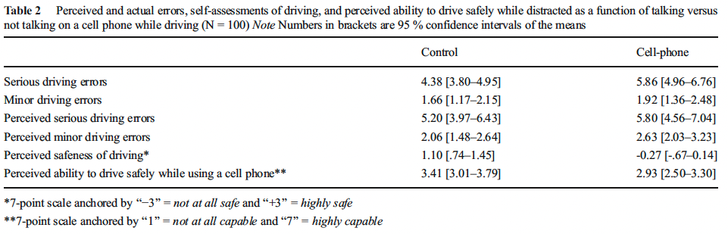
Sanbonmatsu, et al. (2016): Results
Results: Were significant differences observed between control and cell phone users for:
  Making/remembering MAJOR errors?
  Making/remembering minor errors?
  Perceived safety?
  Perceived ability to drive while using a cell phone?

Slide 28
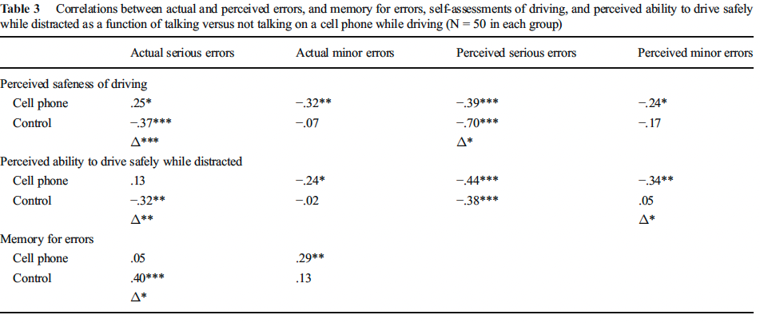
Sanbonmatsu, et al. (2016): Results
Results: Correlations between perceived an actual safety
  Should we expect positive, negative or neutral correlations?
  Where are the ‘whews’ and where are the ‘AHHHHHHHS’?

Slide 29
Sanbonmatsu, et al. (2016): Discussion
Cellphone use not only impaired safeness of participants driving in our study…
…it impared their awareness of the safeness of their driving.
Why are people’s judgments about their own driving while multi-tasking so erroneous and what does that tell us about attention?

Slide 30
Lui & Wong (2012)
Theoretical Question:
Empirical Question:
Introduction:
Immediate effects of multitasking
Chronic effects of multitasking
  Problem: distinguishing multi-tasking from time wasting
What is the explanation for the effect of multitasking?
When might this cognitive style accrue a benefit?
Method:

Slide 31
Lui & Wong (2012): Data

Slide 32
Lui & Wong (2012): Results
Multitasking index was positively correlated with accuracy.
There was a nonsignificant negative correlation with speed.
Eliminated RT for incorrect trials. Was that a good idea?
Multitasking was not correlated with media consumption.
Light multitaskers did better on the tone absent condition. Why is that a potential problem?

Slide 33
Lui & Wong (2012): Discussion
“The present study focused on this aspect of multisensory integration, where one is engaged with a primary task and does not expect or even know of the utility of information coming from another channel.”
  Do you think this experimental paradigm satisfied this goal?
  Do you think the kind of situation described above is ‘more representative of what happens in real life’?
How do you weigh the costs and benefits of multitasking as described in this experiment?

Slide 34
Automaticity
What are some behaviors that you do ‘automatically’?
a) Slamming my foot on the clutch
b) What is 3 + 2?
c) Frequency of occurrence judgments?
d) Some time estimation judgments?
e) Stroop

Slide 35
Automaticity
Posner’s definition of automaticity
a) processes concealed from consciousness
b) unintentional
c) consume few attentional resources (i.e., no dual task cost)
Continuum view
difference of degree, so only the APPEARANCE of automaticity

Slide 36
How does a task become automatic?
Consolidation view
Steps become aggregated with practice
EX: driving; calculating the SD
Instance theory of Gordon Logan
Racehorse model
  algorithm versus memory retrieval
Which is right?
  consolidation view seems to be more general
  Instance view applies more to specialized stimuli/responses
EX: simple math problems

Slide 37
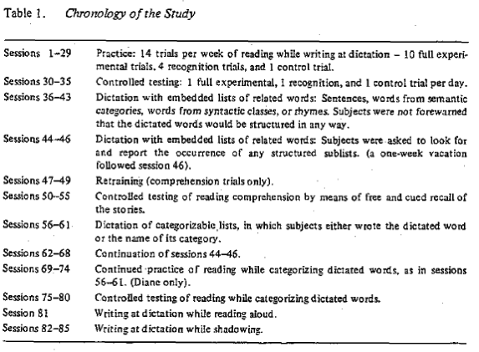
Spelke, Hirst, & Neisser (1976)
Theoretical question:
Empirical Question:
Introduction:
First wave: two simultaneous tasks
  Dangers of introspection
Next wave: dichotic listening experiments
  Tested ‘unattended’ stream in/directly
What was Spelke, et al.’s (1976) approach?
  Dangers of introspection
Method:

Slide 38
Spelke, Hirst, & Neisser (1976): Results
Two conditons:
Baseline: Reading OR dictation
Dual-task: Reading AND dictation
________________________________________
Were they paying attention to both?
Why were Mary's experimental stories used as John's control stories?
What happened when John and Mary switched to categorized lists, sentences, rhymes?

Slide 39
Spelke, Hirst, & Neisser (1976): Discussion
Why do Spelke, Hirst, and Neisser (1976) argue that rapid switching of attention cannot explain their results?
How do Spelke, Hirst, and Neisser (1976) define automaticity?
    How does their definition differ from older ones?
    Do John and Diane exhibit automatic behavior according to the old/new definition?
Could John and Diane learn to take dictation of another story?
Are consciousness and attention the same thing?
What are the ‘limits’ of attention?

Slide 40
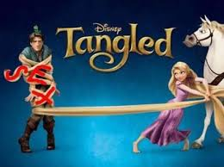
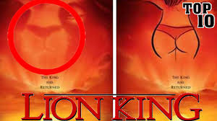
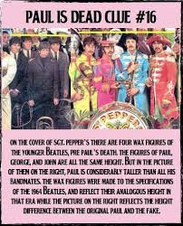
Preconscious Processing
What do we mean by pre-conscious?
Vast Storehouse of knowledge
EX: Freudian word associations
Subliminal processing outside the lab
EX: Information buried in rock albums
Commercials
How do we know Paul is not dead?
Subliminal processing inside the lab?
EX: Priming Nurse ===> Doctor
Butter ========> Doctor
Subconscious is NOT subliminal

Slide 41
Marcel: Subliminal processing in the lab
Target word: PALM
Learning Phase
Never sees Target | Full exposure in context (body part) |  | Subliminal Exposure
Classification Phase
Is PALM a body part? |  | Is PALM a type of tree?

Slide 42
Marcel: Subliminal processing in the lab
Target word: PALM
Problems:
Is effect sub-threshold?
    Identification vs. recognition
Time course of the effect

Slide 43
Subliminal Effect outside the laboratory
Popcorn / Coke
Initial studies seemed to indicate an effect
But…confounding variable
Literature runs 3:1 against.
Effects are short-lived
Embedding "Sex" in an Advertisement
EX: Disney’s Lion King
Backward messages
Self-Help tapes (Friends episode)
Placebo effect
People can detect | People CANNOT detect
Gender Speaker Language | Question v Statement Paraphrase Content category (nursery rhyme; religious; porn)

