Slide 1
Short-Term Memory /
Working Memory

Slide 2
Outline: STM / WM
Describe various forms of memory and the different types of tests used to assess them.
Summarize the Atkinson & Shiffrin / Multi-Modal Model of memory.
Outline the key features of the sensory registers and Short-term Memory including:
Capacity
Duration
Search (serial vs. parallel)
Forgetting (interference vs. decay)
Coding (perceptual vs. conceptual)
Contrast STM and Working Memory (Baddeley).

Slide 3
Varieties of Memory
Who wrote ‘A Prayer for Owen Meany’?
What shoes did I wear last week?
You are at Vals and are in a good mood because it’s Eggs McChucks Day. But, your friend gets a little too excited bites off more than s/he can chew and starts to choke. What do you do?
Whom did you take to the senior prom?
What would you do if the Paris Metro went on strike?
All Champagne is produced in a small region of:
France
Germany
Italy
Camden, NJ
Who played Legolas? (Important Legolas video)

Slide 4
Potential causes for memory failures
Can you recall a recent time you forgot something? Why did you forget whatever it was that you forgot? There are 3 possibilities:
Encoding failure
Storage failure
Retrieval failure

Slide 5
Common Explicit Memory Tests: Recall
Explicit Memory - conscious access of target information
Declarative Memory - conscious access of facts
Type of Test | Learning | Test | Response
Free / Serial Recall | 8-6-7-5-3-0-9
Cued Recall | Foot-watch Cereal-bowl | Foot-_______ Cereal-______
Comphension | Read story about Statue of Liberty? | How long is her extended arm?
Public Knowledge |  | Which Spice Girl was the 1st to leave?

Slide 6
Common Explicit Memory Tests: Recall
Explicit Memory - conscious access of target information
Declarative Memory - conscious access of facts
Type of Test | Learning | Test | Response
Free / Serial Recall | 8-6-7-5-3-0-9 |  | 8-6-7-5-3-0-9
Cued Recall | Foot-watch Cereal-bowl | Foot-_______ Cereal-______ | Watch Bowl
Comphension | Read story about Statue of Liberty? | How long is her extended arm?
Public Knowledge |  | Which Spice Girl was the 1st to leave?

Slide 7
Common Explicit Memory Tests: Recognition
Type of Test | Learning | Test | Response
True/ False | Passage (or not) | Posh Spice is married to Michael Beckham
Multiple Choice | Passage (or not) | My favorite spice girl is: Posh Ginger Baby Scary Sporty
Old / New Recognition | Foot Watch Cereal Bowl | Foot Stereo Cheese Bowl

Slide 8
Common Implicit Memory Tests
Implicit Memory – is observed when a person demonstrates knowledge of or prior exposure to information without directly being asked about prior experience. Both ‘accuracy’ and RT are measured and compared across a control group and an experimental group.
Type of Test | Learning | Test | Response
Naming | E: turkey C: computer | Turkey
Lexical Decision | E: turkey C: computer | Turkey Greeble
Stem Completion | Foot Watch Cereal Bowl | Tur___

Slide 9

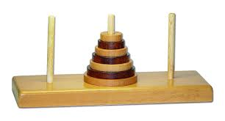
Common Procedural Memory Tests
Procedural memory – memory for skills and other non-verbal information. You demonstrate memory by doing rather than saying.
Mirror Writing
Tower of Hanoi puzzle
Can you think of any ways that you demonstrate procedural memory on a regular / everyday basis?
Why is this interesting?
Amnesic patients
So what?

Slide 10
Four types of Memory Tests
 | Declarative | Procedural
Explicit
Implicit

Slide 11
Memory Test Instructions
Intentional – I’m going to test you later
  SAT and academic work
  Majority of memory research
Incidental – Let’s just do this for fun (sinister laugh…but I’m going to test you later)
  Rate these words
  Remember content, but test on source
  Time estimation tasks

Slide 12
Multi-Modal Model of Memory –
Atkinson and Shiffrin (1968)
Stimuli in
the world
Response
Output
Sensory Registers
STM
LTM

Slide 13
Important Questions:
Sensory Memory
Capacity
Duration
Coding
Search
Forgetting

Slide 14
Important Questions: Sensory Memory
Capacity
    Full v Partial Report
    Size of Display
    Manipulation of ISI
Duration
    ISI
Coding
    Pattern Masking
    Report all letters that rhyme with ‘B’
Search. <Pass>
Forgetting
    Decay v Interference

Slide 15
Answers to Key Questions
 | Sensory Memory | STM
Capacity | VERY large
Duration | Very short
Coding | Physical (analog)
Search | cough
Forgetting | Decay / Interference

Slide 16
STM: Capacity
The ‘Magic’ Number: 7±2 items of information
Memory span studies
Chunking (recoding)
Serial position effects
Recency
Primacy

Slide 17
STM: Duration
With Rehearsal
Maintenance Rehearsal
Elaborative Rehearsal (recoding / imagery)
Serial position effects
Without Rehearsal

Slide 18
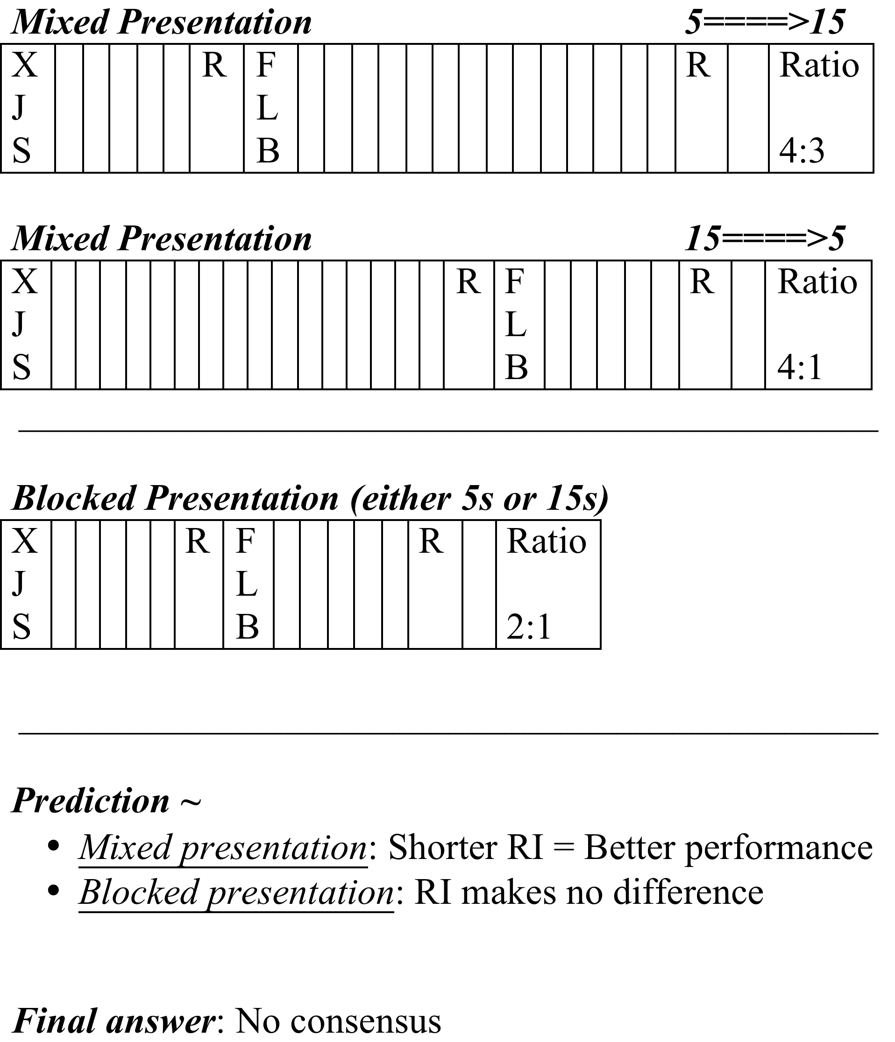
Brown Peterson: Blocked v Mixed Presentation

Slide 19
Brown Peterson: Blocked v Mixed Presentation

Slide 20
STM: Search – Sternberg Task
Logic of Subtraction
How long does process C take?
Have people do A + B + C
Then, have people do A + B
RT(C) = RT1 – RT2
Assumptions:
Discrete stages
Pure insertion

Slide 21
STM: Search – Sternberg Task
Sternberg Task
Give people a list of digits
Ask them if target was on that list
Vary the number of digits in the list
Use slope of the regression line to determine search time per item.
Stage | N Letters | N+1 Letters
Encode Target
Scan Items in Memory
Make Decision
Make Response

Slide 22
STM: Search – Sternberg Task
Sternberg Task
Give people a list of digits
Ask them if target was on that list
Vary the number of digits in the list
Use slope of the regression line to determine search time per item.
Stage | N Letters | N+1 Letters
Encode Target | Same | Same
Scan Items in Memory
Make Decision | Same | Same
Make Response

Slide 23
STM: Search – Sternberg Task Results
Key Results:
Linear increase with a slope of 40 ms
No difference between ‘Present’ and ‘Absent’ Trials
Q: How do these results compare to Visual Search CogLab?

Slide 24
STM: Search – Sternberg CogLab
RT not significantly different across Present v Absent
Present: m = 61 ms
Absent: m = 44 ms

Slide 25
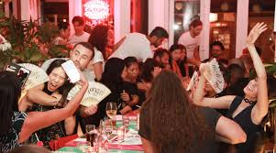
STM: Search – Why have an exhaustive search?
To avoid switching costs.
Sternberg’s idea was that a homonculus does all the comparisons then looks at the readout to assess presence or absence
Going to dinner with a group of people (pre-group text era)

Slide 26

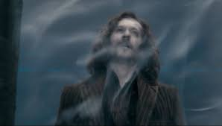
STM: Forgetting – Decay v Interference
(this is when it starts getting nasty)
Decay – As time passes, information begins to crumble, fade, break apart, recede into oblivion, pass through the veil.
Interference – can happen two ways.
NEW information pushes old information OUT.
OLD information doesn’t let new information IN.

Slide 27
STM: Forgetting – Evidence
Can we eliminate interference?
Cockroach studies
Sleep Studies
Anesthesia Studies
 | Supports Decay | Supports Interference
Brown-Peterson | Longer RI = | Intrusions Mixed Bloc
Serial Position Effects | Longer RI = | Surrounding Items

Slide 28
STM: Forgetting – More Evidence
Waugh & Norman (1965)
Manipulated Presentation rate.
Interference Predicts: No effect
Decay Predicts: Reduced Primacy
Crowder & Morton (1969)
Suffix Effect
Interference Predicts: Reduced recency
Decay Predicts: No effect

Slide 29
STM: Forgetting – More Evidence
Interference is a two-way street
Retroactive Interference – NEW items interfere with OLD
Common room noise
Proactive Interference – OLD items interfere with NEW
Phone numbers
Parking Spaces
Release from PI

Slide 30
Answers to Key Questions
 | Sensory Memory | STM
Capacity | VERY large | 7 ± 2
Duration | Very short | Don’t get me started
Coding | Physical (analog) | Largely Physical
Search | cough | Serial and Exhaustive
Forgetting | Decay / Interference | Decay, RI, and PI

Slide 31
Baddeley’s Working Memory Model
Why revamp the modal model?
Difficult to empirically dissociate STM from LTM
Sensitive to many of the same manipulations
EX: Name the US Presidents
Population Evidence
Some populations show poor performance on some STM tasks, but not others.
STM is dynamic
Not a passive storehouse of information; STM manipulates information, as well.
EX: Release from PI
Memory span tasks

Slide 32
Architecture of the Working Memory Model
Central Executive
•Retrieves information from LTM
•Transfers information into LTM
•Reasoning, Decision Making
•Language Comprehension
•Response Initiation
Phonological
Loop
Visual-
Spatial
Sketch
Pad

Slide 33
Comparing STM and WM
Phenomenologically Similar
Both refer to the conscious part of memory
Structurally Distinct
STM – Unitary; a lone box fighting for cognitive justice in an unjust world
WM – Tertiary; three components working together
Conceptually Distinct
STM – Contents oriented
How much can we hold? How is information lost?
WM – Process oriented
How do we represent / manipulate information?

Slide 34
WM: Coding Information
Phonological codes (Phonological Loop)
Phonological Similarity Effect
Visual Codes (VSSP)
Rotation Studies
Other Imagery Tasks
Semantic codes (Central Executive)
Release from PI

Slide 35
Comparing STM and WM: Parsimony Question
Q: Didn’t we say simpler theories were better? Isn’t STM (one box) simpler than WM (three distinct parts)?
A: Yes. WM is less parsimonious, but parsimony must be weighed against the ability to:
Explain existing data
Make new predictions

Slide 36
WM – Unique prediction #1:
Articulatory Suppression
Prediction #1
If:
CE uses a semantic code and
PL uses a phonological code
Then:
articulatory suppression should affect phonological processing but not comprehension.
Evidence:
AS abolishes the phonological similarity effect
AS does not affect comprehension

Slide 37
WM – Unique prediction #2: Word Length Effect
Prediction #1
If:
PL is like a continuously recycling piece of audio tape
Then:
STM capacity should be affected by both the length and the number of the to-be-remembered items.
Evidence:
Cross-cultural differences in IQ (digit span)
Word length effect

Slide 38
Baddeley, Thomson, & Buchanan (1975)
Intro
Why is 7 ± 2 a problematic characterization of capacity?
What are primary memory and secondary memory?
Reading rate predicts memory: why is that not sufficient proof that ‘chunks’ are not a good measure of capacity?
Methods & Results
Experiment | Control Var | Exper Var | Results
I | Frequency | # of syllables | Short > Long
II | Category | # of syllables | Short > Long
III | # of syllables | Artic Time | Short > Long
IV | Phonemes | Artic Time | Short > Long

Slide 39
Baddeley, Thomson, & Buchanan (1975)
Methods & Results (continued)
Experiment | Control Var | Exper Var | Results
V | Same | Visual Presentation | Short > Long AR Mem
VI | Category Familiarity | # of syllables Order | Short > Long Linear slope
VII | # of syllables | Artic Sup | Short > Long AS absolished WLE
VIII | # of syllables | Artic Sup Modality | Short > Long AS absolished WLE in both modes

Slide 40
Baddeley, Thomson, & Buchanan (1975)
Discussion:
Why do the modality data matter?
  Visual info transferred to a phonological code for rehearsal
How is information represented/coded in STM?
  Phonological / physical code
How best to describe STM capacity?
  Time: 1.3 to 1.6 seconds
Why doesn’t recency show an effect of word length?
  Nothing replaces last items in the PL

Slide 41
Problems with the Working Memory model
Not much known about VSSP
Central Executive "Area of Residual Ignorance"
    Why is that a problem?

