Slide 1
Long Term Memory:
Narrative and Autobiographical Memory
No quote…yet!

Slide 2
Outline: LTM – Narrative and AM
Distinguish content accuracy from technical accuracy.
Distinguish reconstructive from reproductive memory.
Discuss the role of schemata in recall and recognition.
Describe classical experiments on eyewitness testimony and discuss the factors that do/do not promote accurate reports.
Describe classical experiments on autobiographical memory and discuss research related to the accuracy of such memories.
Provide a brief overview of amnesic syndromes.
  TV amnesia vs. the real thing
  What does the amnesia tell us about ‘normal’ memory?

Slide 3
When (if ever) is memory accurate?
Technical Accuracy – word for word verbatim accuracy (surface structure)
vs.
Content Accuracy – getting the gist of the message correct (deep structure)

Slide 4
When (if ever) is memory accurate?
Reproduction – our memories faithfully record events down to the very last detail, much like a tape recorder, video camera, or VCR.
vs.
Reconstruction – our memories gather together bits and pieces of events and bind them together using general world knowledge, expectations, and information gathered since the time of the event

Slide 5
Bransford & Franks (1971) – Reconstruction
Semantic integration – we simplify messages by combining information into unified representations.

Slide 6
Bartlett’s ‘War of the Ghosts’
Things that were changed
Normalization - details became more modern
    canoe becomes sailboat
    death less mystical
Things that were left out:
Specific details
    Names of the Towns:
    Number of men in canoe:
Things that were added (intrusions)
Sharpening
    Native American theme
    Totem poles, scalping, war paint

Slide 7
Schema – Barlett’s explanation
Schema – an active organization of past reactions and past experiences
    Native American schema
    Gangster movie
    Physics major
    Williams Student schema (v. Swarthmore)
    "Melvin"/"Bernice"

Slide 8
Scripts – Barlett’s explanation for his data
Scripts – special type of schema organized around familiar activities
going to the doctor
dinner at a fancy restaurant
dinner at McDonald’s
Ballgame
Beach
Consists of: Characters, Plots, Settings, Timing, Dialogue

Slide 9
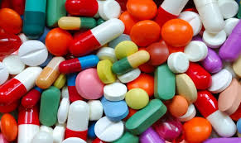

Schema Examples – Pain Reliever

Slide 10

Schema Examples – Laundry Detergent

Slide 11

Schema Examples – Pasta

Slide 12
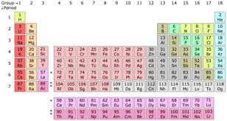
Schema Examples – Chemical Element

Slide 13
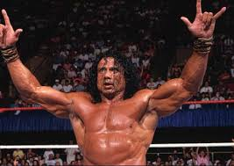
Schema Examples – Professional Wrestler

Slide 14
What do schema/scripts predict about memory?
If we use our general world knowledge to understand,
interpret and make inferences about a story, then:
What are your predictions for recognition?
Vivid Inconsistent Actions/Details
Mild Inconsistent Actions/Details
Consistent Actions/Details
Recall
 | Intrusions | Omissions
Schema-Consistent
Schema-Inconsistent

Slide 15
Sulin & Dooling (1974) – Schema and Memory
Learning Phase
Gerald Martin strove to undermine the government. | Adolph Hitler strove to undermine the government.
Retention Interval for both groups
Recognition Test
Gerald Martin was obsessed with a desire to conquer the world. | Adolph Hitler was obsessed with a desire to conquer the world.
Results
Many more ‘false alarms’ in the Adolph Hitler Group

Slide 16
Why do we put up with the errors that schemas produce?
One day, when I was in college, I went to the record store. I walked around the store. I decided to buy a Duran Duran CD. I picked the Duran Duran CD out of the bin. I brought it up to the cash register. The person at the register types some numbers into the machine. She said, ‘That will be $12.85.’ I reached into my pocket and pulled out my wallet. I unfolded the wallet and took out a $10 bill. Then I took a $5 bill out of my wallet. I handed the money to the woman. She punched more numbers into the register. Then, when the drawer opened, she put my money into the register. She gave me back 2$1 bills in change and then she gave me a nickel and a dime. She put my CD in a bag with the receipt. I dare say that I will never forget that trip to the record store.
My Trip to the Record Store (boring version)

Slide 17
Eyewitness Testimony - Memory in the ‘real world’
In 1979, Father Bernard Pagano was facing trial for several armed robberies committed in the Wilmington, DE area. He maintained his innocence, but 7 eyewitnesses testified that he was the robber. The trial was nearing conclusion, and Father Pagano was certain to be convicted when another man Ronald Clouser confessed to the crimes. Mr. Clouser knew details that only the true robber could know.
Q: Did Robert Pagano resemble Ronald Clouser?
A:
Q: Why then was Pagano arrested and almost convicted?
A: Suggestion by the police.

Slide 18
Eyewitness Testimony: Memory in the Lab
Janitor/radiator study
Staged assault of a professor.
  6 weeks later, 60% (including the professor) of the witnesses couldn't identify the attacker.
  25% chose an innocent bystander
Grocery store robbery
 | Correct Judgment | Incorrect Judgment
Witnessed event | 83% | 17%
Did not Witness | 70% had no memory | 29% ‘remembered’ the janitor
No eyewitness | Eyewitness | Discredited Eyewitness
18% voted to convict | 72% | 68%

Slide 19
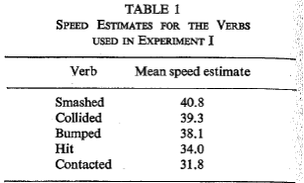
Loftus & Palmer (1974): E1
Method:
Video of a multi-car accident
Answered a number of questions.
Key variable was the verb.
  About how fast were the cars going when they _____ each other?
Implication: Response bias vs. change in memory
Notes:
Form of a question influence the response?
Would speed estimates increase with the violence implied by the verb?

Slide 20
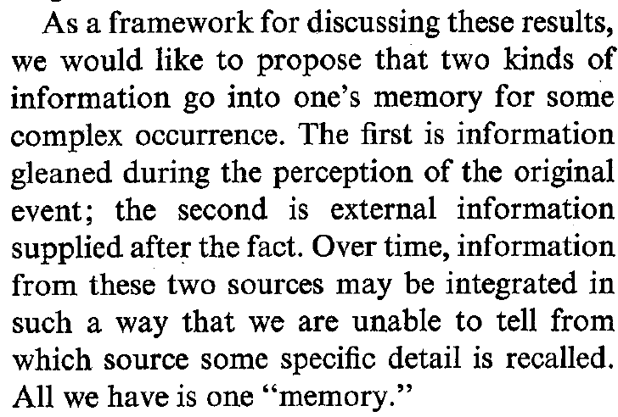
Loftus & Palmer (1974): Discussion

Slide 21
Misinformation Effect
Stage 1: Witness an event
  Stop sign vs. yield sign
Stage 2: Receive post-event information (PEI)
  Consistent
  Inconsistent
  Neutral
Critical question: "Did another car pass the red Datsun while it was stopped at the stop/yield sign?”
<<<Retention Interval of either 20 minutes or 2 weeks>>>

Slide 22
Misinformation Effect
Stage 3: Memory test
Recognition task
Note: chance would be 50% correct
Was stop sign too small to notice?
  Barn Study
 | 20-Minute RI | 2 week RI
Consistent | 75% | ??
Neutral | 59% | ??
Inconsistent | 41% | 20%
Notes:
Not just a sign off to the side of the road.

Slide 23
Theoretical Explanations for the Misinformation Effect
1) Overwriting hypothesis
Computer file analogy
Evidence: Incentives have little effect.
2) Interference hypothesis
Accurate information available, but not accessible
Evidence: Proper sequencing eliminates effect.
3) Response Bias
Not memory impairment, but “if you say so”
Evidence: Test slide v Novel slide eliminates effect.

Slide 24
Smith, Multhaup & Ihejirika (2017)
Theoretical Question: <punt>
Empirical Question(s):
Background Literature:
  Misinformation effects are observed broadly
  DRM effects have been examined in bilingual contexts
  In balanced bilinguals, effects are equal
Prediction
  Unbalanced bilinguals would be more susceptible to misinformation in L1 than L2

Slide 25
Smith, Multhaup & Ihejirika (2017)
Method:
  Waves probably refer to two different semesters; we’re going to ignore that.
  Subjects were all students in an intermediate college class taught entirely in Spanish.
  Four conditions:
Lecture | Test | Notes
Spanish | Spanish | Spanish
English | English | English
English | Spanish | English
Spanish | English | Spanish

Slide 26
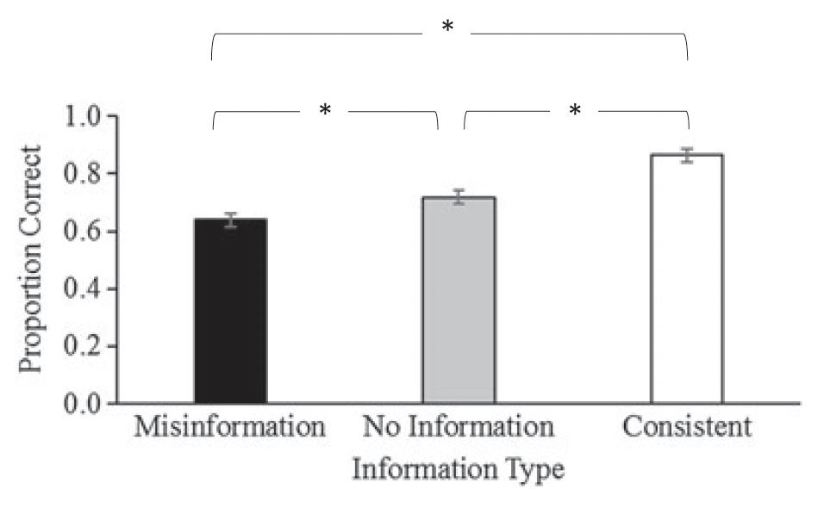
Smith, Multhaup & Ihejirika (2017)
Results: What does Figure 2 tell us?

Slide 27
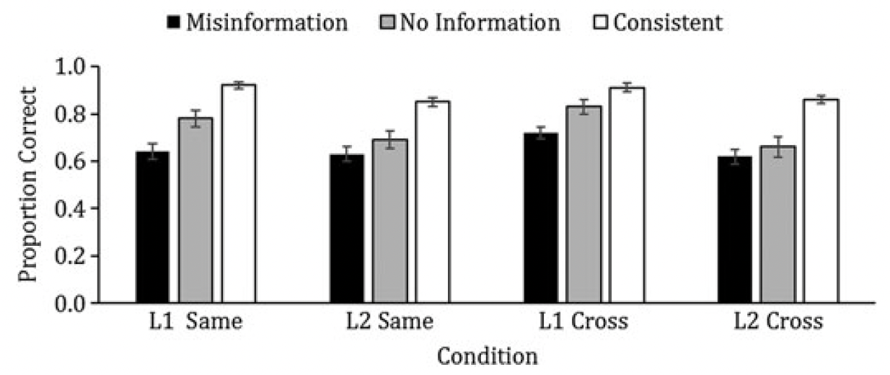
Smith, Multhaup & Ihejirika (2017)
Results: What does Figure 3 tell us?
Subjects performed better when learning and testing was in L1.

Slide 28
Smith, Multhaup & Ihejirika (2017)
Results: What does Figure 3 tell us?
No differences in magnitude of misinformation for consistent language conditions.
Significantly more misinformation when misinformation was in English in the cross conditions.

Slide 29
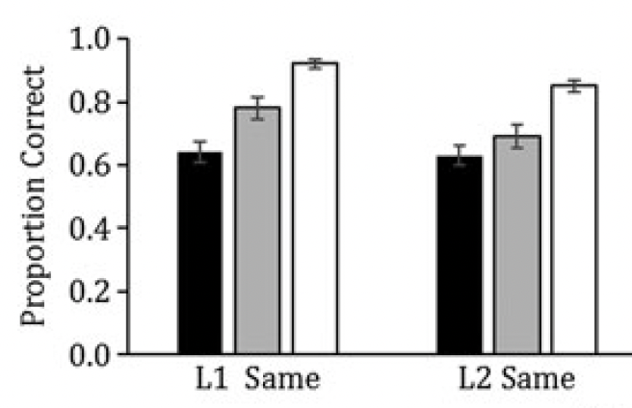
Smith, Multhaup & Ihejirika (2017)
Results: Comparing Figures 2 and 3
Figure 2 Figure 3
Misinformation effect observed in both monolingual conditions.

Slide 30
Smith, Multhaup & Ihejirika (2017)
Conclusions:
Better recognition memory in L1 than L2.
Useful paradigm for examining misinformation in a context other than eyewitness testimony.
Limitation: “items were not counterbalanced across the misinformation, no information and consistent information conditions”.

Slide 31
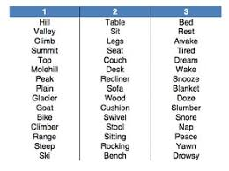
Other ways to introduce error: DRM Procedure
Deese / Roediger / McDermott
Lists of words that are all related to an unpresented ‘critical lure’
Other ‘important’ findings:
Remember / Know
Explicit warnings
Relation to false memory controversy?

Slide 32
Autobiographical Memory
Memory for the events of one’s life
The time I met Charles Barkley in a record store
When I got married
When my Dad knocked me off my bicycle
When I had oatmeal for breakfast this morning
The name of my high school
Key Issues:
Types of events that we remember/forget
Distribution of memories
Accuracy of memory content
Accuracy of memory dating

Slide 33
Distribution of Autobiographical Memories
Typical Retention Function Autobiographical Memory Function
Reminiscence Bump
Childhood Amnesia

Slide 34
Why do we observe a reminiscence bump?
Identity formation - events are special significance because they determine who we are.
    Prediction:
Biased Search Strategy – opt to think about this era
    Prediction:
Nature of ‘bump’ events - lots of important things occur then.
    Prediction:
Evolutionary explanation – brains work best
    Prediction:
Cognitive markers – transitions serve as retrieval cues
    Prediction:

Slide 35
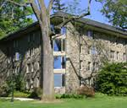
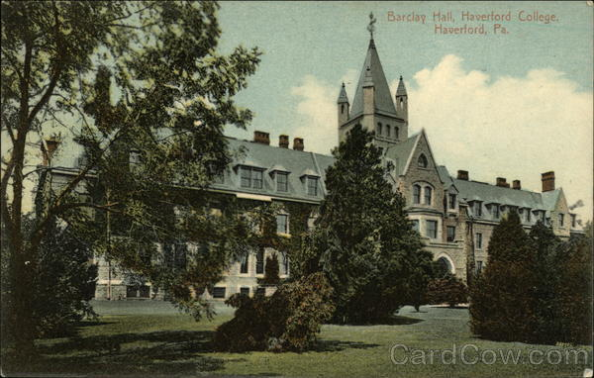
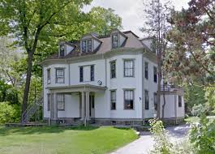
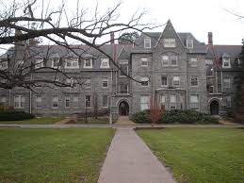
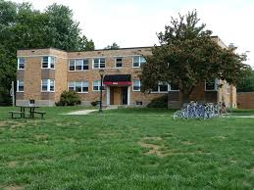
Cognitive Markers: Oh, the Places You’ll go
6 Barnett Place, East Northport, NY
Barclay 308 C
Yarnall 12
Jones 203 A
Barclay 325 A
14 Hannum Drive, Apt. 2B, Ardmore, PA
6 Barnett Place, East Northport, NY
206 S. 21st Street, Apt. ??, Philadelphia, PA
215 Anderson Street, Apt. F., Durham, NC
3907 Shoccoree Drive, Durham, NC
4800 University Drive, Apt. 18A, Durham, NC
105 W. Washington Street, Urbana, IL
1012 W. University Avenue, Champaign, IL
    Homeless
307 E. Tomaras Avenue, Savoy, IL
    Homeless
20 Harwich Road, West Springfield, MA
99 Sand Hill Road, Shutesbury, MA
    Homeless
516 E. Oak Place, Edmond, OK
    Homeless
38 Cosby Avenue, Amherst, MA
11 Hawthorn Road, Amherst, MA 01002

Slide 36
Cognitive Markers: Oh, the Places You’ll go
6 Barnett Place, East Northport, NY
Barclay 308 C
Yarnall 12
Jones 203 A
Barclay 325 A
14 Hannum Drive, Apt. 2B, Ardmore, PA
6 Barnett Place, East Northport, NY
206 S. 21st Street, Apt. ??, Philadelphia, PA
215 Anderson Street, Apt. F., Durham, NC
3907 Shoccoree Drive, Durham, NC
4800 University Drive, Apt. 18A, Durham, NC
105 W. Washington Street, Urbana, IL
1012 W. University Avenue, Champaign, IL
    Homeless
307 E. Tomaras Avenue, Savoy, IL
    Homeless
20 Harwich Road, West Springfield, MA
99 Sand Hill Road, Shutesbury, MA
    Homeless
516 E. Oak Place, Edmond, OK
    Homeless
38 Cosby Avenue, Amherst, MA
11 Hawthorn Road, Amherst, MA 01002

Slide 37
Why childhood amnesia?
Brain development I
Brain not developed enough to lay down stable long term memories.
  Prediction:
Brain Development II
  At some point post-infancy, our brain radically changes the way we store and retrieve information making us unable to use the old code.
  Prediction:

Slide 38
Why childhood amnesia?
Language development
  Little memory because poor language skills.
  Prediction:
Repression
  Our earliest memories are so traumatic and emotional, that we block them out.
  Prediction:

Slide 39
Accuracy of AM
The data are mixed.
Beepers studies: not too good.
Diary studies and Personal Semantics: not too bad.
Two biggest determinants of accurate recall
1) Uniqueness
One-off events; Life-changing events
2) Cues
Method: 6 year-olds go to a museum
2 retention intervals: 6 months, 6 years
Results: No cues: remembered very little
With cues: remembered a lot

Slide 40
Flashbulb Memories:
Talarico & Rubin (2003)
Flashbulb Memories – Unusually distinct memories for surprising and/or important events that are particularly resistant to forgetting.
________________________________________
Theoretical Question:
Empirical Question:
Questions:
What triggers the special mechanism?
What concerns have been raised about the special status of flashbulb memories?

Slide 41
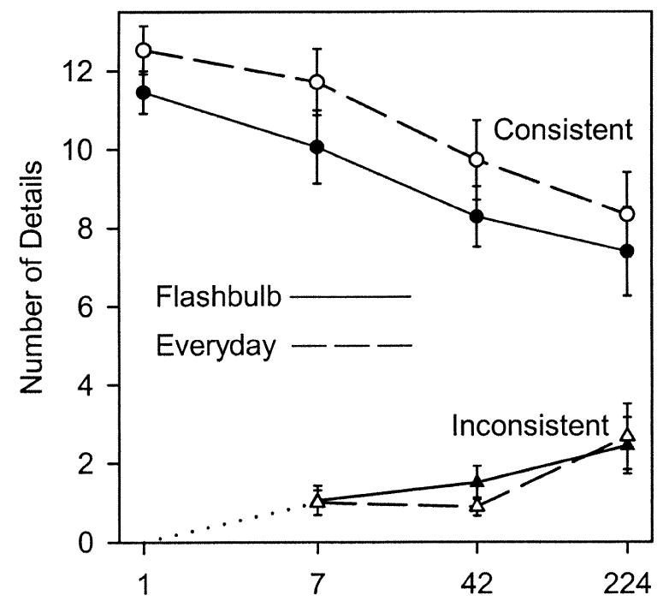
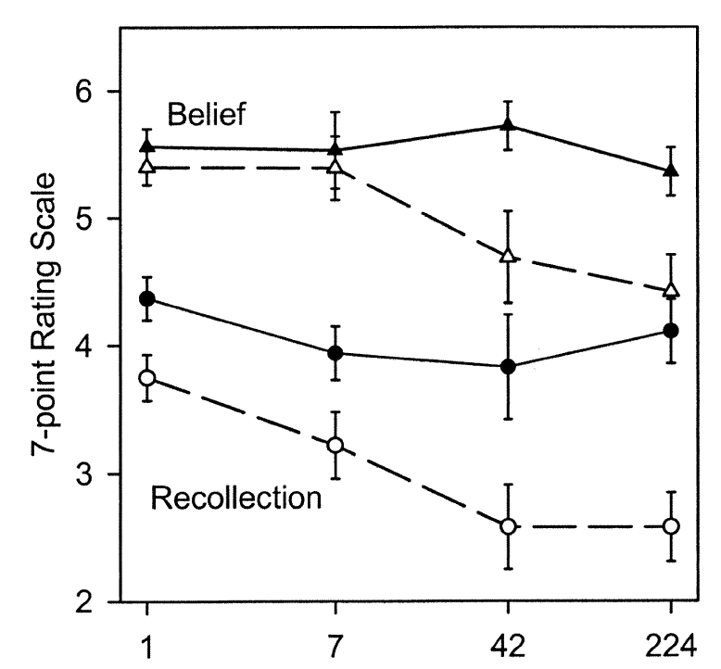
Talarico & Rubin (1988):
Method & Results
Method:
Recorded FMs for 9/11 on 9/12.
Recorded everyday memory from 2-3 days prior
Retested memories for both at logarithmic intervals
    Results:

Slide 42
Talarico & Rubin (2003): Discussion
Are FMs particularly accurate?
Are FMs produced by a special mechanism?
What is the difference between FMs and regular memories?
Why do you think these differences emerge?
  Special memory mechanism
  Normal memory mechanism
  Demand characteristics

Slide 43
Summary of Episodic Memory
Is episodic memory accurate?
  A1: Broad outlines? Yes
  A2: Details? Not so much.
Why?
  Perhaps, this is because we store the gist of the event, but not the ancillary information.
Why do we see so much distortion in episodic tasks relative to autobiographical memory tasks?
  Episodic tasks: details are somewhat arbitrary
  AM tasks: crucial to our sense of self, so may rehearse more

Slide 44
Amnesia - Frederick vs. Soap Operas
 | Soap Opera Amnesia (e.g., Jason Bourne) | Real world Amnesia (e.g., Frederick)
Episodic Memory
Semantic Memory
Procedural Memory
Temporal Direction

Slide 45
Amnesia – The day I had my wisdom teeth removed
H.M.
Father passed away
Aging of his wife
Lunch experiment
Clock-watching experience
Typical Causes
Closed-Head Injury (Motor cycles, fencing)
Oxygen Deprivation (stroke, heart attack)
Tumors
Herpes
Transient Global Amnesia (Bourne-ish Amnesia)

Slide 46
Amnesia: Cardinal symptoms
1) Discrepancy between IQ & memory performance
    Dementia: both are compromised
2) Declarative memory across a delay is ruined
    Verbal and non-verbal
    All sensory modalities
3) Spared implicit and procedural memory
    Korsakoff’s patient and pin doctor
    But no memory for previous experiences

Slide 47
Amnesia: Cardinal symptoms
4) Semantic memory
    OK on old information, but new vocabulary is difficult
5) Little confabulation
    Distinction from dementia
6) Cognitive mediation
    Simple: Yes; Complex: No
7) Binding
    Integrating item and context

Slide 48
Consolidation
Consolidation - memory encoding; the process of transferring information from STM (WM) to LTM.
Two time courses
    Short-term consolidation - Hippocampus
    Long-term consolidation - Frontal Lobes
Evidence:
H.M.
Patients with damage to certain areas of the frontal lobes, show the opposite pattern. Retain more recent information but have trouble recalling remote information (semantic dementia)

