Slide 1

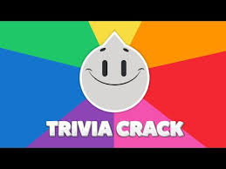
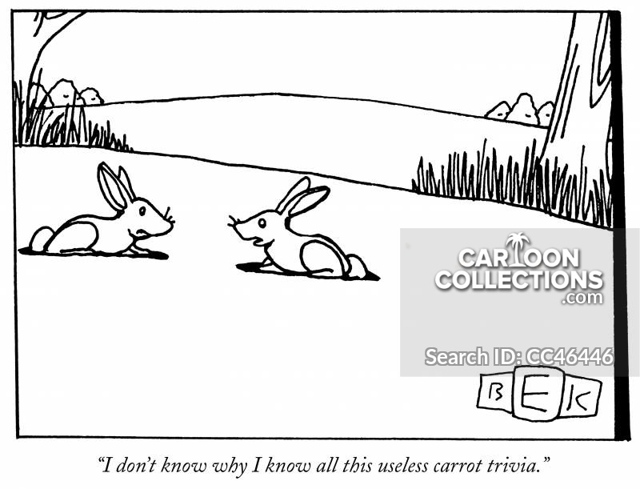

Semantic Memory

Slide 2
Outline: Semantic Memory
1) Provide a working definition of semantic memory.
2) Discuss four main approaches to understanding the structure of semantic memory:
spreading activation
feature models
prototype theory
PDP / connectionist approach
3) Highlight the strengths and weaknesses of each.
4) Discuss Bahrick's work on memory for semantic information across the lifespan.

Slide 3
Semantic Memory
Semantic memory - our knowledge about the world
Is the earth flat?
How many pencils are in a gross?
A sentence consists of a subject and a …?
What is bigger, a horse or a goat? What is a horse?
Who was the last horse to win the Triple Crown?
The Academy Award for best picture went to….?
Who was the first psychologist to systematically study memory by training himself to learn lists of nonsense syllables?
How do you get to Judie’s?

Slide 4
Experimental Distinctions
Neuropsychological Dissociations – rare-ish
  Semantic dementia vs. Amnesia?
 | Episodic Memory | Semantic Memory
Experimental Procedures | Teach then test | Just test
What do we measure? | Accuracy RT | Usually just RT
Why? |  | Can’t test what you don’t already know
Key Questions | Capacity, forgetting, efficacy | Storage Organization

Slide 5
Collins & Quillian (1969) Spreading Activation Model
History: Developed from an attempt to write a program that would allow a computer to understand language.
Key components:
    Nodes - locations that store items of data
    Pathways - connections between various nodes
    Activation - the process of accessing information from semantic memory and bringing it into consciousness (above threshold).
Key concepts:
Threshold
‘Wastebasket’ term
Spread of activation

Slide 6
A sample semantic network (space)

Slide 7
Rules of the Spreading Activation model
 | If I say doughnut…
1. Activation spreads from one node to another. | …sweet should also become activated.
2. Activation takes time. | …sweet should become activated before smelly.

Slide 8
Rules of the Spreading Activation model
 | If I say doughnut…
3. Activation is limited; it decays… | …sweet should also become activated.
a) …over time. | …and wait, sweet will no longer be activated.
a) …over distance. | …sweet is more likely to become activated than smelly.
a) …propotional to the number of connected paths. | …sweet will become activated in proportion to all other associates of doughnut.

Slide 9
Rules of the Spreading Activation model
4. Activation spreads automatically. | If I say doughnut…sweet will become activated even if you are not aware of it.
5. All pathways are not created equaly; they vary in strength. | If I say wife, sweet will be activated more quickly /strongly than tennis.
6. Pathways are not necessarily symmetrical. | Tennis may activate sport more than sport activates tennis.

Slide 10
Semantic memory is structured hierarchically

Slide 11
Evidence of hierarchical structure

Slide 12
Challenges for spreading activation
Semantic memory is not strictly hierarchical
  Response: memory is logically imperfect.
  EX: Is a pumpkin a fruit?
Does not predict typicality effects:
  EX: A robin is a bird. Vs.
  An ostrich is a bird.
New nodes
Circularity

Slide 13
More evidence against spreading activation
Subjects read paragraphs like this:
The scientist nudged the sheriff.
The sheriff stared at the spacecraft.
The spacecraft transported the alien.
The alien drew a weapon.
The weapon vaporized the mountain.
Priming:
Near pairs: spacecraft==>sheriff
Far pairs: spacecraft==>mountain

Slide 14
More evidence against spreading activation
Predictions:
More priming for near pairs.
Priming should develop more slowly for far pairs.
Priming should peak later for far pairs.
3
1
2

Slide 15
Feature Models
Concepts consist of a list of features.
Automobile:
Defining features must be present.
Characteristic features are usually present.
Two Search Procedures:
Easy Decisions - If the feature overlap is nearly complete, or nearly absent, decisions are made quickly.
Difficult Decisions – defining features are examined one by one until a failure is observed (no) or the list is exhausted.

Slide 16
Feature Models
Two Search Procedures:
  Easy Decisions - If the feature overlap is nearly complete, or nearly absent, decisions are made quickly.
  Difficult Decisions – defining features are examined one by one until a failure is observed (no) or the list is exhausted.

Slide 17
Dimensional Feature Theories
Category membership/organization based on where the item falls along defining dimensions for that particular category.
For a set of animals that might be:
Size, Ferocity & Humanness
 | Size | Ferocity | Humanness
Elephant | High | Low | Pretty Low
Crocodile | Moderate | High | Very Low
Mouse | Low | Pretty High | Low
Ape | High | Moderate | High

Slide 18
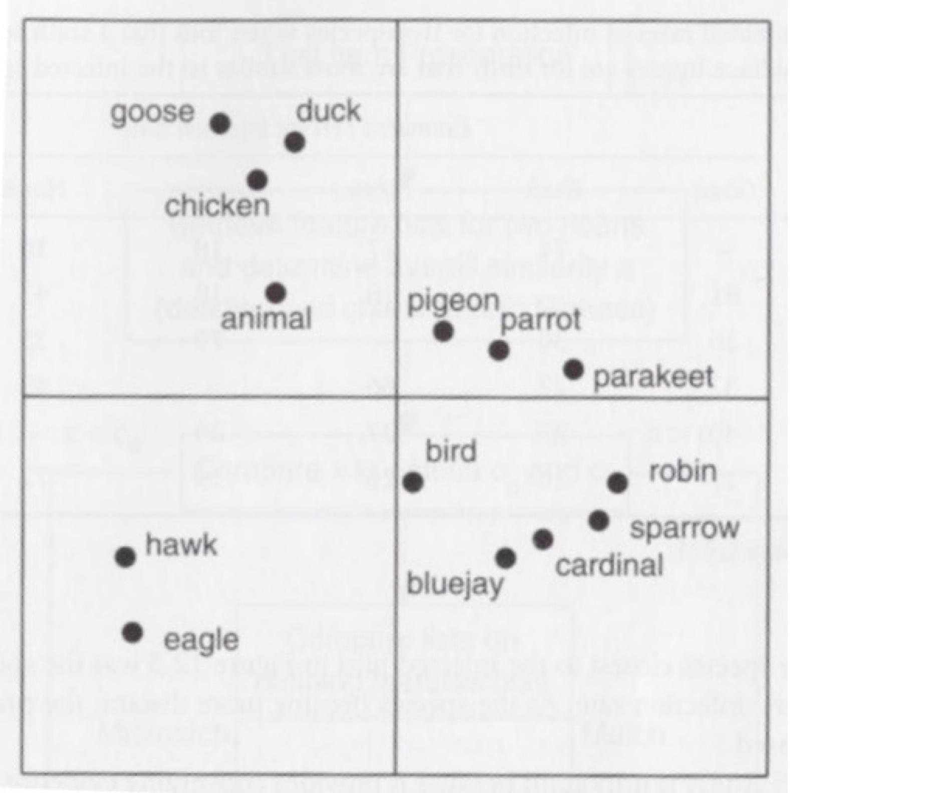
Similarity Scaling Experiments

Slide 19
Challenges for Feature Theories
Sufficiency
Continuous vs. categorical decision times
Distinguishable from spreading activation?
Learning
Parsimony

Slide 20

What is this object?

Slide 21
What is this object?
Cardboard Chair

Slide 22
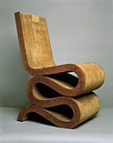
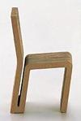
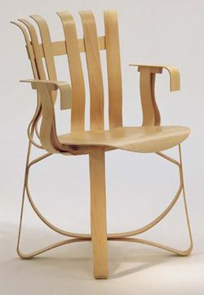
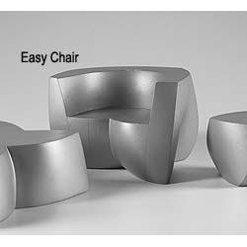
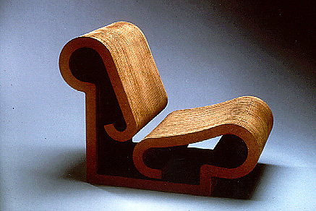

Continuous rather than categorical

Slide 23
Challenges for Feature Theories
Sufficiency
Continuous vs. categorical decision times
Distinguishable from spreading activation?
Learning
Parsimony

Slide 24
Biggest Challenge for Feature Theories
Typicality
    Geometric figure
    Fruit
    Piece of furniture
    Occupation
    College Professor
    Color

Slide 25
Prototypical Shapes

Slide 26
Prototype Theory
All concepts are organized around a prototype
  prototype need not exist
  Concepts organized around characteristicness.
  Not defining attributes but typicality / Family Resemblance
___________________________________________
Do all birds fly?
Are all birds small?
Do all birds have a furcula?
___________________________________________
Important Point: the features that define a category may not be the ones we use to identify category members.

Slide 27
Research on prototypes
Structure of categories:
  Some prototypes are cultural universals
  EX: colors
  Prototypes exist for ad-hoc categories
  EX: college professor
  Things to take on a camping trip
  Category structure is graded
  Sentence verification correlates highly with prototypicality
  EX: a) Is a robin a bird?
  b) Is an ostrich a bird?

Slide 28
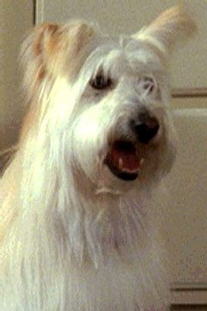
Basic Level Descriptions

Slide 29
Prototype CogLab

Slide 30
More Prototype Research
Memory and perception:
1) Memory positively correlated with prototypicality.
2) RT varies indirectly with the prototypicality.
3) Errors gravitate towards prototypes.
______________________________________________
Challenges for Prototype Research:
1) Context effects – Down on the Farm
2) Generality – What is a good odd #?

Slide 31
Exemplar Theory
More than one prototype per category
EX: Songbirds
Birds of Prey
Birds for eatin’
Main advantage====> Flexibility
Easier to identify an unknown object because more reference points against which to compare it.
Main drawback====>
______________________________________________
Hybrid model:
a) Combines hierarchy of spreading activation models
b) Family resemblance of prototype theory
c) Weaknesses of hybrid models (in general)

Slide 32
Parallel Distributing Processing (PDP) Models
The problem of the “Engram” or “Grandmother cell”
Karl Lashley:
Q: Is there a single cell the represents a concept like “Mim”? If not, then how do we store information?
Connectionists:
A: Information is spread (distributed) across a seemingly infinite network of neurons.

Slide 33
PDP / Connectionist Models

Slide 34
PDP / Connectionist Models

Slide 35
How do connectionist models work?
Three basic parameters:
1) Units may take on 1 of three states
  Baseline
  above baseline
  below baseline
2) Connections can either be
  Excitatory
  inhibitory
3) Connections are weighted

Slide 36
What is good about connectionist models?
Allows us to have multiple systems working at once, explains how people respond so well, so quickly, and so flexibly.
2) Mirrors the way we know neurons actually work.
3) Plausible answers to two key questions:
What is learning?
  Gradual strengthening of connections between units.
What is forgetting?
  Gradual weakening of connections between units.
Circumvents the engram problem.

Slide 37
Where connectionism struggles?
1) One-trial learning.
2) Reversal of old patterns.
  Is a pumpkin a fruit?
Connectionist response: Two systems.
One system for slow, stable, long-term memory
One system for quick, adaptable learning that is eventually integrated with the connectionist network.

Slide 38
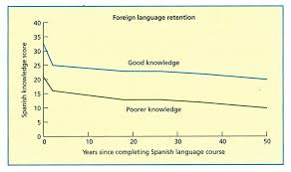
Bahrick, Bahrick, & Wittlinger (1975)
Longitudinal vs. cross-sectional research:
  Economics
  Ecological validity
  Cohort differences
  Group changes
Methods:
  Free and cued recall
  Picture and name recognition
  Statistical control of confounding variables

Slide 39
Implications of Bahrick’s work
Permastore
EX: HS Spanish / Math
college town
students and teachers
  Ebbinghaus / Rubin & Wenzel
  Schulkind, Hennis, & Rubin
2) Spaced practice
3) Descriptive research
    Many factors so can't isolate which causes forgetting
    Observation part of scientific method

