Slide 1
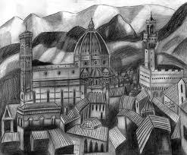
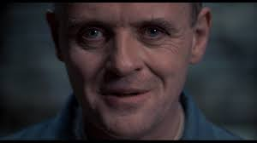
Imagery
It’s the Duomo as seen from the Belvedere…do you know Florence?

Slide 2
Outline: Mental Imagery
Define mental imagery and give examples from several sensory modalities.
Describe the distinction between the two major models of imagery representation
  analog
  propositional
Define the concept of functional equivalence and its relationship to the analog/propositional debate including
    cognitive maps of the world.
    neuropsychological evidence.
Discuss practical applications of mental imagery including its use a mnemonic technique.

Slide 3
Mental Imagery
Imagery - a mental representation of an object that is not physically present.
a) Visual Images
b) Auditory Images
c) Tactile, Olfactory, Gustatory
d) Motor Imagery
e) Emotional Imagery
Key questions:
How are images represented?
Relationship to true perception.
Individual Differences.

Slide 4
The Great Representation Debate:
Analog vs. Propositions
Analog Code: Images take a form very similar to the actual, physical object. (Hint: analogy)
Kosslyn: Visual images are literally pictures in the brain. We have an internal movie theater in our heads. There is an internal camera that projects the image, an internal screen that receives the image and an internal eye the views the image.

Slide 5
The Great Representation Debate:
Analog vs. Propositions
Propositional Code: Images are constructed using abstract, verbal descriptions.
Pylyshyn: Images are an epiphenomenon. We don’t spontaneously generate them. They appear to us as a consequence of activating the propositions that describe an object and we only use them under highly constrained situations.

Slide 6
Contrasting analog v propositional
How do you get from Fayerweather to your dorm?
Analog Propositional
Left, right, left right…

Slide 7
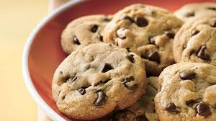
Contrasting analog v propositional
How do you know when chocolate chip cookies are done?
Analog Propositional
Challenging!

Slide 8
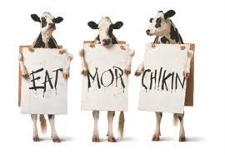
Challenges of studying mental imagery
Problem #1: Unobservable process.
Solution #1:
Measure reaction time
EX: Form an image of a cow
Raise your hand when you are done.

Slide 9
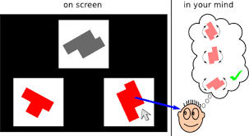
Challenges of studying mental imagery
Problem #2: Interpreting RT
RT varies with ability.
RT varies with level of detail.
Level of detail varies with ability.
Solution #2: Measure RT and accuracy
EX: Ask people to manipulate an object in their heads and ask verifiable questions. (e.g., Shepard & Metzler, 1971)

Slide 10
Functional Equivalence
Functional equivalence - Although the experience of imaging an object is not identical to perceiving a real object, images should share the properties of real objects and manipulation of images and real objects should be analogous to one another.

Slide 11
Predictions of Functional Equivalence
Predictions:
1) Imaged objects should follow the same laws of time and space as physical objects.
2) The relations of elements of a visual image should be analogous to those of an actual object.
3) We should be able to infer information from mental images that were not specifically stored at encoding.
4) The construction of mental images should be analogous to the construction of visually perceptible figures.
5) The brain structures that are used to perceive objects should be largely the same as those used to image objects.

Slide 12
Shepherd & Metzler (1971): Rotation Studies
Theoretical Question:
Empirical Question:
Introduction:
  Introspective reports
Method:
Why did they choose unfamiliar objects?
Picture Plane and depth

Slide 13
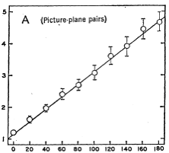
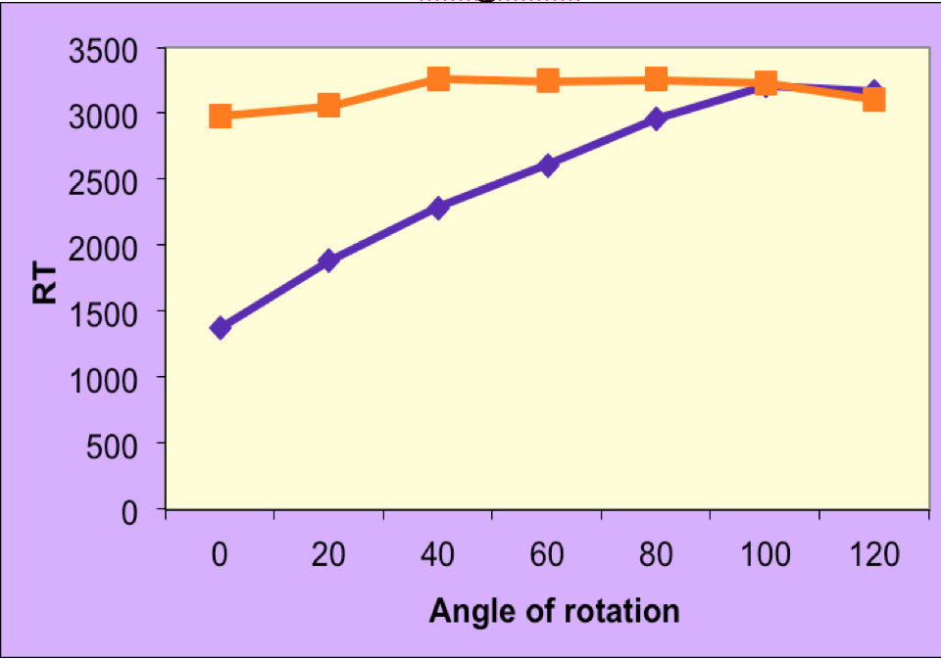
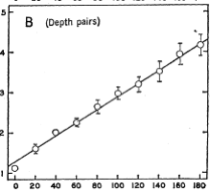
Rotation Study Results
Shepherd & Metzler (1971)
CogLab
What do these data say vis a vis functional equiv?

Slide 14
Other data related to functional equivalence
Individual differences: People with good spatial ability are much faster at imagery tasks than people with bad spatial skills.
Grain size: the ‘larger’ the image, the faster/easier the task.
  Elephant next to a rabbit v fly next to a rabbit
Symbolic distance effects: greater discrepancies yield smaller RTs.
  Which is larger a man or a mouse? Typically faster than…
  Which is larger a moth or a bird?
Clock images
  4:10 v 9:23 typically faster than 3:15 v 5:30

Slide 15
Functional Equivalence: Imagery Fusion studies
Exercise #1:
Construct an image of a capital letter M, and an image of an inverted capital letter M. Align the two images so that the bottoms (3-point ends) touch. What do you have?
Exercise #2:
Superimpose an image of a capital letter X with an image of a capital letter H. What do you have?

Slide 16
Mental maps: SchulkindLand
Notes:
]

Slide 17
Where does functional equivalence stand?
Claims
Imaged objects should follow the same laws of time and space as physical objects.
The relations of elements of a visual image should be analogous to those of an actual object.
We should be able to infer information from mental images that were not specifically stored at encoding.
Evidence
Mental rotation and mental scanning
Grain size, symbolic distance, mental scanning
Imagery fusion, mental scanning, map data

Slide 18
Where does functional equivalence stand?
Claims
The construction of mental images should be analogous to the construction of visually perceptible objects.
The brain structures that are used to perceive objects should be the same as those used to image objects.
Evidence
Complexity increases construction and rotation latencies.
Dual-task costs, neuropsychological data

Slide 19
The other side: data that counter functional equivalence
Bartlett Figures
Does a Jewish Star contain a parallelogram?
Grasp the left, front, bottom corner of a cube with your left hand, and the right, rear, upper corner with your right hand. Mentally rotate the cube so that the corner in your left hand is directly below the corner in your right hand. How many corners of the imaginary cube are in the middle plane (i.e., not being grasped by your hands?
Draw a penny

Slide 20
Mental maps and functional equivalence
Which is further west:
Los Angeles or San Diego?
San Diego or Reno, NV?
New York or Miami?
Which is a longer trip:
  Philadelphia to Pittsburgh Philadelphia to Richmond
  New York to Pittsburgh Richmond, VA to Pittsburgh
  Miami, FL to New York Miami, FL to Columbus, OH?
Which is farther north: Rome or Philadelphia?
Draw an outline of the state of South Carolina.
Draw a US Map.

Slide 21
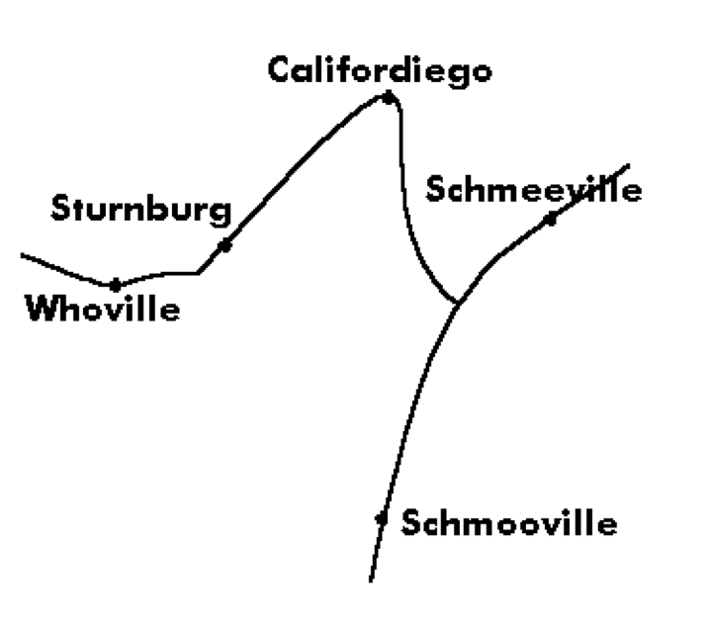
More on maps

Slide 22
Compromise is always a good thing (???)
Two types of representation
Surface / Analog representation
Accounts for picture-like quality
Deep / Propositional representation
used to handle more difficult tasks.
arbitrary relationship between what is represented and how it is represented.

Slide 23
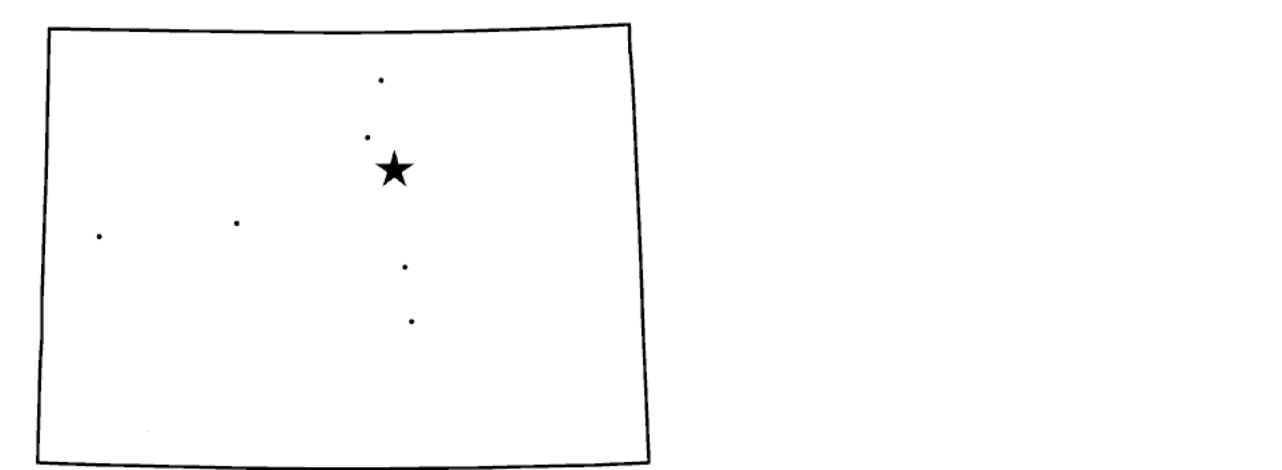


Neuropsychological data
Martha Farah – ERP data
Group 1: Read a list of concrete words
Group 2: Read and image same list
Results: No difference for first half-second
More occipital lobe activity in Group 2
Two Component model
  Visual - physical appearance of an object
EX: Which states share shape: NC, VA, CO?
  Spatial - relationships between different objects
EX: Which states are closest: FL, GA, MO
  Patient (LH)

Slide 24
Practical Applications of Imagery
Therapy
Systematic desensitization
Guided imagery (recovered memories)
Athletics
Typing
Art
Painting
Literature - See the movie or not?
School
Visit your professors

Slide 25
Imagery as a mnemonic device
Pegword system
One-Bun Six-Sticks
Two-Shoe Seven-Heaven
Three-Tree Eight-Gate
Four-Door Nine-Dime
Five-Hive Ten-Hen
Method of Loci
______________________________________________
Why is imagery an effective mnemonic?
Bizarreness?
Interactivity

