Slide 1
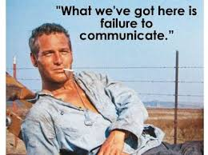
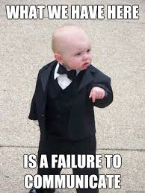
Language

Slide 2
Outline: Language
Distinguish between language and communication.
Discuss the hierarchical structure of language.
Examine a variety of approaches aimed at understanding and predicting linguistic behavior:
Speech perception
Speech production
Syntax
Chomsky’s Tranformational Grammar
Pragmatics
Re-visit the nature vs. nurture debate as it related to language learning.
Discuss language learning by non-human primates.

Slide 3
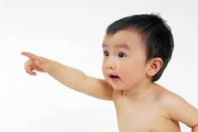
Defining Language…is hard
Language is very difficult to put into words.
~ Voltaire
Language is…
a system of symbols that individuals use to communicate ideas or feelings to one another
a rule-governed use of arbitrary symbols.
a shared symbolic system for communication
Language is not synonymous with communication!!!

Slide 4
Universal truths and critical features
Universal truths:
Universal
1st Language learning is seemingly effortless
Infants distinguish phonemes of all languages
_________________________________________________________

Slide 5
Universal truths and critical features
Critical features of Language
Semanticity / communicativity
Productivity/generativity
Arbitrariness
Structure
Displacement
Dynamic
Traditional Transmission

Slide 6
Building blocks of language: I
Phoneme
categorical
change based on context
Morpheme
smallest unit of meaning, e.g., truckers
content vs. function
tense, number, possession, comparison
Words
contentives and functors
Parts of speech

Slide 7
Building blocks of language: II
Phrase
subject, verb, object
Sentence
Positive vs. negative
True vs. false
Discourse
Speaking roles

Slide 8
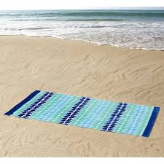
Analyzing language at multiple levels
“My friend Pete stole the little boy's rocks and put them under his towel.”
“My friend Pete stole the little boy's towels and put them under his rock.”
Phonology
Phonemes - deleting phonemes
Morphemes - speech errors
Syntax
Words - lexical access (TOT)
Parts of Speech - anaphor resolution
Phrase - expectations/comprehension

Slide 9
Analyzing language at multiple levels
“My friend Pete stole the little boy's rocks and put them under his towel.”
“My friend Pete stole the little boy's towels and put them under his rock.”
Semantics
Sentence - words v structure
Pragmatics
Discourse - audience factors

Slide 10
Phonology: Speech Perception
Size of phoneme set:
English 40 phoneme
Hawaiian 15 phonemes
African languages 60 phonemes
Phonology – rules for combining phonemes EX: Squirrel (let’s be fair)
Co-articulation
phonemes are blended in speech
telephone operator
Problem of invariance

Slide 11
Phonology: Speech Production
Allophones
slightly different articulations of the same sound
"Please put the paper cup to your lip"
foreign language perception
regional differences in English

Slide 12
Is speech perception different? Yes!
EXTREME fluency
50 phonemes/second; 50 times faster than non-speech stimuli
Categorical Perception
/ba/ vs. /pa/
Voice Onset Time – pit vs. bit

Slide 13
CogLab: Categorical Perception

Slide 14
Is speech perception different? Not so much…
Categorical perception of non-speech stimuli
Time perception –
Color
Emotional expressions
Context effects
phonemic restoration effect
phonemic refinement (Deutsch demo)
REM effect
______________________________________________________
Compromise position: modularity

Slide 15
Syntax: the study of grammar
Prescriptive grammar –
what your HS English teacher tried to teach you
Descriptive grammar –
the rules that govern ‘legal’ English utterances

Slide 16
Syntax: the study of grammar
Which of these sentences use proper English syntax?
The students bought the book.
Bought the book.
Bought the student the book.
The book was bought by the student.
By whom was the book bought?
By student the book bought.
The student was bought by the book.
Who bought the book?
The book bought the student.
The book bought.

Slide 17
Syntax and Semantics
Semantics – how do we express meaning through language?
Speech errors - in-class confusions, maintain morphemes
Right- and left-branching languages
He bought the book at the store. vs.
He bought at the store the book.
Notes:
My brother and I are hard to distinguish on the phone.
Rocks and blankets example.
Ball is not an agent; things are done with and to balls. Balls typically don’t do stuff.

Slide 18
Syntax and Semantics
Lexical entries include syntactic information
Objects can have different roles
Agent doer of an action
Patient receiver of an action
Beneficiary indirect recipient of an action
Instrument means used to implement it
“Mary and John saw the mountains flying to California’

Slide 19
Linguistic Relativity / Whorfian Hypothesis
Strong Version
language determines thought
Weaker Version
language influences thought.
New Version
language obligates us to entertain certain thoughts.
Notes:
Includes snow, snows, snowing.
Difficult to express numbers, but implications are clear.

Slide 20
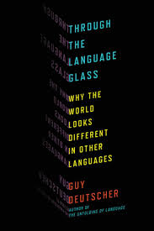
Linguistic Relativity / Whorfian Hypothesis
Data tossed around as evidence:
Inuit language has 100 different words for “snow”.
Cross-cultural differences in color words
Languages that like counting or timing words.
“There are 53 people on the boat but only enough lifeboats for 36.”
Not unaware of the passing of time.
Marked/Unmarked terms
In English: Belief/Disbelief
In German: Doch vs. Doch stimt.
Issues of translation
Die brucke (f) vs. el puente (m)
My North foot
Notes:
Includes snow, snows, snowing.
Difficult to express numbers, but implications are clear.

Slide 21
Syntax and semantics: Confusion reigns
The horse raced past the barn fell.
The florist sent the flowers was very pleased.
The old train the young.
______________________________________________
Garden path sentences - these sentences are hard because the form of the sentence creates expectations that are not met.

Slide 22
Chomsky’s Transformational Grammar
A panda walks into a bar…
Shallow Structure
The words used to express an utterance
Deep Structure
What those words actually mean
Why is the distinction important?
Word order makes a difference
The French bottle smells good.
The French bottle good smells.
Notes:
Small difference in surface; big difference in deep.
No difference in surface; big difference in deep.

Slide 23
Chomsky’s Transformational Grammar
Shallow structures are often ambiguous
I saw a man eating fish.
The spy saw the cop with binoculars.
The Mayor ordered the police to stop drinking.
Librarian: Shh!! The people around you can't read.
Student: Then what are they doing in a library.

Slide 24
Do we ever remember the shallow structure?
Jokes, personal statements, and insults
Why? Because exact wording matters
Rhythmic speech
Rubin (1977) memory for 23rd Psalm, National Anthem, Preamble
Why? Rhythmic structure gives you an opportunity to restart at the next rhythmic juncture

Slide 25
Do we ever remember the shallow structure?
Song lyrics and counting-rhymes
Why? Integrated levels of multiple constraints
Friend of the Devil
I've got two reasons why I cry away each lonely night,
The first one's named Sweet Anne Marie and she's my heart's ____________.
The second one is prison babe, and the Sheriff's on my trail,
And if he catches up with me I'm gonna spend my life in _________________.

Slide 26
Pragmatics: how we express our thoughts
Surface structure changes dramatically (and spontaneously) depending on the audience’s
Age
Native language
Social Standing
Relationship
Setting

Slide 27
Pragmatics: how we express our thoughts
The musicality of speech
Prosody – pitch variations in speech including tonal languages
Cadence – the timing of speech utterance (stressed v unstressed syllables)
Both have implications for meaning
Difference between different languages

Slide 28
Language learning: Nature v. Nurture
Imitation
However, never would hear "goed"/"buyed"
Babbling closely tied to native language
Parents speak differently to girls than boys and girls develop language earlier
Learn a set of rules
What is the plural of "wuk"?
What is the plural of "wug"?
Behaviorist Account
rewarded for sounds that approach real words
Abby’s first word was ‘Dada’

Slide 29
Language learning: Nature v. Nurture
However, not good at explaining grammar
mothers correct errors of fact; ‘Nobody don’t like me.
generalize to novel situations
generate/understand novel utterances

Slide 30
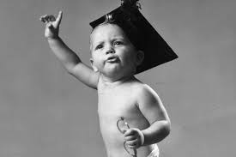
Saffran, Aslin, & Newport (1996): Intro
Theoretical Question:
Empirical Question:
Intro:
What is the evidence of experience-independent learning? Experience dependent learning?
Why is language segmentation a difficult problem?
What are transitional probabilities?

Slide 31
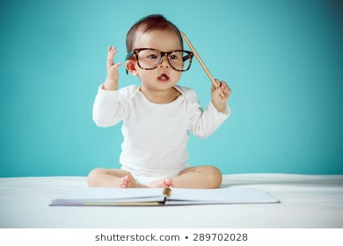
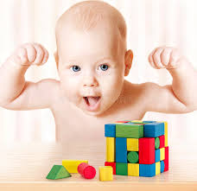
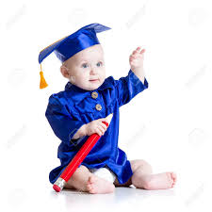
Saffran, Aslin, & Newport (1996): METHOD
Method:
Why did they use synthesized speech?
Words: tupiro/golabu/bidaku/padoti
Transitional probabilities?
E1 Test: tupiro vs. dapiku
E2 Test: tupiro vs. rogala or bubida

Slide 32
Saffran, Aslin, & Newport (1996): Results and Discussion
Results: Listened longer to:
Implications/Questions:
What did Exp 2 accomplish that Exp 1 did not?
How do infants learn vocabulary?
Is this type of learning completely experience-based?
What are the ‘other types of cues’ that Saffran, et al. (1996) allude to in the penultimate paragraph?
Why did the authors use a habituation procedure? Do you have any concerns about this methdology?
___________________________________________________
Aside: Better with foreign language than nonsense

Slide 33
Language learning: Nature v. Nurture
Cultural Universals
Progress very similar across cultures
Girls hit major milestones before boys do (could be genes)
Cooing
sounds the same across cultures and even in deaf children
deaf children don’t babble
Infant phoneme recognition
Through at least 6 months, all phonemes are distinguishable
Japanese kids lose /l/ vs. /r/
English kids lose allophones of /t/
Subject-Verb-Object Order
OVS and OSV never used

Slide 34
Language learning: sensitive periods
Definition
Plasticity confined to a restricted period
Learning is irreversible
children denied speech (Genie)
2nd language learning
Adults learn faster but rarely gain same level of proficiency
early vs. late learners of sign language
Cortical organization of L1 and L2

Slide 35
Language learning: sensitive periods
Why do sensitive periods occur?
By-product of specialization
Cortical areas respond to wide-range of stimuli
Slowly become specialized
When specialization is complete, critical period closes
EX: Raising animals in the dark

Slide 36
Natural language in non-humans
Semanticity
Chimps make different sounds for different predators
Flexibility
Animal communication is not dynamic
But, whales change calls after exposure to other pods.
Limited Scope
No signal for trees, different fruits, emotions
Displacement and Productivity
“Let me tell you about the snake I saw yesterday”
“Whew, glad that wasn’t an eagle”
“No eagles anywhere in sight”

Slide 37
Non-human language learning
Speech
Primates…no.
Birds… maybe? (see also this…and this)
Washoe’s impressive sign language ability:
By age 1, she could combine signs
"more fruit"
"open out please hurry”
By age 4, she understood 160 signs
Creative use of language
Gardners fridge = "cold box"
Washoe fridge = "open food drink”

Slide 38
Non-human language learning
But:
By age 4, a child knows 20x as many words
Utterances never averaged more than 1-2 morphemes;
Child by age 3 averages 4 morphemes per utterance
Elementary Constructions

