Slide 1
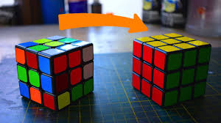
Problem Solving

Slide 2
Outline: Problem Solving
Explore different kinds of problems and break down the basic anatomy of a problem.
Look at methods that encourage and interfere with for successful problem solving.
Discuss three important issues related to success:
    Transfer
    Incubation
    Insight
Examine personality characteristics/individual differences related to problem solving:
    Talent
    Creativity
    Expertise

Slide 3
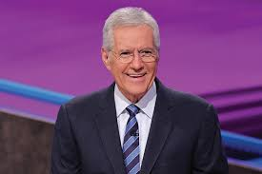
Define the verb ‘Trebek’

Slide 4
Characteristics of problem solving
    Characteristics of problem solving
      Goal Directedness
      Sequence of steps
      Cognitive operations
      Subgoal decomposition

Slide 5
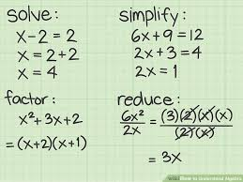


Types of problems
Well-defined –
  problems with a limited set of inputs and operations that have a definite answer and a definite solution procedure.
  EX: algebra problems
Fuzzy –
  problems with a functionally infinite set of inputs and operations with no obvious definite solution or best answer.
  EX: psychology exam
Everyday problems:
I need to get to the bank, and the grocery store, mail my phone bill, go to class be at work at 2:00.

Slide 6
Types of problems
Natural progression
    Theory vs. application
    Inside vs. outside the lab
    Across your educational career

Slide 7
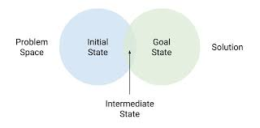
Anatomy of a problem
Beginning State –
  the set of information given at the beginning; the state of affairs before any attempt to solve the problem is made.
Problem Space –
  a listing of all the relevant elements, procedures and rules for solving a problem
Goal State –
  the definition of what constitutes a successful solution to the problem.

Slide 8
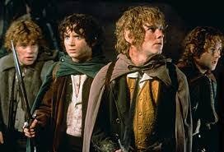
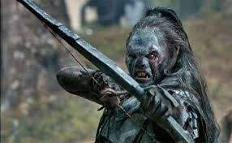
General problem solving strategies
Difference Reduction Method - create a number of attainable subgoals that will reduce the difficulty of the task to a series of manageable steps.
Three orcs and three hobbits are on the West side of the Connecticut River. As you know, there are hardly any bridges across the CT River, so everyone decides to take a boat. The only rowboat available carries two creatures. Your job is to get all 6 Middle-Earthers across the river, with the following stipulation. If you leave more orcs than hobbits on one side of the river, it’s curtains for the hobbits.

Slide 9
General problem solving strategies
Generate/Test –
  Generate a potential solution; see how well it works.
  EX: professor's age
A professor offered her students the following challenge. ‘I don’t mind if you know my age and I’ll offer extra credit to anyone who can figure it out from the following information. If you subtract my age from one of yours, you’ll get 44 and the product of my age and one of yours is 1280’. How old is the professor?

Slide 10

General problem solving strategies
Alternative Representations –
  try describing the problem space in a different modality (e.g., visual instead of verbal)

Slide 11

General problem solving strategies
Solution Reversal –
  start at the end state and try to work your way back to the beginning state.
  EX: Ten Pennies (you can take 1, 2, or 3; last one loses)

Slide 12
Pick a Penny – Any Takers?

Slide 13
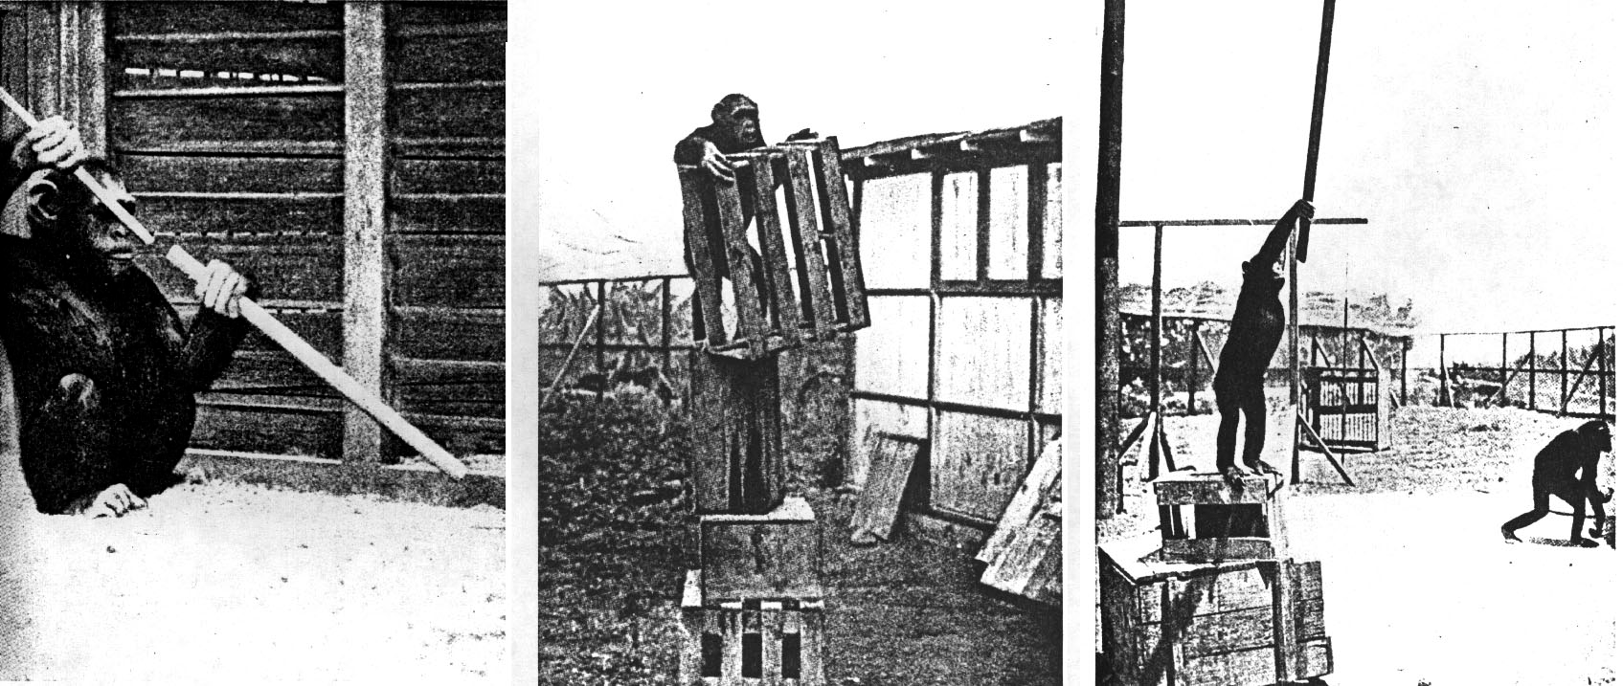
General problem solving strategies
Means-end analysis –
  create a subgoal that will allow a certain operator to become useful.
  EX: Sultan the Monkey

Slide 14
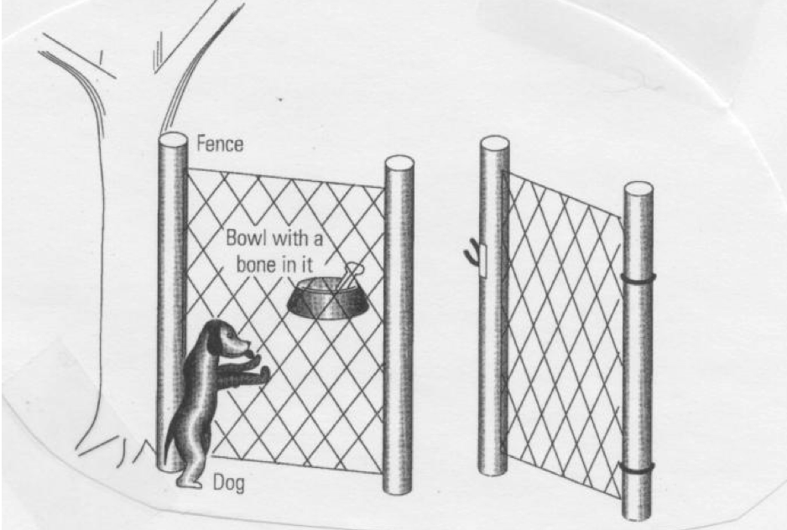
What makes problem solving hard?
Difference reduction –
  bias to make the move that will have the greatest affect on the distance to the goal state.
EX:

Slide 15


Difference Reduction: People version
C O L D
__ __ __ __
__ __ __ __
__ __ __ __
W A R M

Slide 16

Difference Reduction: People version
F A L L
__ __ __ __
__ __ __ __
__ __ __ __
C O L D

Slide 17
What makes problem solving hard?
Repeat State Avoidance –
  bias against returning to an earlier state; sometimes you have to go backwards in order to go forwards
  EX: football vs. soccer
  Orc / Hobbit
  Tower of Hanoi

Slide 18
Orc Hobbit Problem
Three Orcs and three hobbits are the West side of the Connecticut River. As you know, there are hardly any bridges across the CT River, so everyone decides to take a boat. The only rowboat available carries two creatures. Your job is to get all 6 Middle-Earthers across the river, with the following stipulation. If you leave more Orcs than Hobbits on one side of the river, it’s curtains for the hobbits.

Slide 19
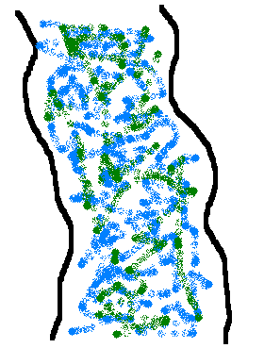
Orc / Hobbit: Step 1
H
H
H
O
O
O

Slide 20

More problems with problems: Persistence of set
You have three jugs (A, B, and C) and a faucet. Use the jugs to create the target volume of water in Column D.
A | B | C | D
21 | 127 | 3 | 100
14 | 163 | 25 | 99
18 | 43 | 10 | 5
9 | 42 | 6 | 21
20 | 59 | 4 | 31
23 | 49 | 3 | 20

Slide 21
More problems with problems: Persistence of set
Solve these Anagrams:
hcsip rbkoo ugeid
hcfie rfhes tseal

Slide 22
Functional fixedness: dot problem
. . . .
. . . .
. . . .
. . . .

Slide 23
Functional fixedness: matchsticks
Match Problem: You have six matches. Arrange them such that you create 4 equilateral triangles with each side equal to the length of one match.

Slide 24
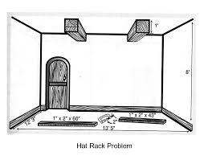
Last bit on functional fixedness: hat rack
Using just the materials shown here, can you construct a hat rack in the room shown in this figure?

Slide 25

Which game would be easiest to win?
1) A set of cards showing the integers 1-9 are placed face up between two players. The goal of the game is to be the first to hold three cards bearing integers that sum to 15 (you are not limited to three cards, but three of your cards must sum to 15). If neither player satisfies these conditions, the game is declared a draw, the cards are replaced on the table, and the game begins anew.
2) Tic-Tac-Toe
3) Each player chooses a square. The first player who completes a horizontal, vertical, or diagonal line that sums to 15 wins. If neither player wins, the game is a draw and play starts over.
6 | 1 | 8
7 | 5 | 3
2 | 9 | 4

Slide 26
Analogical transfer
How well do we extract relevant information from an example and use it to solve future problems?
Depends on two factors:
  Structural similarity - similar to deep structure
  Surface similarity - similar to surface structure

Slide 27

Gick & Holyoak (1980)
Lightbulb story: Biff broke the filament of a lightbulb in the physics lab where he works. A single high-energy laser [ultrasound wave] would fix the filament, but would break the glass of the bulb [would be too weak to fix the filament]? How can Biff fix the bulb? (phase 1: 4 versions)
Tumor story: A patient has a tumor that is inoperable by standard means. A high intensity laser beam would destroy the tumor, but would also destroy too much of the surrounding tissue. How can the patient be saved? (phase 2: 1 version)

Slide 28
Wason Selection: If vowel, then even
E
K
4
7

Slide 29
Wason Selection: If alcohol, then > 21
Beer
Soda
16
24

Slide 30
Wason Selection Task – CogLab data

Slide 31
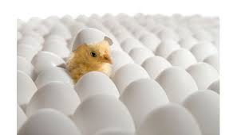
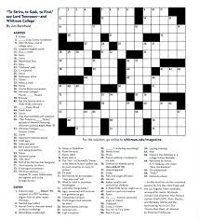

Incubation
Incubation –
  when all else fails, set the problem aside for a while and do something else.
  EX: crossword puzzles
Why does incubation work?
  decay of less important details
  consolidation
  new stimuli may activate different perspectives
  new problem enables analogical transfer
  when cognitive arousal is low, a larger number of more remote cues can become activated leading to a problem solution
Ways to make incubation work for you:
  try hard before setting the problem aside
  be patient; not good if working on a deadline
  REALLY STOP THINKING ABOUT IT!

Slide 32

Insight
Insight Problem –
  a problem for which the solution requires the solver to dramatically re-conceptualize some aspect of the problem.
Example #1: A prisoner was attempting to escape from jail. He found a rope that was half as long as he needed to slide out of his cell window and down to safety. He divided the rope in half and tied the two parts together and escaped. How did he do it?
Example #2: You have 4 links of chain. It costs two cents to open a link and three cents to close the link back up. Your goal is to join all 4 links into a single circle at a cost of no more than 15 cents.
Notes:
‘knowledge’ of the world affects our images

Slide 33
Insight
Insight Problem –
  a problem for which the solution requires the solver to dramatically re-conceptualize some aspect of the problem.
Example #3: Move three pennies to form a triangle pointing in the opposite direction.

Slide 34
Nature of insight
Selective encoding –
  learn what to pay attention to and what to ignore
Selective comparison –
  learn how two pieces of seemingly separate information actually relate to one another.
Selective combination –
  learn how to combine pieces of information into a unified representation.

Slide 35
Metcalfe & Wiebe (1987)
Theoretical Question:
Empirical Question:
Intro:
  What is metacognition?
  Why is insight so difficult to study?

Slide 36
Metcalfe & Wiebe (1987)
Method:
  Solved insight and noninsight problems
  Gave warmth ratings and expectations / predictions regarding whether a problem would be solved correctly
Results:
  Expectations / predictions were more accurate for noninsight problems
  Large changes in both incremental and angular warmth ratings were associated with insight problems

Slide 37
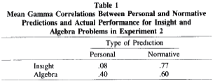
Metcalfe & Wiebe (1987): Discussion
Their conclusion: Metacognitive experience can distinguish insight from noninsight problems
What was the difference between Exp. 1 and Exp. 2? Why were both included in the paper?
What is the difference between personal and normative predictions of success? Why might they differ? What do the data related to this analysis mean?
What are some other possible interpretations for the results of the experiments?

Slide 38
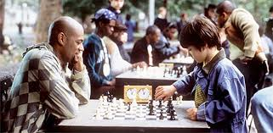
Problem solving: nature v nurture
What determines success?
  Nurture: Practice makes perfect
  Nature: Some people born with an ability (a talent) to perform certain tasks?
Genes do matter
  Parents who read well have kids who read well (and vice versa)
  I was never in any danger of playing a sport professionally.
But, you can always get better
  ‘geniuses’ tend to practice a lot
  10,000 hour rule

Slide 39


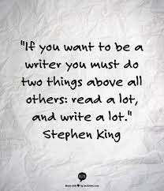
Amount of ideas one produces
I give you a problem and ask you to create as many solutions as you can think of. I measure diversity, numerosity and appropriateness of your responses
It’s what you know
Creative people study their domain more, so they know more, and therefore, can produce more valuable and new ideas by combining and reshaping what they already know.

Slide 40


It’s who you are
openness to new ideas, new ways of thinking and seeing the world; intrinsic motivation
It’s where you are
your environment (parents) and social, scientific, and artistic communities in which you are raised all play a role

