Slide 1
Decision Making
Burt Johnson: I don’t drink because drinking affects your decision making.
Arthur: You may be right, I can’t decide.

Slide 2
Outline: Decision Making
Describe the difference between decision making under certainty and decision making under uncertainty.
Briefly discuss the rules for decision making under certainty.
Describe the steps for making a decision under uncertainty and describe the kinds of errors typically made at each step in the process.
Define and illustrate some common decision making heuristics.

Slide 3
Syllogisms: Decision making under certainty
If we are on a long car trip, then Tammy is asleep.
Interpreting scientific papers:
  Scientist makes a prediction: ‘If p, then q’
  Run an experiment showing that q is true
  Conclude that p is also true. Not a valid inference.
Syllogism | Fact | Inference | Validity?
p is true, ∴q is true | We are on a long car trip. | ∴Tammy is asleep.
p is false, ∴q is false | We are NOT on a long car trip | ∴Tammy is NOT asleep.
q is true, ∴p is true | Tammy is asleep. | ∴We are on a long car trip.
q is false, ∴p is false | Tammy is NOT asleep | ∴We are NOT on a long car trip.

Slide 4
Drawing inferences under uncertainty
Where should I go to graduate school?
Erroneous assumption: There is a ‘soul mate’ choice.
Gathering information
    get graduate program
    get website URL
    Find people who went to grad school
Sampling information
    READ graduate program
    READ website
    Talk to The Darkness

Slide 5
Drawing inferences under uncertainty
3) Selecting relevant data
    Geographical location
    Fellowships
4) Integrating information
    Prioritizing

Slide 6
Common decision making errors: Stages 1 and 2
Gathering information
  Erroneous theories
  confirmation bias
Sampling information
  confirmation bias
  representativeness of sample
  sample size
  sampling bias

Slide 7
Common decision making errors: Stages 3 and 4
Selecting relevant data
  regression to the mean
  dilution effect
Integrating information
  conjunction fallacy
  covariance errors
  IP constraints
  framing effects
  Peak-End rule
  base rates

Slide 8
Gathering stage errors – Erroneous theories
Is it going to rain?
  Clouds make rain.
  Therefore, if there are no clouds, it will not rain.
I’m thinking about taking Stats from The Darkness. Is he a good professor? Yes because…
…I got a good grade.
…occasionally, he tells a funny story.
…he donates blood regularly.
…even though I didn’t learn a damn thing, I figure that it was probably my fault.

Slide 9
Gathering errors – Confirmation bias
When trying to determine the validity of an assertion:
Information search is highly biased towards finding confirming evidence. (gathering)
__________________________________________
Is Donald Trump likely to be impeached?
MSNBC v. Fox News
New York Times v. Wall Street Journal

Slide 10
Sampling errors – Confirmation bias
When trying to determine the validity of an assertion:
Information search is highly biased towards finding confirming evidence (gathering).
Information search terminates too quickly (sampling).
____________________________________________
Is Donald Trump likely to be impeached?
MSNBC v. Fox News
New York Times v. Wall Street Journal
Do you stop after reading the NYT, or do you also consult WSJ?

Slide 11
Sampling errors – sample characteristics
When Camila Giorgilooks in the mirror.
Does she say, "I'm a good tennis player!”?
______________________________________________
Representativeness of sample
    extreme values will throw off sample
Sample size
    small samples are less likely to be representative
Sampling bias
    Who/what are you going to sample?
    Things that are available.

Slide 12
Selection errors
Regression to the mean
Sports Illustrated jinx; Madden NFL jinx
Are children typically taller than their parents?
You bomb the first exam, but do better on the second. Whew, now I know what I’m doing!
Dilution
unrelated information waters down people’s predictions.
“Just the facts, ma’am”

Slide 13
Integration errors
Conjunction Fallacy
I randomly select a student from this class:
  What is the probability that the student is a male?
  What is the probability that the student is a male who – on at least one occasion – drank more alcohol than he should have?
  Which of your two probabilities was larger?

Slide 14
Integration errors: Covariation
Illusory correlation – a mistaken impression that two variables ‘go together’.
A little bit of truth…
 | Scored | Failed to score
Stick toss | 60% | 20%
No stick toss | 15% | 5%

Slide 15
Preparing for the MCAS
You are the principal of Belchertown High. You are concerned that your 600 seniors won’t pass the MCAS. Your brother-in-law - the Vice Principal - devises two test preparation plans.
  400 people will fail.
  1/3 chance no one will fail; 2/3 chance all will fail.
Which plan do you choose?

Slide 16
Preparing for the MCAS
You decide to fire your stupid brother-in-law. The new Vice Principal also devises two test preparation plans.
  200 people will pass.
  2/3 chance no one will pass; 1/3 chance all will pass.
Which plan do you choose?

Slide 17
Integration error: Framing effects
When our choices are framed in terms of:
  gains, we are risk-aversive.
  losses, we are risk-seeking.

Slide 18
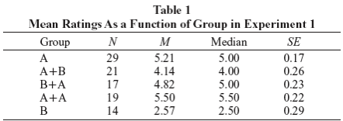
Integration errors: Do, Rupert, & Wolford (2008): E1
Theoretical question:
Empirical question:
Experiment 1: DVD choice with adults

Slide 19
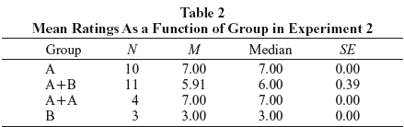
Integration errors: Do, Rupert, & Wolford (2008): E2
Experiment 2: Halloween candy with kids
Interpretation:
Are these data consistent with the peak-end rule?
Do you think the results of the experiment might differ if the gifts were more valuable?

Slide 20
Classic Integration error: Ignoring the base rate
Kahneman &Tversky (1973)
3 factors should influence judgments:
Base rate
Individuating information
Reliability of individuating information

Slide 21
Classic Integration error: Ignoring the base rate
Kahneman &Tversky (1973)
How likely is someone to be a grad student in each area?
Areas of Study | Base Rate | Similarity Judgments | Likelihood
Business | 15
Computers | 7
Engineering | 9
Humanities | 20
Law | 9
Library | 3
Medicine | 8
Natural Sciences | 12
Social Sciences | 17

Slide 22
Classic Integration error: Ignoring the base rate
Kahneman &Tversky (1973)
Individuating Information
Tom W. is of high intelligence, although lacking in true creativity. He has a need for order and clarity, and for neat and tidy systems in which every detail finds its appropriate place. His writing is rather dull and mechanical, occasionally enlivened by somewhat corny puns and by flashes of imagination of the sci-fi type. He has a strong drive for competence. He seems to feel little sympathy for other people and does not enjoy interacting with others. Self-centered, he nonetheless has a deep moral sense.

Slide 23
Classic Integration error: Ignoring the base rate
Kahneman &Tversky (1973)
How similar is Tom W. to a typical grad student in each area?
Areas of Study | Base Rate | Similarity Judgments | Likelihood
Business | 15 | 3.9
Computers | 7 | 2.1
Engineering | 9 | 2.9
Humanities | 20 | 7.2
Law | 9 | 5.9
Library | 3 | 4.2
Medicine | 8 | 5.9
Natural Sciences | 12 | 4.5
Social Sciences | 17 | 8.2

Slide 24
Classic Integration error: Ignoring the base rate
Kahneman &Tversky (1973)
How likely is Tom W. to be a grad student in each area?
Areas of Study | Base Rate | Similarity Judgments | Likelihood
Business | 15 | 3.9 | 4.3
Computers | 7 | 2.1 | 2.5
Engineering | 9 | 2.9 | 2.6
Humanities | 20 | 7.2 | 7.6
Law | 9 | 5.9 | 5.2
Library | 3 | 4.2 | 4.7
Medicine | 8 | 5.9 | 5.8
Natural Sciences | 12 | 4.5 | 4.3
Social Sciences | 17 | 8.2 | 8.0

Slide 25
Classic Integration error: Ignoring the base rate
Kahneman &Tversky (1973)
3 factors should influence judgments:
Base rate
Individuating information
Reliability of individuating information
__________________________________________________
Q: Is ignoring the base always a mistake?
Q: When should you ignore the base rate?

Slide 26
Classic Integration error: Ignoring the base rate
Kahneman &Tversky (1973)
3 factors should influence judgments:
Base rate
Individuating information
Reliability of individuating information
__________________________________________________
Q: Is ignoring the base always a mistake?
Q: When should you ignore the base rate?

Slide 27
Classic Integration error: Ignoring the base rate
Kahneman &Tversky (1973)
3 factors should influence judgments:
Base rate
Individuating information
Reliability of individuating information
__________________________________________________
Q: Is ignoring the base always a mistake?
Q: When should you ignore the base rate?
Q: Were these conditions met in the study?

Slide 28
Classic Integration error: Ignoring the base rate
Kahneman &Tversky (1973)
3 factors should influence judgments:
Base rate
Individuating information
Reliability of individuating information
__________________________________________________
Q: Is ignoring the base always a mistake?
Q: When should you ignore the base rate?
Q: Were these conditions met in the study?
Q: Did the subjects know HOW to apply base rate information?

Slide 29
General DM strategies: Algorithms and heuristics
Algorithm - a set of well-defined steps that will necessarily lead to an accurate conclusion
    Benefit:
    Cost:
Heuristic - a short-cut or rule-of-thumb that past experience demonstrates results in reasonably accurate conclusions.
    Benefit:
    Cost:
EX: Finding a book in the library
Lost gloves / cell phone

Slide 30
Common decision making heuristics: I
Availability Heuristic - the easier it is to call something to mind, the more likely that event is to occur
EX: More people die each year from:
lightning strikes
Tornadoes
Representativeness Heuristic - make decision based on how likely it is that an object belongs to a given category
EX: social judgments (my child is a genius)

Slide 31
Common decision making heuristics: II
Subjective randomness - people’s idea of what constitutes a random event isn’t exactly random
EX: Random Dot Man
Which of the following is more likely to be a random sample? 65, 65, 65 or 64, 68, 63
Overconfidence - people typically estimate the likelihood of a common event and estimate the likelihood of an uncommon event.
EX: Meteorologists

Slide 32
Common decision making heuristics: III
Gambler’s Fallacy - if there is chance event with two equally likely outcomes, x and y, then if x happens three times in a row, the probability that y will happen next is very high (or very low)
EX: basketball shooting
gambling in Vegas (hunches)
Simulation heuristic - consider a number of possible outcomes for a given event; the one that is easiest to picture is the one you think will happen
EX: How will my SO Spring Break indiscretion
The time I ruined my Mom’s car…

Slide 33
Common decision making heuristics: IV
Imagination Inflation
  Winning lottery OR Convicted of robbery
  Everyone rated the likelihood of the two events.
  People rated the event they imagined higher than people who imagined the other event
Anchoring and Adjustment - the order in which we encounter stimuli affects our judgments about them; early exposures create a basis from which to make comparisons
EX: paper folding (100 times)
the grill purchase

Slide 34
Hindsight bias: Louie, Curren, & Harich (2000):
Intro
Theoretical question:
Empirical question:
Introduction:
Power Company forecast
Prediction vs. postdiction
What is the major difference between Patriots example and LCH?

Slide 35
Hindsight bias: Louie, Curren, & Harich (2000):
Hypothesis & Measures
Major prediction of ‘self-serving bias’ hypothesis?
    Hindsight bias would be observed ONLY if one’s team was successful or another team failed (not if others succeeded or you failed).
Method:
    Measured MBA students in a zero sum game with clear winners/ losers.

Slide 36
Louie, Curren, & Harich (2000): Results
Table 1: Mean Hindsight Estimates
_______________________________________________________
Net likelihood of an increase Prediction Postdiction
_______________________________________________________
Favorable-outcome condition
Self-evaluation (n=15) 16.00 39.33
Other-evaluation (n=18) -1.39 -0.28
Unfavorable-outcome condition
Self-evaluation (n=17) 14.12 16.18
Other-evaluation (n-18) 0.00 -17.22
_______________________________________________________

Slide 37
Louie, Curren, & Harich (2000): Results
I knew… | But not…
Table 1: Mean Hindsight Estimates
_______________________________________________________
Net likelihood of an increase Prediction Postdiction
_______________________________________________________
Favorable-outcome condition
Self-evaluation (n=15) 16.00 39.33
Other-evaluation (n=18) -1.39 -0.28
Unfavorable-outcome condition
Self-evaluation (n=17) 14.12 16.18
Other-evaluation (n-18) 0.00 -17.22
_______________________________________________________

Slide 38
Louie, Curren, & Harich (2000): Discussion
Is this consistent with the self-serving bias?
Could memory reconstruction explain these data?
Were the students able to predict success?
How can hindsight bias undermine future decisions?
Ecological validity
Random assignment?

Slide 39
Gross, et al. (2018): Introduction
Free riders – someone who uses a good or service without paying for it
  Examples:
Collaboration: Good, bad, or both
Theoretical Question:
Empirical Question:

Slide 40
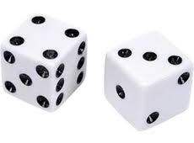
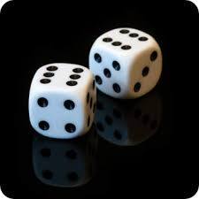
Gross, et al. (2018): Method
Die-rolling task
  Pairs of subjects
  Computer rolled die
  Payment was based on
    Matching
    Amount rolled
  Lying was encouraged
    1st subject was incentivized to inflate number
    2nd subject was incentivized to report a match
  Partners could switch in some conditions

Slide 41
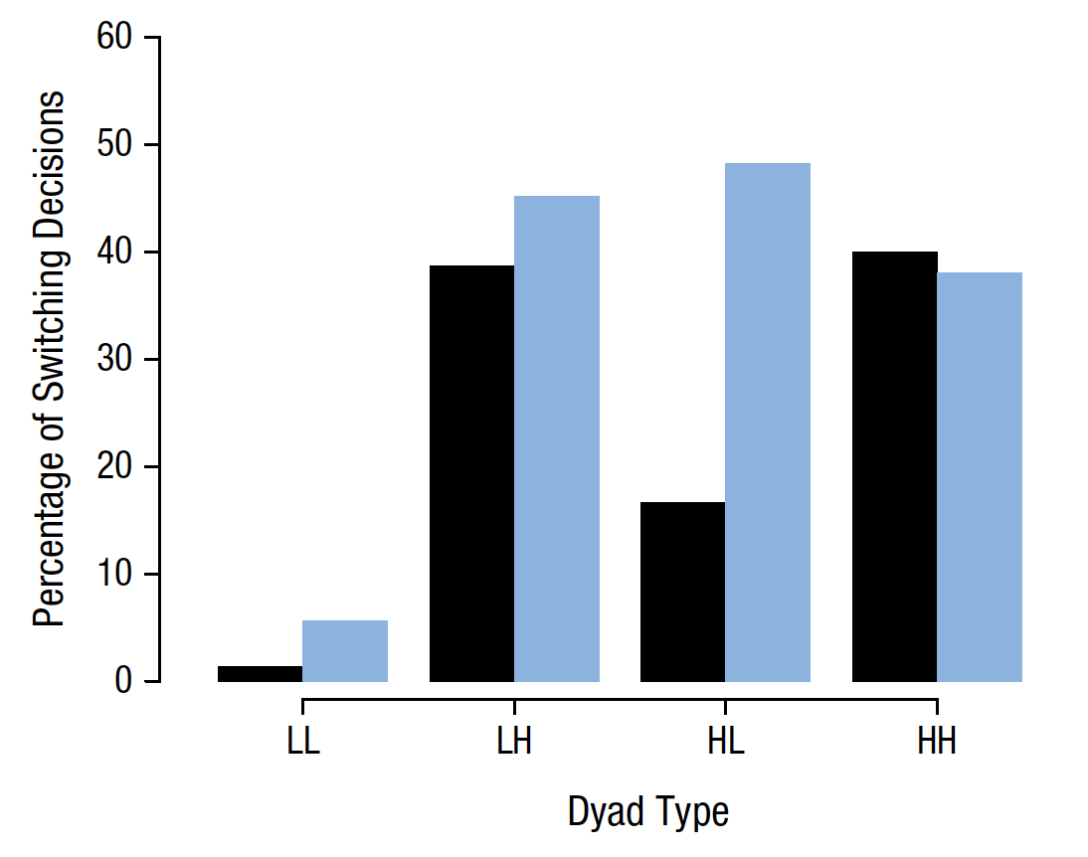
Gross, et al. (2018): Results
    Was there evidence of free riders? If so, where?

Slide 42
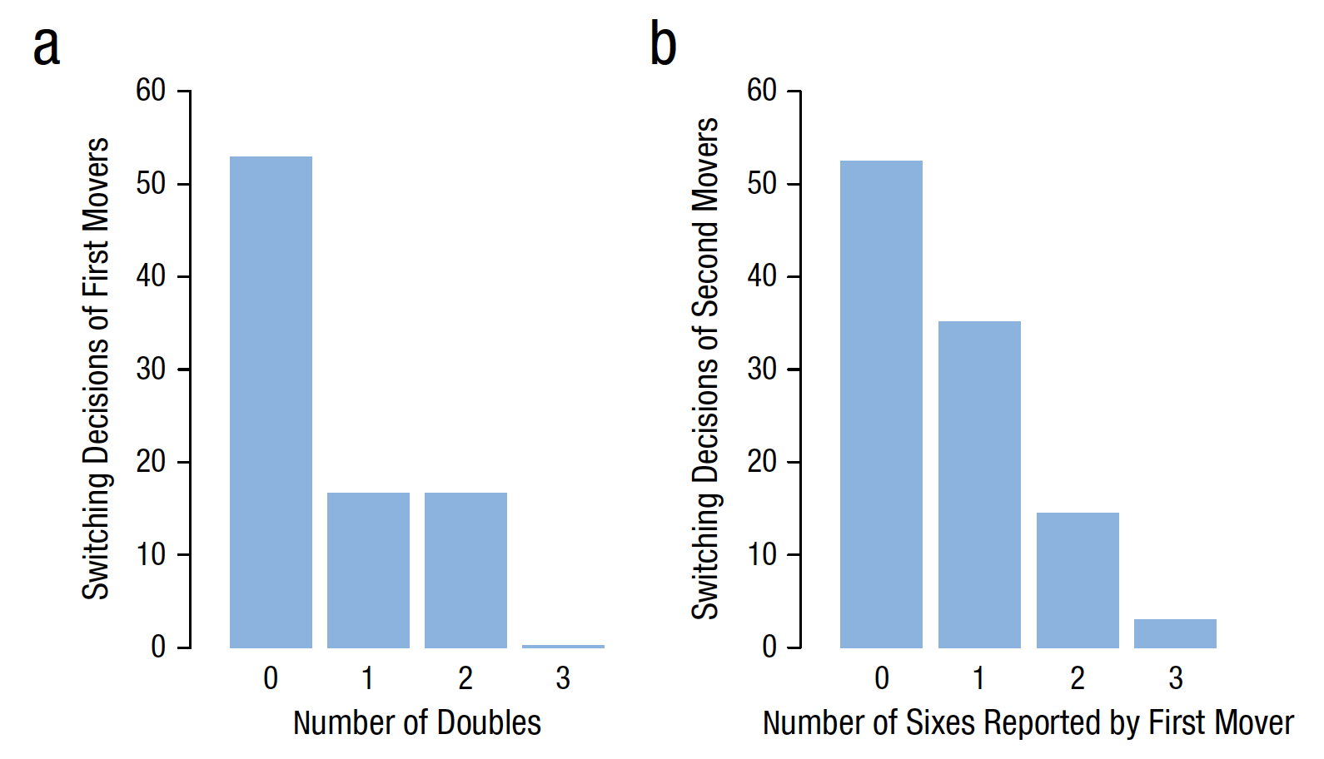
Gross, et al. (2018): Results
    Decisions of the dishonest movers: What do these data tell us?

Slide 43
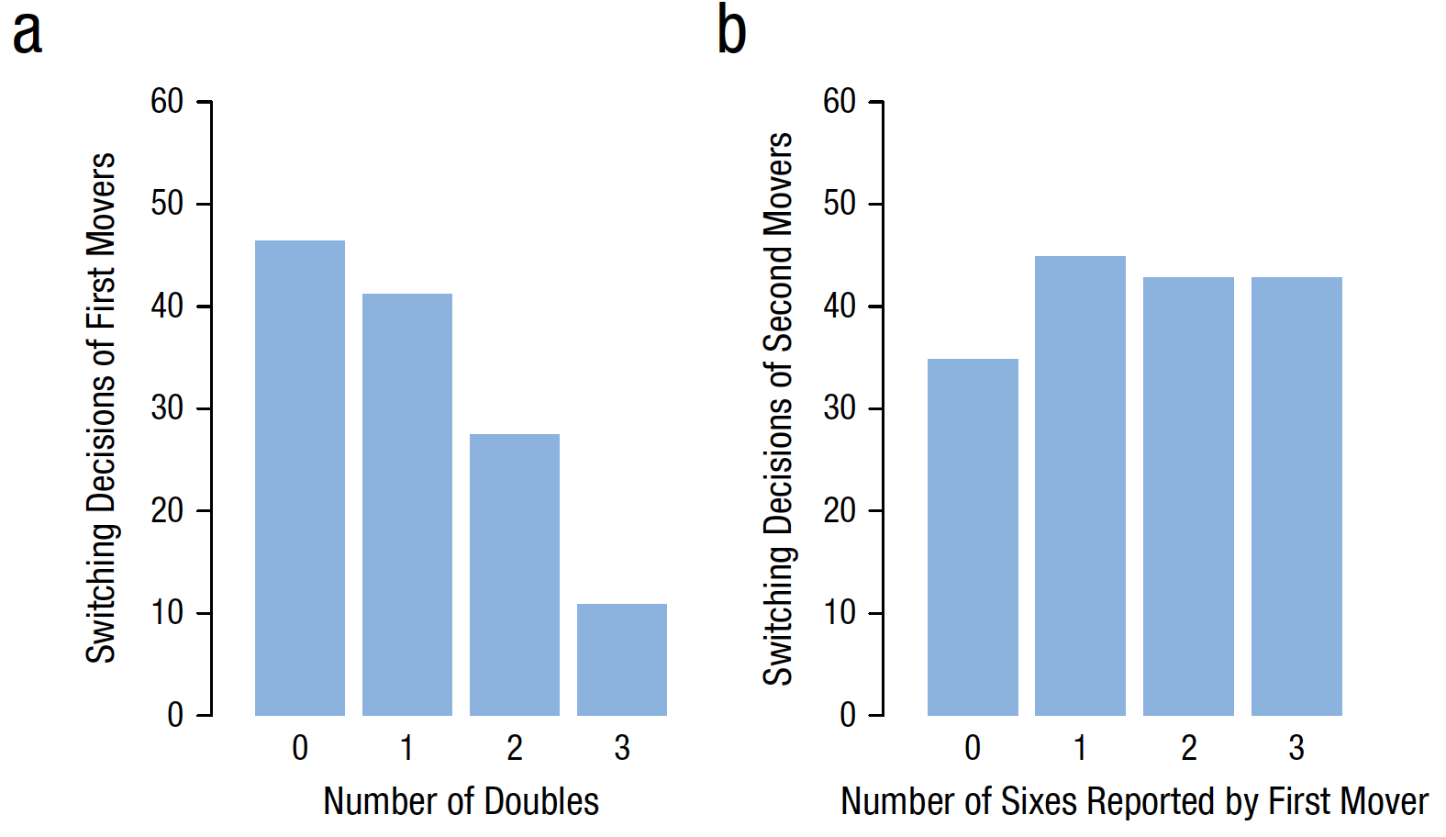
Gross, et al. (2018): Results
    Decisions of the honest movers: What do these data tell us?

Slide 44
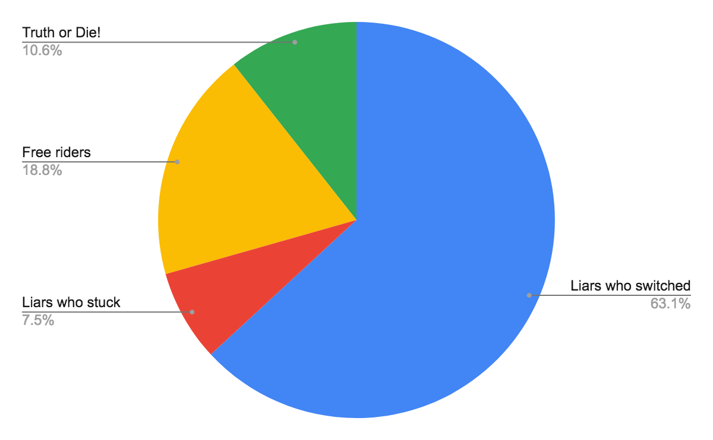
Gross, et al. (2018): Results

Slide 45
Gross, et al. (2018): Conclusions
In general, people are lying sacks of #$%
Lying is contagious.
Liars prefer liars.
Honest people accept lying even if they are unwilling to lie themselves (free riders).
Are we are all going to heck in a handbasket?

Slide 46
Why is DM research important?
Before you believe an assertion, you need to think:
What other factors might lead to the same outcome?
What other pieces of information do I need to know before I can evaluate the assertion?

