Slide 1
Individual Differences –
IQ and Gender
No quote…yet.

Slide 2
Outline: IDs – Intelligence and Gender
Review the distinction between nomothetic and idiographic research.
Discuss the overarching questions that must be considered when conducting individual differences research.
Describe the two theoretical approaches to understanding IQ and describe how IQ is measured.
Discuss the relative contributions of nature and nurture to the development of IQ.
Outline difficulties inherent to the empirical study of gender differences.
Review the literature on gender differences in verbal, quantitative, and spatial domains.

Slide 3

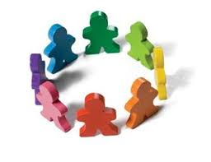
Two general approaches to research
Nomothetic Research - directed towards finding general rules or principals that all people have in common.
Idiographic Research - directed towards illustrating differences between different individuals or groups of people

Slide 4
Big Questions about ID Research
Are there significant differences between groups or individuals?
Are these differences meaningful?
What do these differences mean?
What is the source of these differences?
Biology
Environment

Slide 5
Big Questions about ID Research
We will look at IDs in 5 domains:
  Intelligence
  Gender
  Culture
  Age
  Expertise

Slide 6

Intelligence: Definition(s)
Formal Definition - an individual’s ability to:
understand complex ideas
adapt effectively to the environment
learn from experience
engage in various forms of reasoning
overcome obstacles by careful thought.

Slide 7
Measures of Intelligence (WAIS)
Verbal Tests
Vocabulary
Digit Span
General Knowledge
Similarities
Arithmetic
Comprehension
Formal Tests
Object Assembly
Picture Arrangement
Block Design
Picture Completion
Digit Symbol

Slide 8
Measures of Intelligence (WAIS)
Verbal Tests
Vocabulary
Digit Span
General Knowledge
Similarities
Arithmetic
Comprehension
Formal Tests
Object Assembly
Picture Arrangement
Block Design
Picture Completion
Digit Symbol

Slide 9
Measures of Intelligence (WAIS)
Verbal Tests
Vocabulary
Digit Span
General Knowledge
Similarities
Arithmetic
Comprehension
Formal Tests
Object Assembly
Picture Arrangement
Block Design
Picture Completion
Digit Symbol

Slide 10
Measures of Intelligence (WAIS)
Verbal Tests
Vocabulary
Digit Span
General Knowledge
Similarities
Arithmetic
Comprehension
Formal Tests
Object Assembly
Picture Arrangement
Block Design
Picture Completion
Digit Symbol

Slide 11
Measures of Intelligence (WAIS)
Verbal Tests
Vocabulary
Digit Span
General Knowledge
Similarities
Arithmetic
Comprehension
Formal Tests
Object Assembly
Picture Arrangement
Block Design
Picture Completion
Digit Symbol

Slide 12
Measures of Intelligence (WAIS)
Verbal Tests
Vocabulary
Digit Span
General Knowledge
Similarities
Arithmetic
Comprehension
Formal Tests
Object Assembly
Picture Arrangement
Block Design
Picture Completion
Digit Symbol
Notes:
3 pieces of gum cost 5 cents. How much would 24 pieces cost?

Slide 13
Measures of Intelligence (WAIS)
Verbal Tests
Vocabulary
Digit Span
General Knowledge
Similarities
Arithmetic
Comprehension
Formal Tests
Object Assembly
Picture Arrangement
Block Design
Picture Completion
Digit Symbol

Slide 14
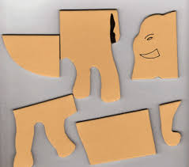
Measures of Intelligence (WAIS)
Verbal Tests
Vocabulary
Digit Span
General Knowledge
Similarities
Arithmetic
Comprehension
Formal Tests
Object Assembly
Picture Arrangement
Block Design
Picture Completion
Digit Symbol

Slide 15
Measures of Intelligence (WAIS)
Verbal Tests
Vocabulary
Digit Span
General Knowledge
Similarities
Arithmetic
Comprehension
Formal Tests
Object Assembly
Picture Arrangement
Block Design
Picture Completion
Digit Symbol

Slide 16
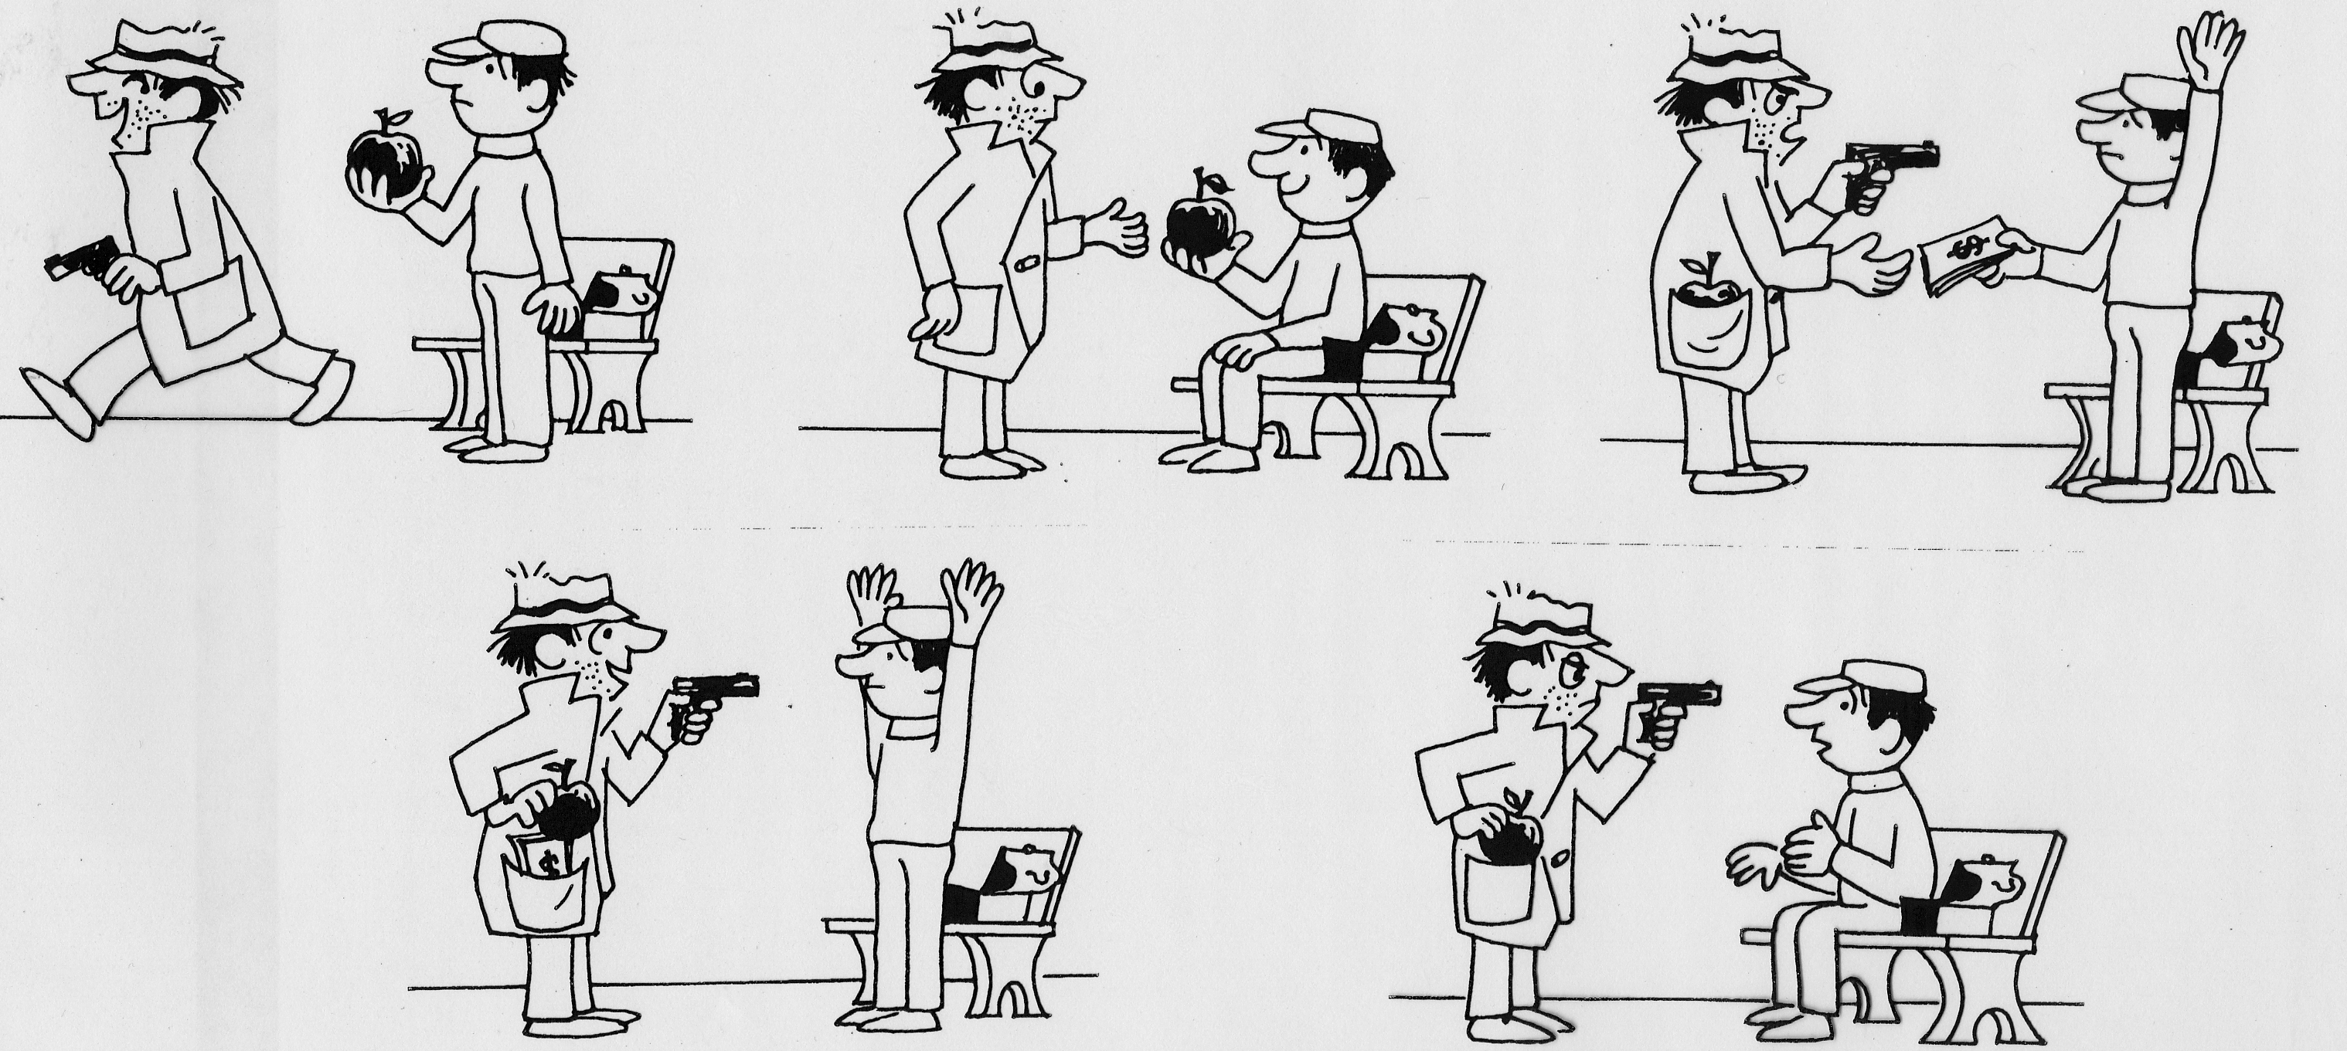
Place the following panels in the correct order.

Slide 17
Measures of Intelligence (WAIS)
Verbal Tests
Vocabulary
Digit Span
General Knowledge
Similarities
Arithmetic
Comprehension
Formal Tests
Object Assembly
Picture Arrangement
Block Design
Picture Completion
Digit Symbol

Slide 18
Block Design - 1

Slide 19
Measures of Intelligence (WAIS)
Verbal Tests
Vocabulary
Digit Span
General Knowledge
Similarities
Arithmetic
Comprehension
Formal Tests
Object Assembly
Picture Arrangement
Block Design
Picture Completion
Digit Symbol

Slide 20
Measures of Intelligence (WAIS)
Verbal Tests
Vocabulary
Digit Span
General Knowledge
Similarities
Arithmetic
Comprehension
Formal Tests
Object Assembly
Picture Arrangement
Block Design
Picture Completion
Digit Symbol

Slide 21
Digit Symbol task
On each trial, you’ll see a table like this one.
1 | 2 | 3 | 4 | 5
 | ❖ | ☺ | ✪ | 
One of the five symbols will appear beneath the table. Your job is to call out the number that corresponds to the symbol.

Slide 22
Theoretical approaches to IQ
Lumpers - one construct underlies all human thought.
EX: Spearman’s G
Splitters - intelligence is composed of a number of dissociable qualities that are not necessarily correlated with one another
EX: Gardner’s typology:
Empirical problems in evaluating models
dissociation is difficult
separating nature vs. nurture
Musical | Linguistic
Logical / Mathematical | Spatial
Interpersonal | Intrapersonal
Bodily / Kinesthetic

Slide 23
Intelligence as academic performance
The Bell Curve – Herrnstein and Murray (1994)
Intelligence is a “real” concept that varies from person to person.
All academic tests measure intelligence to some degree.
IQ tests are the best measures of intelligence.
IQ scores are relatively fixed.
  Crystallized vs. Fluid intelligence
IQ scores are largely heritable.

Slide 24
Intelligence as academic performance
The Bell Curve – Herrnstein and Murray (1994)
Intelligence is a “real” concept that varies from person to person.
All academic tests measure intelligence to some degree.
IQ tests are the best measures of intelligence.
IQ scores are relatively fixed.
  Crystallized vs. Fluid intelligence
IQ scores are largely heritable.

Slide 25
Evidence supporting heritability of IQ (nature)
They rejected the idea that environment is a significant determinant of IQ based on twin studies.
Familial Relationship | Genetic Relationship | Pairwise correlations
Identical twins | 100% | .86
Fraternal twins | 50% | .60
Siblings | 50% | .47
Parent / Child | 50% | .40
Foster parent / child | 0% | .31
Cousins | 12.5% | .15

Slide 26
Closer look at twin study data - Nurture
Familial Relationship | Genetic Relationship | Pairwise correlations
Identical twins Together Apart | 100% | .86 .72
Fraternal twins Together | 50% | .60
Siblings Together Apart | 50% | .47 .24
Parent / Child | 50% | .40
Foster parent / child | 0% | .31
Cousins | 12.5% | .15

Slide 27
Nature AND Nurture
Scarr & Weinberg
Adopted kids more similar to adoptive parents than biological parents
Not necessarily either or
Will my kids play in the (W)NBA?
RV
Todd Marinovich

Slide 28
Rushton & Jensen (2006)
Meta-analytic approach:
IQ differences (≈ 1 SD) across racial groups
Largest difference on test with highest g-loading
IQ is largely heritable, esp. in industrialized cultures
Dickens & Flynn (2006)
IQ gap has decreased by ¼ - ½ SD
What would that finding imply?

Slide 29
What explains discrepancies?
Selection of data sets included in the studies
  How do you decide who is right?
Selection of (sub-)samples within studies
Trendline projection
Secular changes (Flynn effect) do not co-vary with race-related changes
Controlling for age

Slide 30
What explains discrepancies?
Two important points:
If R&J are 100% right, does that mean that social or cultural environments do not influence IQ?
Cultural differences exist for things like height, so why not IQ?

Slide 31
What do (I think) we need to know
What is a reliable definition of intelligence?
What is a reliable measure of intelligence?
What genes contribute to intelligence?
  What are the relevant variants of the genetic code?
How do the genes operate?
  How do the variants operate differently from one another?
  How are the variants related to performance?
How are the genes/variants influenced by cultural, social, environmental factors?
Are there significant differences in the distribution of these genes across race that predict intelligence?

Slide 32
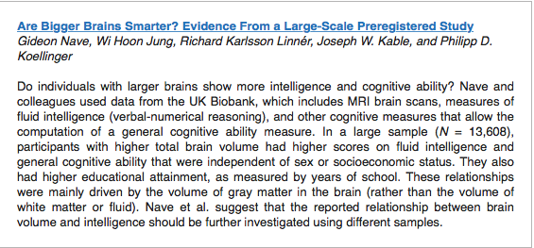
Big Head = IQ

Slide 33
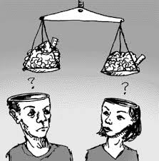
Challenges to studying gender differences
Differences are small relative to variability
Studying IDs
  the individuals in your sample can significantly influence your results.
Null effects are hard to report
  There are many reasons why two groups could produce the same result
Experimenter expectations
Subject expectations

Slide 34
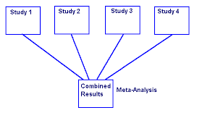

Surveying the literature to increase power
Narrative Review
Vote Counting
Meta-Analyses
Statistical Significance vs. Practical Significance
Even with these techniques, it’s hard to make a definitive decision regarding gender differences.

Slide 35
Gender differences in STEM
Why are there gender differences in STEM?
Mean differences vs.
Differences in variability
Why might IQ variability be related to high-level achievement in math or science?
What are the difficulties with interpreting the extant data?
Thorndike’s argument based on assumption of differences in variability
Potential differences in variability
  Length OR thickness of tails

Slide 36
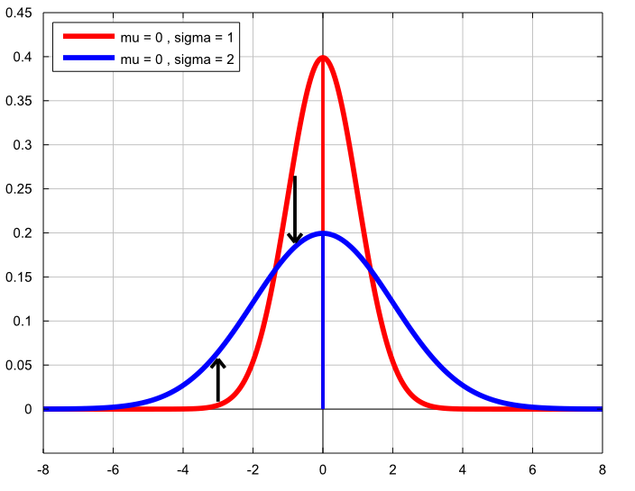
Gender differences in IQ
Why are there gender differences in STEM?
Mean differences vs.
Differences in variability
Why might IQ variability be related to high-level achievement in math or science?
What are the difficulties with interpreting the extant data?
Thorndike’s argument based on assumption of differences in variability
Potential differences in variability
  Length OR thickness of tails

Slide 37
Gender differences in STEM
Developmental course
  No differences through childhood
  Achievement test scores start to diverge around puberty.
Nature v. Nurture: Benbow & Stanley
  Chose smart girls and boys in Jr. High
  Provided similar environments
  Boys scored much higher on Math SAT
Interpretation:
  Proves that boys did better than girls
  Does not address whether both groups were doing as well as they can (e.g., perhaps environment was better suited to boys)

Slide 38
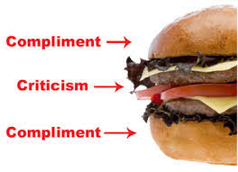
Explanations for gender differences in STEM
Boys are criticized for conduct and/or execution
Girls are criticized for content
Result:
  Girls tend to attribute failure to internal causes
  Boys tend to attribute their failure to external causes.
Is this a sex difference?
Attributions of boys and girls change if given different feedback.
EX: Anson Dorrance

Slide 39
Explanations for gender differences in STEM
Mean differences vs. Differences in variability
Why might variability be related to high-level achievement in math or science?
What are the difficulties with interpreting the extant data?
Potential differences in variability
  Length or thickness of tails (kurtosis)

Slide 41
Explanations for gender differences in STEM
Mean differences vs. Differences in variability
Why might variability be related to high-level achievement in math or science?
What are the difficulties with interpreting the extant data?
Potential differences in variability
  Length or thickness of tails (kurtosis)

Slide 42
Gender differences in IQ

Slide 43
Gender differences in verbal ability
Developmental track:
Childhood: Females show advantages by age 3½
Adulthood: Gap closes
Nature vs. Nurture:
Correlations between parents and children
Rate of development is similar across gender
Mothers and fathers speak differently to children and children speak differently to mothers and fathers
  EX: parents are more emotional and interpersonal with daughters than sons.

Slide 44
Gender differences in AM
Consistent gender differences:
Women tell richer, more coherent, more emotional, stories than men.
Women tell stories about relationships
Men tell stories about achievements
Why?
Socialization
More emotional, more emphasis on story-telling

Slide 45
Explanations for gender differences in AM
Q: Do men and women tell different narratives because of
      Verbal or narrative ability
      Memory advantages
      Willingness to share
      Choice of narratives
A: Examine Amherst Admission stories
      Women told longer stories, but few differences on any other measure.
Problem?

Slide 46
Gender differences in episodic memory
Research suggests that females episodic memories are superior to males for a wide range of stimuli.
  Words
  Stories
  Pictures
  Faces
These effects are:
  Small
  Consistent across stimulus types, retention intervals, etc.
  Reliable.

Slide 47
Heisz, et al. (2013): Intro and Method
Theoretical question:
Empirical question:
Method:
  Four-day and One-day experiments
  Face-name pairs
  Cued Recall and Recognition tests
  Eye movement tracking data

Slide 48
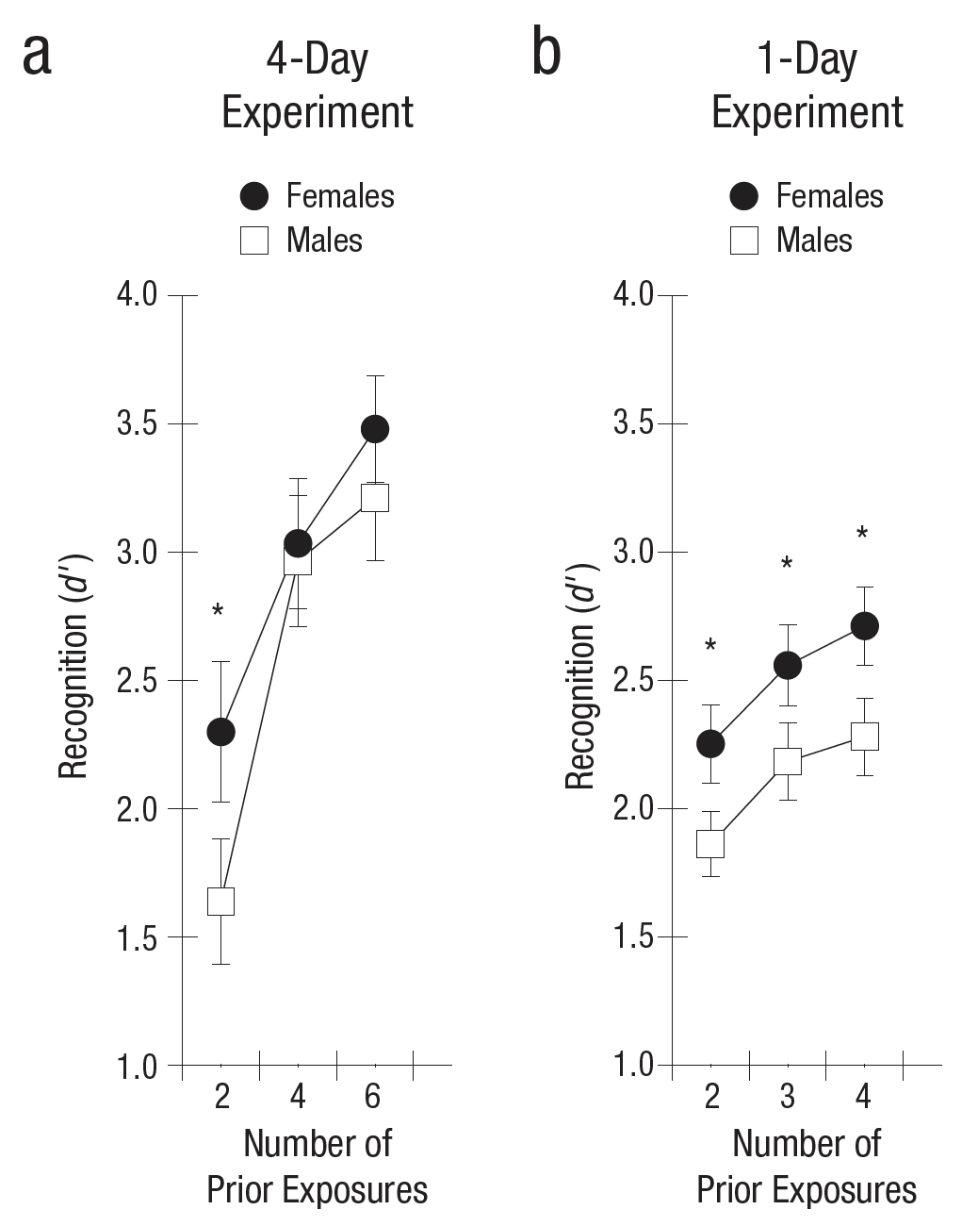
Heisz, et al. (2013): Results

Slide 49
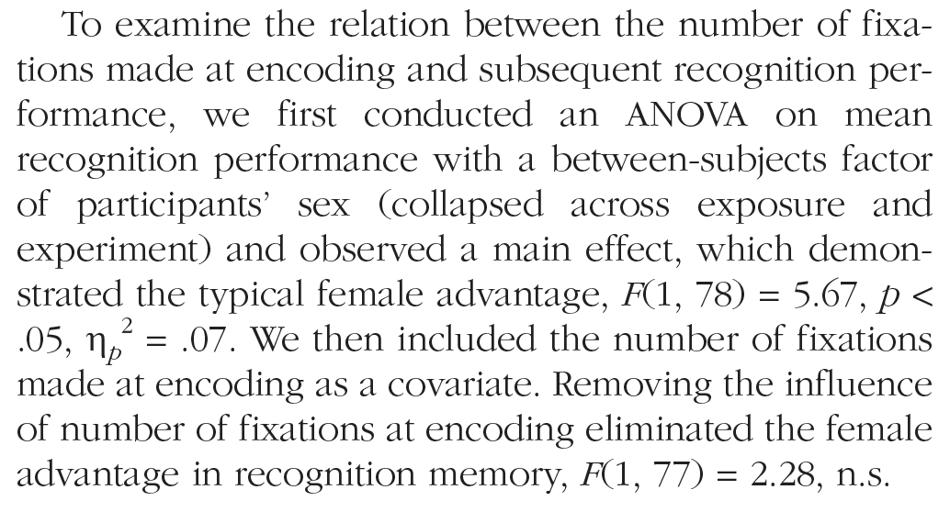
Heisz, et al. (2013): Results
Eye Fixations data:
  Females made more fixations than males overall
  Females made more fixations on the eyes of female faces during repeated exposures

Slide 50
Heisz, et al. (2013): Results and Discussion
They also observed significant correlations between fixations and recognition memory performance.
  Why is that important?
Sex differences in both memory and eye fixations differed across multiple exposures.
  What does that imply?
Discussion:
What do these data tell us about the existence of gender differences at
  Encoding
  Storage
  Retrieval

Slide 51
Gender differences in spatial ability
Cognitive style – Orientation vs. Landmarks
EX: Tammy getting around Champaign in the Jeep
Biology or environment?
Hormones have an effect on ability

Slide 52
Munion, et al. (2019): Intro
Theoretical Question:
Empirical Question:
Introduction:
Do gender differences exist?
Does support help?
  Landmarks strategy
  Practice
  Availability of maps
Challenges in studying navigation in humans?
Solution proposed by Munion, et al.?

Slide 53
Munion, et al. (1998) - Method
West point cadets completed a required orientation exercise
  Were required to locate flags using a map and compass in ‘rugged, wooded terrain’
  Measured success in finding flags
  Measured ‘how’ they explored environment via GPS
    Persistence
    Pausing
    Re-visiting
  Main question was whether exploration ‘style’:
    Differed between men and women
    Predicted ability to find flags

Slide 54
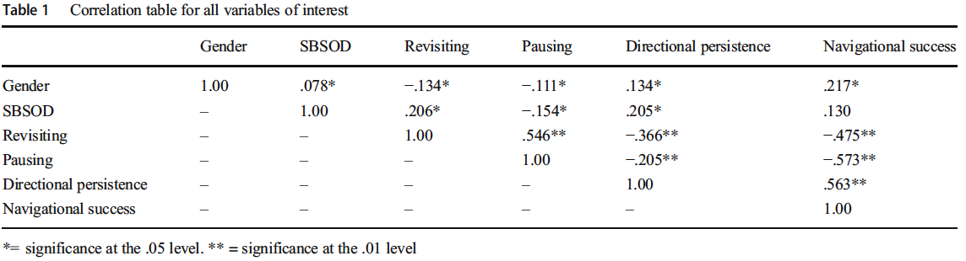
Munion, et al. (2019) - Results
Correlation results:
  Was there consistency in navigation strategies?
  Were there gender differences in navigation strategies?
  Were there gender differences in flag-finding success?
  Did navigation predict flag-finding success?

Slide 55
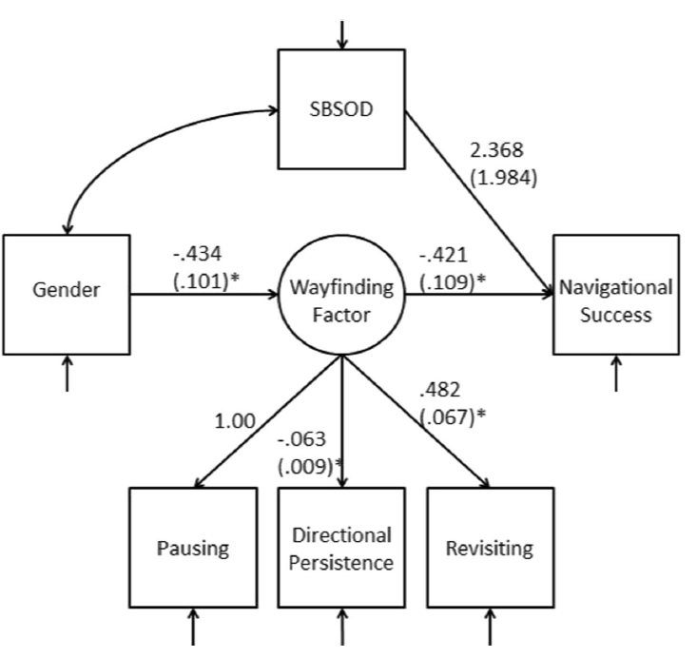
Munion, et al. (2019) - Results
Mediation results:
  Gender differences disappeared when navigation strategy was controlled for

Slide 56
Munion, et al. (2019) - Discussion
What do the mediation data mean? That is, what does it mean that eliminating navigation strategy differences eliminated differences in task success?
SBSOD also did not predict performance. How do you interpret that?
Limitations
    Non-standard paradigm
    Unusual population
    Experience with compass/map
    Lack of easily used landmarks
What ‘big’ question is left unanswered by this research?

Slide 57
Gender differences in quantitative ability
Developmental course
  No differences through childhood
  Achievement test scores start to diverge around puberty.
Nature v. Nurture: Benbow & Stanley
  Chose smart girls and boys in Jr. High
  Provided similar environments
  Boys scored much higher on Math SAT
Interpretation:
  Proves that boys did better than girls
  Does not address whether both groups were doing as well as they can (e.g., perhaps environment was better suited to boys)

Slide 58
Explanations for gender differences in quantitative ability
Boys are criticized for conduct and/or execution
Girls are criticized for content
Result:
  Girls tend to attribute failure to internal causes
  Boys tend to attribute their failure to external causes.
Is this a sex difference?
Attributions change of boys and girls change if given different feedback.
EX: Anson Dorrance

