Slide 1
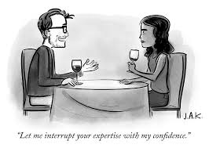
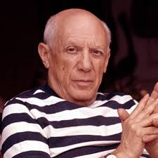
Individual Differences –
Culture, Aging, and Expertise
No quote…yet.

Slide 2
Outline: IDs – Aging and Expertise
Discuss the contribution of biological and non-biological factors on cognitive changes across the lifespan.
Contrast the three main theories of cognitive decline.
Present the conditions that minimize age differences in cognition.
Explain how expertise influences cognition.

Slide 3
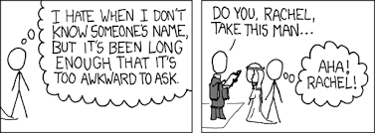
Cognitive Gerontology
Write down 5 words that come to mind when you think about aging:
Two important points:
Younger adults frequently make the same errors as older adults.
Stereotypes about aging are culturally-determined
Asian aging stereotypes are very different…and…
Older adults raised in Asian cultures show smaller cognitive declines than those raised in Western cultures
Notes:
Forgetting people’s names
Losing their way
Forgetting appointments
Medication

Slide 4
Age differences in cognition: culture or biology?
One of the broadest, most common results in the cognitive gerontology literature is that, relative to younger adults, older adults perform worse on most – but not all – tasks.

Slide 5
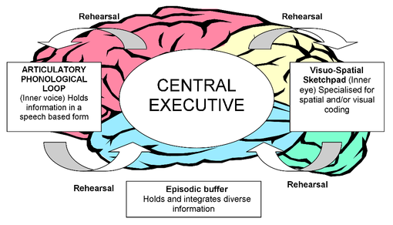
Age differences in working memory
Working Memory -
Age differences on span tasks:
Digit Span Task:
    4 9 5 6 1 8 3 6
Word Span Task:
    hat baby closet mouse book pencil …
Reading Span Task:
Notes:
"Unfortunately, Bob had to take the box back to the old man's home.
"After a long day at the beach, Susan remembered she had a hair appointment.
"Even though the children were playing happily, the babysitter appeared very concerned.

Slide 6


Theoretical explanations for age differences
Capacity –
  OA have limited capacity. Cannot simultaneously juggle as much information/as many tasks as YA.
  Evidence: Span tasks

Slide 7
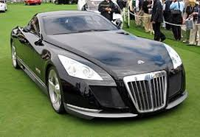
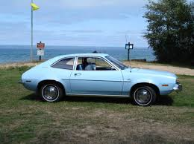
Theoretical explanations for age differences
2) Speed –
  Younger brains work faster than older brains.
  Evidence: simple arithmetic
AND: there is a high correlation between speed based-tasks and more complex cognitive tasks.
Problem: There is also a high correlation between complex cognitive tasks and…
Notes:
Mazes; circling letters on a page digit-symbol tasks

Slide 8
Theoretical explanations for age differences
Inhibition – the ability to screen irrelevant information from consciousness. OA are worse at inhibition tasks relative to YA.
List 1 | List 2

Slide 9
Theoretical explanations for age differences
Inhibition – Directed Forgetting Paradigm
  OA show worse memory for List 2.
  Incorrectly intrude more List 1 items.
List 1 | List 2
ball | lake
hat | coat
tree | fire
bike | street
house | doll
pencil | tank

Slide 10
Age differences in episodic memory
Speed - OA read much slower than YA
Inhibition: Strategic differences
  Strategies – Older adults use strategies (e.g., imagery, sub/objective organization.
  Evidence: Age diffs decrease as more organization is provided or available.
Content vs. technical accuracy –
  OA aim for gist; YA aim for verbatim
Perseverative errors
  Less able to switch to a new strategy

Slide 11

Age differences in spatial memory
Locations (i.e., keys, wallet)
  OA much worse than YA
  However, familiarity eliminated this effect
  Familiar vs. unfamiliar grocery store
  Home vs. novel environment
Routes
  No age differences in navigation
  However, subsequent attempts to draw a map of the space showed a clear advantage for YA

Slide 12
Age differences in source monitoring
Distinguishing the source of a memory.
  Did I roll up the windows of my car?
  Did I do the dishes last night or did Tammy?
  I heard that the Noom really works. Did I read that in the NYT or on Insta?
HUGE age differences.
  Except…things that matter to OA

Slide 13
Age differences in prospective memory
Remembering to do something in the future
EX: turn on the dishwasher.
Two kinds of prospective memory tasks
  Time-based tasks – Check the pine nuts frequently to make sure they don’t burn.
  Event-based tasks – Turn off the Christmas lights before you go to bed.
Two factors affect age differences:
  Task type
  Task complexity

Slide 14
Age differences in prospective memory
Remembering to do something in the future
  EX: turn on the dishwasher.
Two kinds of prospective memory tasks
  Time-based tasks – Check the pine nuts frequently to make sure they don’t burn.
  Event-based tasks – Turn off the Christmas lights before you go to bed.
Two factors affect age differences:
  Task type
  Task complexity

Slide 15
Good news: it isn’t all downhill
Practice –
  Age differences tend to decrease across the length of the experiment (although fatigue can become an issue).
Familiarity
List 1 | List 2
Walkman | Spotify
Cable TV | NetFlix
Email | Group Text
Smaller Age Diffs | Larger Age Diffs

Slide 16
Good news: it isn’t all downhill
Type of test influences Age Diffs
  Recall vs. Recognition
  Details vs. Gist
  Speeded vs. at own pace
  Implicit vs. Explicit
  Procedural vs. declarative
Forgetting –
  OA and YA show similar forgetting functions (assuming equal levels of original learning).

Slide 17
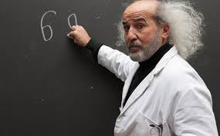
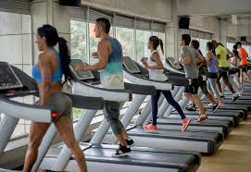
More reasons to be hopeful
"Use it or Lose it”
  Old Professors Study
Education Levels
Exercise

Slide 18


More reasons to be hopeful
Semantic Memory
  meanings of words (vocabulary)
  general knowledge
  comprehension of text
Situational (rather than biological) causes of decline
  Beliefs about memory
  Anxiety and worry
  Stereotype activation
  Time of day

Slide 19
Non-biological explanations for aging
Stereotype threat –
  Behavior tends to move in the direction of a negative stereotype about a group member if that identity is activated. (contrast with stereotype lift).
Claude Steele –
  African-American and Caucasian students at Stanford took a verbal section of the GRE.
  Varied the instructions to the subjects:
  Measuring IQ: AA worse than C
  Psychological Processes: No differences

Slide 20
Non-biological explanations for aging
Stereotype threat: Causal Mechanisms
  anxiety
  motivation
  dis-identify
  self-efficacy

Slide 21
Stereotype threat and cognitive gerontology
As we saw in class last time, there is a major aging/cognitive performance stereotype in Western culture.
Plus, there is a large body of empirical data which suggest that the stereotype is well -founded.
So, the question before the peanut gallery is: Do stereotypes about aging influence cognitive performance? How would you decide?

Slide 22
Rahhal, Hasher, & Colcombe (2001)
Theoretical Question:
Empirical Question:
Introduction:
Why does it matter whether situational variables influence age differences in cognition?
  Evidence for and against?
How do explicit and implicit memory tests differ?
How do intentional and incidental tests differ?
Why is stereotype threat relevant to this paper?

Slide 23
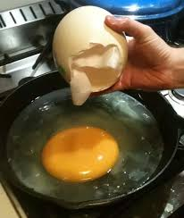
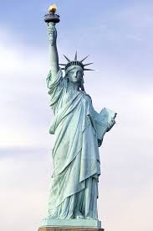
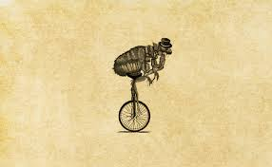

Rahhal, Hasher, & Colcombe (2001): Method
Method: Subjects learn obscure trivia statements.
  It takes 6 hours to boil an ostrich egg.
  The right arm of the Statue of Liberty is 46 feet.
  All of the fleas in the flea circuses are males.
  50% of dentists in Greece are women.
Key manipulation – Instructions
Predictions:

Slide 24
Rahhal, et al. (2001) – Results of E1
What does Figure 1 tell us?
Problems with the ‘blank’ response option?

Slide 25
Rahhal, et al. (2001) – Results of E2
What does Figure 2 (above) tell us?
Does the pattern of data cause you any consternation?
Why aren’t ‘new’ items considered in the analyses?
How do the authors explain their data?

Slide 26
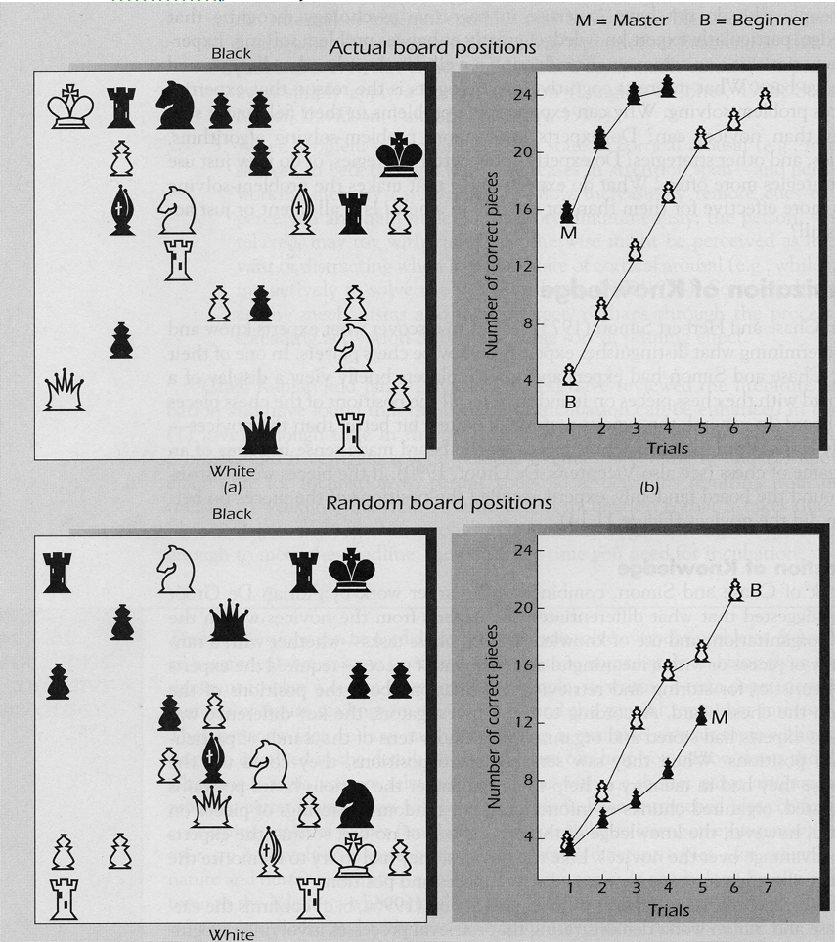
Expertise: Chase & Simon (1973)

Slide 27
Theoretical explanations for expertise differences
Experts…
…are smarter.
…have better memories.
…organize information differently.
…have developed task-oriented perceptual skills.

Slide 28
Reingold, Charness, Pamplun, & Stampe (2001)
Theoretical Question: What is the cause of expertise differences in memory?
Empirical Question: Will the eye movements of expert and novice chess players differ when asked to study a chessboard?
Introduction:
What is the seminal finding that RCPS explore?
How might Hoffman, et al. explain this result?

Slide 29
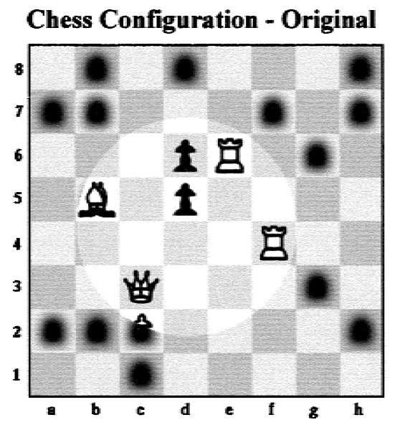
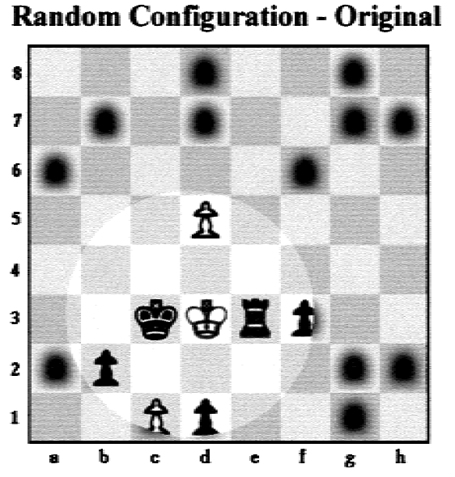
Reingold, et al. (2001): Method
Procedure:
Gaze Contingent Window
Randomization
Independent Variables
Experts vs. Novices
Random vs. Ordered
Symbols vs. Letters
Dependent Variables
Change Detection
Check Detection

Slide 30
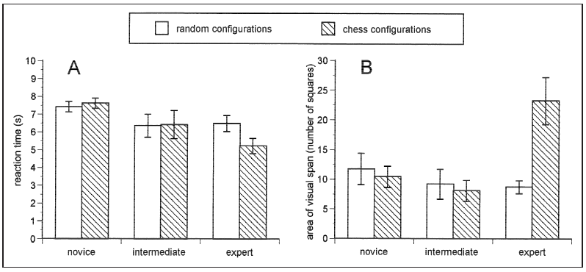
Reingold, et al. (2001): Change detection results

Slide 31
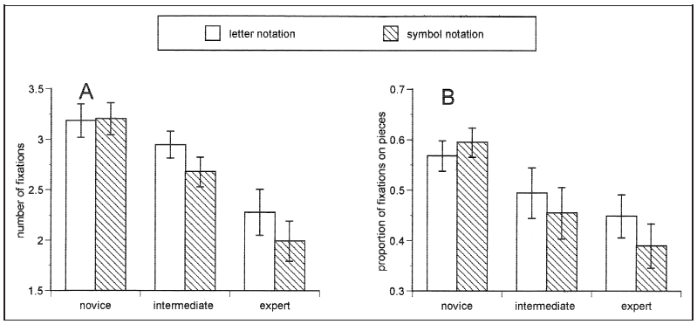
Reingold, et al. (2001): Check detection results

Slide 32
Reingold, et al. (2001): Discussion
What do the authors mean by foveal and parafoveal regions of visual space?
Are expertise effects in memory purely a memory phenomenon? Are they purely a perceptual phenomenon?
How can experts have greater spans, but only when viewing meaningful arrangements of pieces?
How might you design an experiment to investigate this question further?

