Slide 1
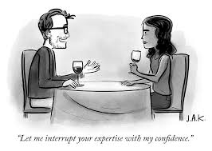
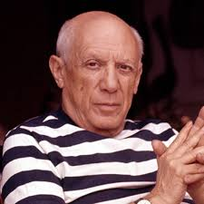
Individual Differences – Culture, Aging, and Expertise
No quote…yet.

Slide 2
Outline: IDs – Culture, Aging, & Expertise
Discuss important questions relating to research on the effect of culture on cognition.
Describe a variety of dimensions along which cultures differ.
Examine cultural differences in a variety of cognitive behaviors:
Perception
Memory
Influence of language

Slide 3
Outline: IDs – Culture, Aging, & Expertise
Discuss the contribution of biological and non-biological factors on cognitive changes across the lifespan.
Contrast the three main theories of cognitive decline.
Present the conditions that minimize age differences in cognition.
Explain how expertise influences cognition.

Slide 4
Cultural differences in cognition: Key concepts
Key Concept #1: Finding differences is only the beginning.
It’s important to understand what aspect of the culture - if any - is responsible for these differences.
EX: Cross-cultural studies of digit span
Key Concept #2: Experimental control is a problem
EX: Random assignment isn’t feasible
Key Concept #3: Culture-fair / culture-free tests
EX: SAT; GRE
Moroccan rug merchants

Slide 5
A brief primer of cultural dimensions
Tightness – # / strictness of rules
EX: Taliban
Manuel Mattke’s feelings about Europe
Vertical / Horizontal Relationships –
Does one group make the rules, or is rule-making more egalitarian?
EX: Dissatisfied students; Gender roles
Complexity – # of cultural roles
EX: hunter/gatherer

Slide 6
A brief primer of cultural dimensions
Activity/Passivity
EX: capitalism vs. Zen
Honor –
extreme sensitivity to affronts and endorsement of violence as a means to redress / protect one’s honor.
EX: Miguel Knipper y El Señor
Jamaica (correlated with surface politeness)
Collectivism / Individualism –
the extent to which the group is valued over the individual or vice versa
EX: East vs. West

Slide 7
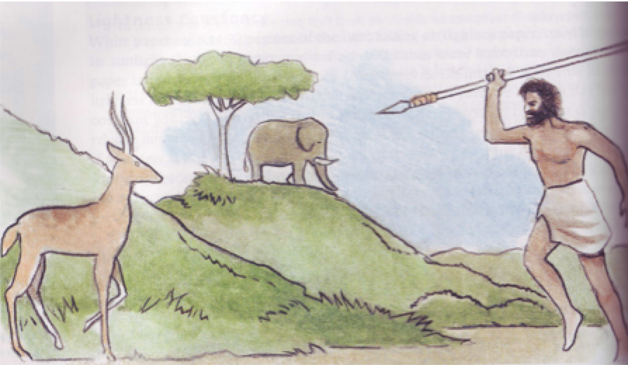
Visual perception
Formal education/exposure to photographs and visual images influences the interpretation of ‘ambiguous’ pictures

Slide 8
Visual perception
Müller-Lyer
Is this cultural difference related to culture, or is it an effect of training / experience?
EX: Jungle dweller on the plains
Horizontal/vertical illusions

Slide 9
Emotion perception
Culture of honor –
a culture in which maintaining one’s honor (one’s manhood) is of paramount importance. Civility and politeness are highly prized, because defending one’s honor implies violence.
Zinedine Zidane…Speaks
More likely to be killed by someone you know

Slide 10
Emotion perception
Dov Cohen
Two people complete a task together.
The confederate acts like a jerk in an attempt to provoke a response from the subject.
Result #1:
Southerners were much slower to show a reaction, but their reaction was much more violent / pronounced.
Result #2:
Other subjects watched videotapes and were asked to assess the likelihood of strong response. Southerners were much worse.

Slide 11
Language as a cultural mediator
Whorfian Hypothesis -
Language controls (constrains) thought.
______________________________________
Linguistic Codability –
memory and perception are influenced by the verbal labels we use to identify stimuli. Shorter, more efficient codes tend to produce better memory / perception.
EX: Color Naming studies
Jellybean studies
Person perception

Slide 12
Cultural differences in memory
Spontaneous categorization
Developmental track across level of industrialization
Does this reflect different memory processes?
Evidence:
When recall was prompted by category, performance showed the expected increase.
Interpretation:
Memory works the same way across cultures, but Western cultures induce more categorization.

Slide 13
Cultural differences in memory
Related findings:
Spontaneous categorization varies across level of industrialization: structure vs. surface
However, use structure when instructed or when culturally relevant
Interpretation: ‘Form Follows Function’
Children raised in nomadic cultures do better on certain spatial memory tasks
Cultural universality vs. relativism –
common processes modified by culture vs.
different processes

Slide 14
Paolini, et al. (2022): Intro
Theoretical Question:
Empirical Question:
Introduction:
Cyberball – It’s rough
Being part of a stigmatized group heightens the typical response to social exclusion
And/but exclusion by an in-group member elicits a stronger response
Exclusion activates EF brain areas…
And/but has paradoxical effects on cognition

Slide 15
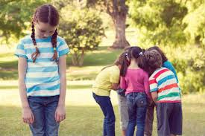
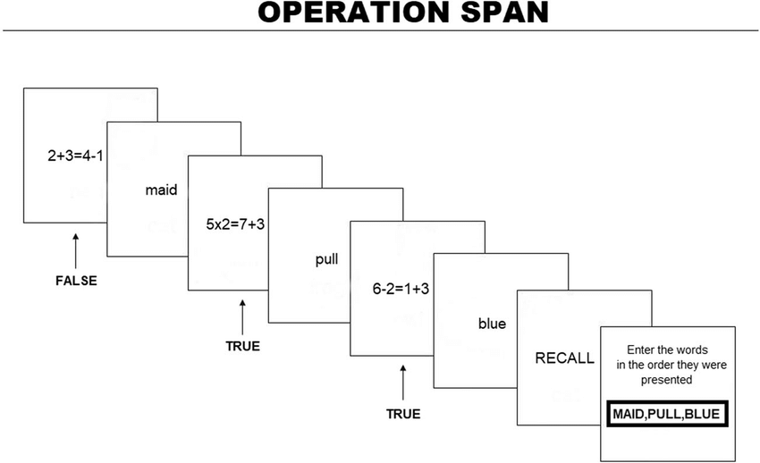
Paolini, et al. (2022): Hypotheses and Method
Stereotype Threat Hypothesis
Method:
Recruited self-reported heterosexual and not-heterosexual men
Told that the experiment dealt with attitudes about social issues including sexual orientation
Played CYBERBALL
Then completed an OSPAN task.
Followed by a manipulation check

Slide 16
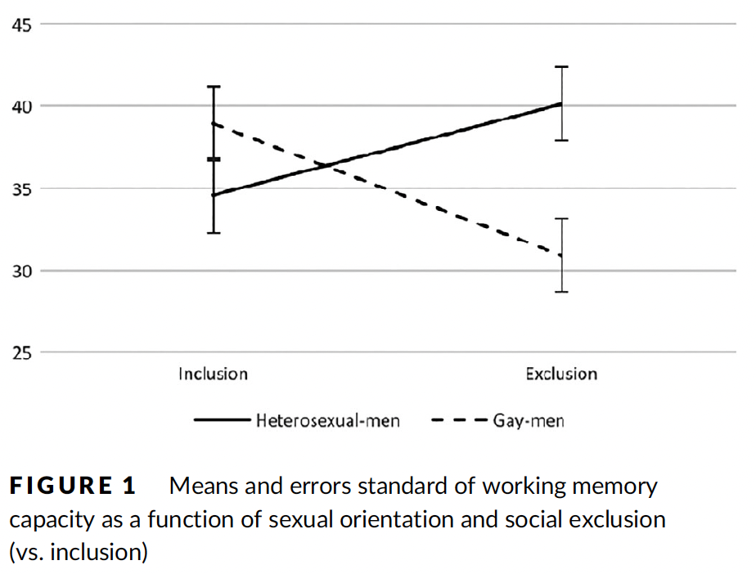
Paolini, et al. (2022):Results
Manipulation check: was it effective?
Main effect of Cyberball
No main effect of sexual orientation
No interaction
Main research question

Slide 17
Paolini, et al. (2022): Discussion
Glass half full: sexual orientation differences only observed in exclusion condition
Glass half empty: no significant differences due to Cyberball in non-heterosexual group.
Subjects did not know if they were being in/excluded by in/out-group.
Self-producing cycle
Authors’ limitations. Others?
Are you concerned that the subjects were told that sexual orientation was central to the study?

Slide 18
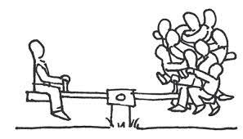
Cultural differences in AM: Wang (2008)
Introduction:
What are some of the East/West differences in AM mentioned by Wang?
What explanations does Wang offer to explain these differences?
What population does Wang choose to study and why?

Slide 19
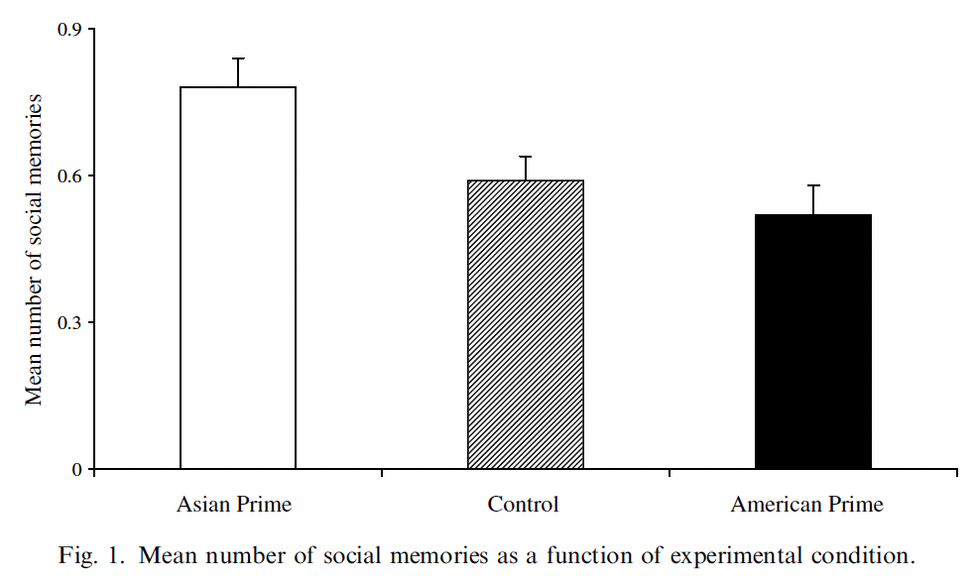
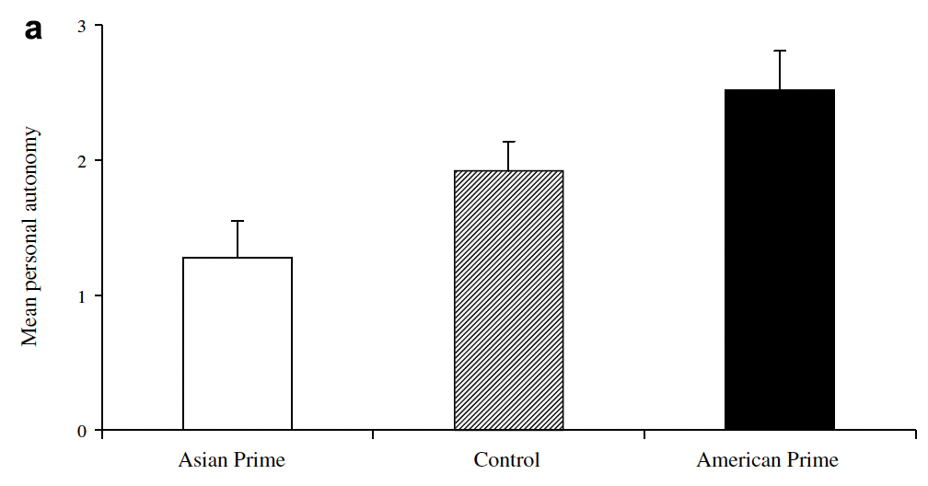
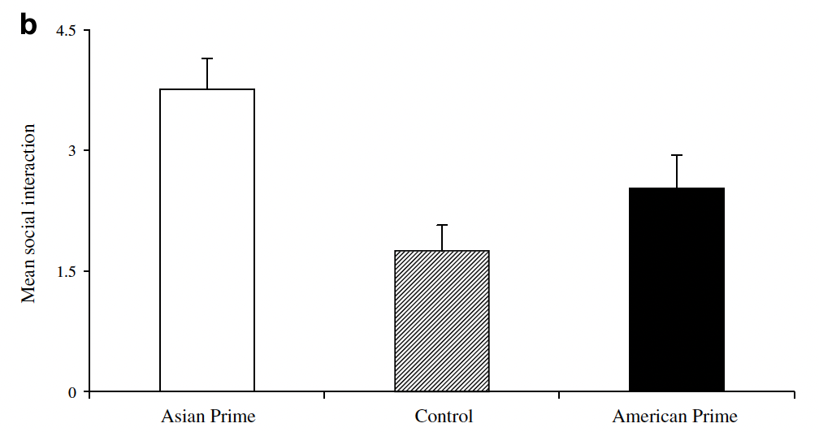
Cultural differences in AM: Wang (2008)
Results
Manipulation check: what was it and was it effective?
Social memories and interactions
Autonomy themes
Discussion
What is the significance of these results according to Wang?
What does this imply about identity? Is the self consistent? If not, how do we remain ourselves as we move through the world?

Slide 20
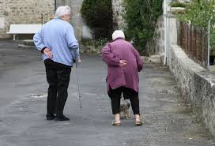
Cultural differences in social interactions: Wong and Hong (2005)
Theoretical Question: Would activating cultural identity shift social interactions between in- and out-group members?
Empirical Question: Will performance in the prisoner’s dilemma change depending on whether a more or less collectivist identity is activated?
Introduction:
Big problem with previous research?
Alternative?
Predictions?
What’s new?

Slide 21
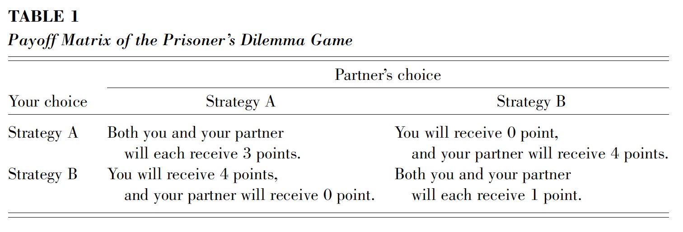
Wong and Hong (2005)
Method:
Priming Condition
Prisoner’s Dilemma
With a friend or a stranger

Slide 22
Wong and Hong (2005)
Method:
Dependent measures:
Choice – what did the subject choose
Expectation – what did they expect partner to choose
Motivation – were they motivated to maximize joint output

Slide 23
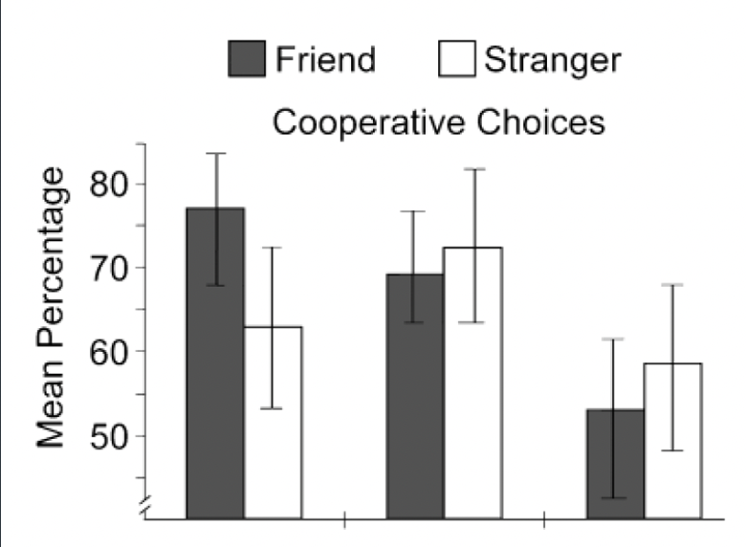
Wong and Hong (2005)
Results:
Choice:

Slide 24
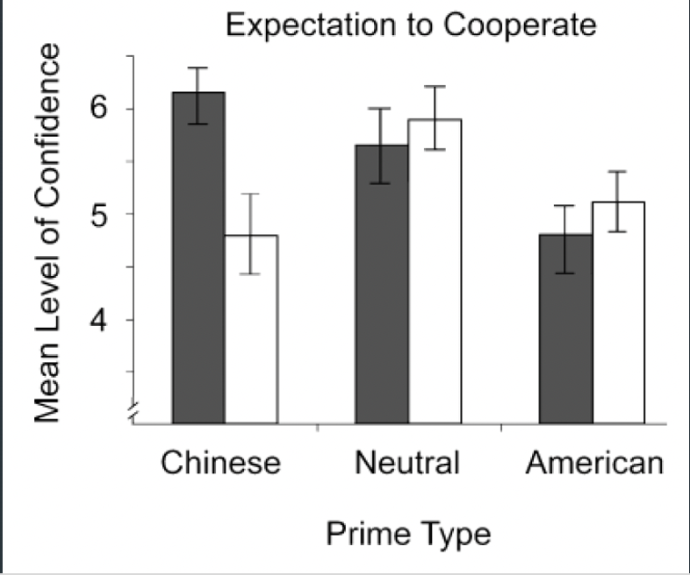
Wong and Hong (2005)
Results:
Expectation:

Slide 25
Wong and Hong (2005)
Discussion:
Cultural cues can prime cultural frameworks that influence behavior
However, the effect of cultural cues depend on the social context.

